Slide 1
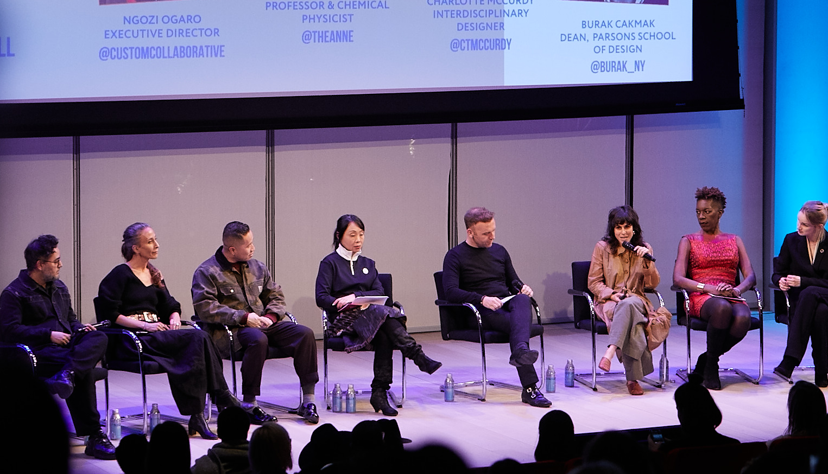
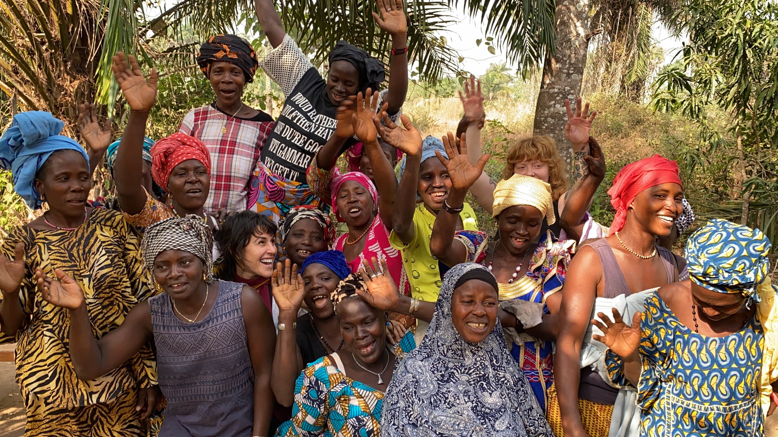
Bio-materials for Fashion Introduced to Broad Audience at NY Times Sustainability Summit
MRSEC: DMR-1420634
2020
Theanne Schiros, Columbia University Center for Precision Assembly of Superstratic and Superatomic Solids
Professor Theanne Schiros spoke to a full house of over 700 at the New York Times Center in January 2020 as part of a Sustainability Summit focused on the environmental impact of the fashion industry and positive solutions. The event brought together scientists, activists, and fashion industry luminaries to present a solutions-focused approach to the climate crisis. She showed the audience an adaptation of indigenous techniques for tanning leather applied to microbial bioleather, and showed the audience how her MRSEC-supported laboratory work is uncovering the key ways in which this process works, allowing for scalable production of sustainable materials. This innovation was recognized by the One x One Conscious Design Initiative by Slow Factory, Svarowski and the United Nations Office of Partnerships; a collection of bioleather bags created by Schiros for Telfar Global will be featured at the United Nations Headquarters and during New York Fashion Week in Fall 2020. The bioleather innovation will also be featured in a climate change documentary in “The Nature of Things” television program, filmed in part in MRSEC labs. Schiros in engaged in sustainable development for economic empowerment of women and artisans in Guinea and Cote d’Ivoire, providing trainings on natural dyes and biofabrication.
Left, Schiros speaking at the Sustainability summit. Right, Schiros with students in Grand Bassoon, Cote d’Ivoire.

