Slide 1
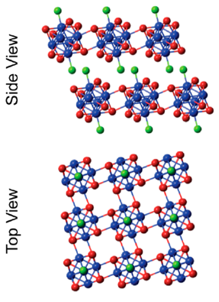

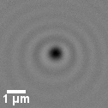
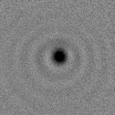
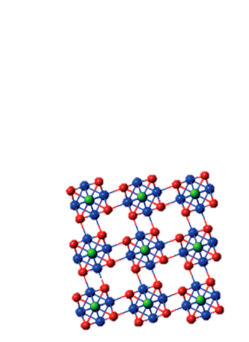
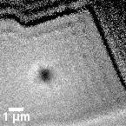
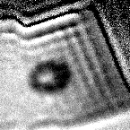
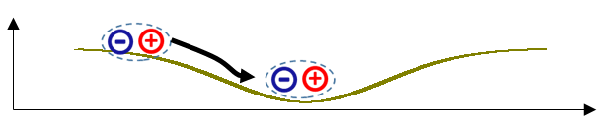
Active control of long-range exciton transport in superatomic materials
MRSEC: DMR-2011738
2021
Milan Delor, Columbia University Center for Precision-Assembled Quantum Materials (PAQM)
Active control over exciton (electron-hole pair) transport is a much sought-after goal to create reconfigurable excitonic and optoelectronic transistors. The PAQM team achieved the first example of predictive optical control over exciton transport in semiconductors.
Superatomic materials are ideal for active control over electronic properties. The electronic coupling between superatom clusters is strongly modulated by inter-cluster distance and relative orientation. Phonons (vibrations) that delocalize over more than a single cluster can therefore strongly perturb inter-cluster electronic coupling, which in turn will modulate exciton transport properties.
Here the PAQM team successfully exploited these electron–phonon interactions to control exciton transport in the superatomic semiconductor Re₆Se₈Cl₂ at room temperature. Using ultrafast optical excitation of coherent phonons in thin flakes of Re₆Se₈Cl₂, the team achieved a >60-fold improvement in exciton propagation length (limited by sample size), and importantly gained the entirely new ability of optically switching and directing this long-range transport toward any chosen target site.
no phonon wave: slow exciton propagation (transport length ≈ 100 nm). Dark contrast ≡ exciton population profile
Re₆Se₈Cl₂
optically launch coherent phonons
-
0 ns
3 ns
+
watch exciton
transport with or without phonons
phonon-modulated electronic coupling
with phonon wave: surfing excitons (transport ≈ 6 μm, limited by flake size)
0 ns
3 ns
energy
space

