Slide 1
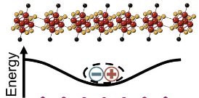
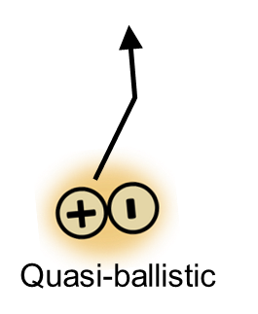
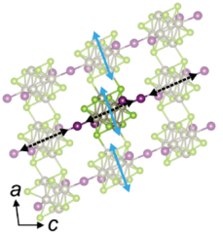
Columbia University MRSEC
DMR-2011738
Engineering exceptional transport in van der Waals superatomic semiconductors
The PIs of IRG2 have substantially refined synthetic control over the synthesis of superatoms and their assemblies into macroscopic single crystals. They are now leveraging this control to engineer new, exceptional semiconductor transport properties not seen in any other material.
Two recent highlights are shown on the right:
The PIs have developed the first semiconductor capable of sustaining ballistic (scatter-free) electronic energy flow over macroscopic scales in the superatomic semiconductor Re₆Se₈Cl₂. Experiments and theory show that this property emerges due to strong coupling of excitons with acoustic phonons in the material. The team showed record-breaking transport at room temperature, even exceeding carrier transport in silicon (Science 2023, arXiv 2024). This discovery could enable lossless transistors for new classical and quantum computing architectures.
The PIs have developed a new semiconductor, CsRe₆Se₈I₃, with quasi-1-dimensional structure (JPCC 2023). Transition dipoles in the clusters align in a head-to-tail fashion, facilitating a coherent state known as superradiance in a macroscopically-ordered solid for the first time. One consequence is coherent transport of excitons at unprecedented speeds exceeding 1600 km/s (JPCL 2023).
Berkelbach, Delor, Nuckolls, Roy, Zhu, Columbia University
Re₆Se₈Cl₂: Excitons form acoustic polarons protected from lattice scattering, leading to record-breaking micrometer mean free path at room temperature and ultralong range exciton transport.
Re₆Se₈Cl₂
CsRe₆Se₈I₃: Highly anisotropic structure promotes J-aggregate superradiance. J-aggregates and long-range crystalline order leads to exceptionally fast coherent exciton transport at 1600 km/s over 300 femtoseconds.
superradiance
a
c
CsRe₆Se₈I₃
1 μm
Science 2023, 382, 438 arXiv 2024, 2401.14312
JPCL 2023, 14, 10249 JPCC 2023, 127, 1519
Notes:
What Has Been Achieved: Fundamentally new electronic energy transport phenomena in superatomic semiconductors, not seen in any other material, including the first demonstration of ballistic exciton flow at room temperature, and the first demonstration of J-aggregate superradiance in a macroscopic crystalline solid.
Importance of the Achievement: The transport of energy carriers in the form of electrons and excitons underlies the function of all semiconductor technologies. At room temperature, all current technologies suffer from scattering between carriers and lattice phonons and impurities, resulting in fundamental limits on processing speeds and power efficiencies. By developing new superatomic semiconductors with finely-tuned coupling between adjacent unit cells, the PIs have achieved new transport regimes that shield carriers from scattering with lattice phonons and impurities. These fundamentally new transport regimes could form the basis of next-generation technologies such as wavelike electronics for quantum information processing, and lossless transistors for ultra-high efficiency microelectronics.
How is the achievement related to the IRG, and how does it help it achieve its goals? The new transport regimes discovered in this program all emerge because of the unique structure of superatomic solids – Refining the materials science and leveraging the emergent properties of superatomic solids is the central goal of IRG2. Specifically, in Re6Se8Cl2, a fairly unique electronic structure and lattice framework enable very strong coupling between electronic and acoustic degrees of freedom, forming 2-dimensional acoustic polarons that are kinematically protected from scattering. In CsRe₆Se₈I₃ , the quasi-1-dimensional structure favors highly anisotropic electronic coupling between unit cells, resulting in a highly sought-after superradiant state. Although previously achieved in disordered molecular aggregates, this work is the first example of microscopic superradiance achieved in a macroscopically ordered van der Waals crystal. The IRG2 collaboration between materials chemists, spectroscopists and theorists were crucial in identifying these emergent properties.
Where the findings are published:
Science 2023, 382, 438
arXiv 2024, 2401.14312
JPCL 2023, 14, 10249
JPCC 2023, 127, 1519

