Slide 1
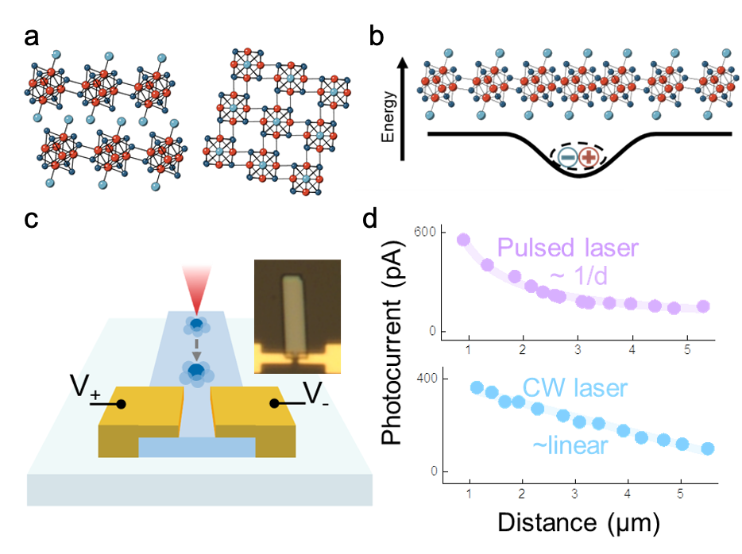
Columbia University MRSEC
DMR-2011738
Novel coherent transport in superatomic semiconductors
Berkelbach, Delor, Nuckolls, Reichman, Roy, Zhu, Columbia University
IRG2 has pushed the boundaries of energy transport in superatomic materials, controlling phonon, electron, and exciton interactions. The team published a breakthrough report in Science and several follow up demonstrations of acoustic exciton-polarons quasiparticles in materials, such as the superatomic semiconductor Re₆Se₈Cl₂ (Fig. 1a,b), which enable ultrafast, phonon-shielded transport, surpassing silicon. The team also uncovered coherent superradiant transport in 1D superatomic crystals. We have now published a theoretical model to explain this new transport behavior.
Building from this, the IRG2 team has fabricated rod-shaped photodetectors (Fig. 1c) and demonstrated that photogenerated acoustic polarons travel over 5 microns, with 1/distance scaling (Fig. 1d, top), confirming lossless, isotropic two-dimensional transport at room temperature. These results enable acoustic polaron transistors, enabling ultrafast, phonon-shielded charge propagation that outperforms conventional semiconductors. Experiments also show continuous-wave excitation generates polaron-driven photocurrents (Fig. 1d, bottom), with distinct transport behavior linked to weak polaron–polaron interactions in steady-state conditions.
Fig. 1. (a) Re₆Se₈Cl₂. (b) Formation of acoustic polarons. (c) Photodetector device geometry for measuring the distance dependence of acoustic polaron transport. Inset: device based on Re₆Se₈Cl₂. (d) Photocurrent extraction as a function of distance from electrodes under both pulsed and continuous-wave excitation.
Publications: (1) Science 2023, 382, 438-442. (2) J. Phys. Chem. C 2023, 127, 1519-1526. (3) J. Phys. Chem. Lett. 2023, 14, 45, 10249–10256. (4) J. Chem. Phys. 2024, 160, 204705. (5) Manuscript in preparation
Notes:
What Has Been Achieved: IRG2 researchers have demonstrated ballistic photocurrent transport in the superatomic semiconductor Re₆Se₈Cl₂, confirming that acoustic exciton-polarons can propagate over 5+ microns without loss. The IRG2 team published a theoretical understanding of this phenomenon that will inform future materials design. This marks a breakthrough in phonon-shielded charge transport, enabling ultrafast, lossless energy transfer that surpasses conventional semiconductors. Additionally, continuous-wave excitation was found to drive polaron-driven photocurrents, revealing weak polaron–polaron interactions in steady-state conditions. These discoveries lay the foundation for acoustic polaron transistors, offering new possibilities for quantum transport and next-generation electronics. A high-impact manuscript detailing these findings is in preparation.
Importance of the Achievement: This achievement marks a major leap in quantum transport, proving that acoustic exciton-polarons can drive lossless charge propagation over extended distances at room temperature. By shielding electrons from phonon scattering, this mechanism enables ultrafast energy transfer, surpassing conventional semiconductors, including silicon. The discovery lays the groundwork for acoustic polaron transistors, a new class of quantum devices that could revolutionize low-power electronics, optoelectronics, and quantum information processing. The ability to sustain ballistic photocurrent transport in device-relevant conditions opens up new possibilities for high-speed, energy-efficient technologies beyond traditional semiconductor limits. This breakthrough is a critical step toward harnessing quantum transport for practical applications, setting the stage for a transformative approach to electronic devices. The theoretical understanding the IRG2 team is developing is helping design the next generation of materials.
How is the achievement related to the IRG, and how does it help it achieve its goals? One of the main goal of IRG2 is to investigate novel transport behaviors in superatomic materials. The demonstration of ballistic photocurrent transport in Re₆Se₈Cl₂ directly advances this mission by revealing a phonon-shielded charge transport mechanism that enables lossless energy propagation over extended distances at room temperature. These findings not only validate core IRG2 hypotheses but also open new avenues for device applications leveraging quantum transport in complex materials.
Where the findings are published:
Science 2023, 382, 438-442.
J. Phys. Chem. C 2023, 127, 1519-1526.
J. Phys. Chem. Lett. 2023, 14, 45, 10249–10256.
J. Chem. Phys. 2024, 160, 204705.
Manuscript in preparation

