Slide 1
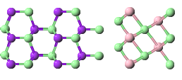
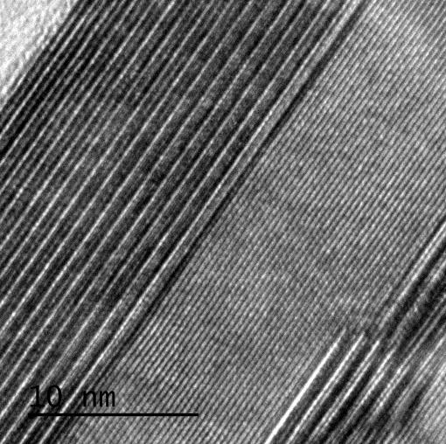
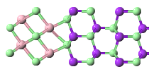
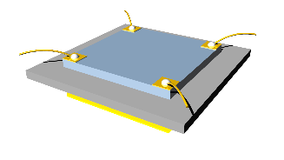
Robust topological interfaces and charge transfer in epitaxial Bi₂Se₃/II-VI semiconductor superlattices (NanoLetters 2015)
Zhiyi Chen, Lukas Zhao, Kyungwha Park,Thor Axtmann Garcia,
Maria C. Tamargo, and Lia Krusin-Elbaum
Se(2)
Se(3)
Se terminated
(d)
(a)
(b)
S
Bi₂Se₃
ZnCdSe
Bi(1
Se(1)
Zn(1)
10 nm
(c)
d
Zn terminated
(d)
(e)
A
C
D
V_{g}
B
Notes:
We have achieved a successful molecular beam epitaxy growth of Bi₂Se₃ / Zn_{x}Cd_{1-x}Se superlattices in which topological properties of individual 10 nm thick TI layers are enhanced. Zn_{x}Cd_{1-x}Se (ZnCdSe) is a `trivial’ wide band gap II-VI group semiconductor with a 2.12 eV band gap and a nearly perfect lattice match to Bi₂Se₃. We demonstrated that in these superlattices a two-dimensional (2D) weak antilocalization quantum correction to classical magneto-resistance associated with topological Berry phase scales with the number of TI layers, having one quantum channel per layer obtained from the fits to 2D localization theory. The choice of layers abutting topological surfaces can be critical. The robustness of our multilayer topological structure and the ZnCdSe (wurtzite) crystal structure that induces interfacial electronic asymmetry show that surface charge transfer and the corresponding bending of 2D-like subsurface bulk bands can be controlled.
(a) HRTEM image of a superlattice (grown on a sapphire substrate, S). Zn-terminated (red arrow) and Se-terminated (blue arrow) interfaces are marked on the image. DFT calculated charge transfer at (b) Se-terminated interface of ZnCdSe with a TI Bi₂Se₃ (blue arrow) and at (c) Zn terminated interface (red arrow). Our experiments and band structure calculations demonstrate that Se-termination does not induce interfacial charge transfer and hence a formation of the 2DEG states, but Zn-termination does (hatched region of negative ΔQ in (c)). (d) The effect of Zn dangling bonds and charge transfer is clearly seen in the shift of Dirac point corresponding to the maximum of longitudinal resistance R_{xx} vs. gate voltage V_{g}. Here the red curve (sample S5) is with interfacial Zn and black curve (sample S6) is without. This demonstrates that the interfacial asymmetry induced by a suitable crystal structure of the spacer layer (here ZnCdSe is wurtzite) can guarantee that only one interface remains topological. (e) This is confirmed by the quantum interference correction to the 2D conductance measurements which scales with the number of TI layers in the superlattices and has only one quantum conductance channel per layer.

