Slide 1
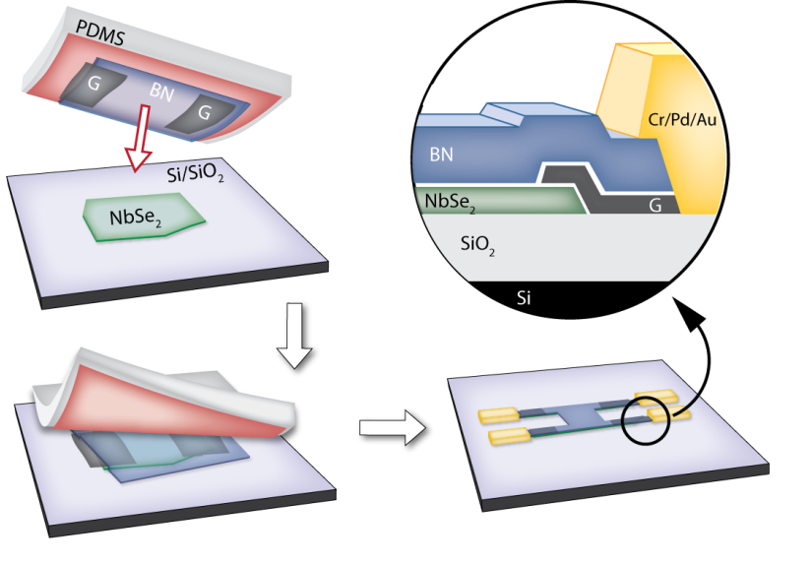
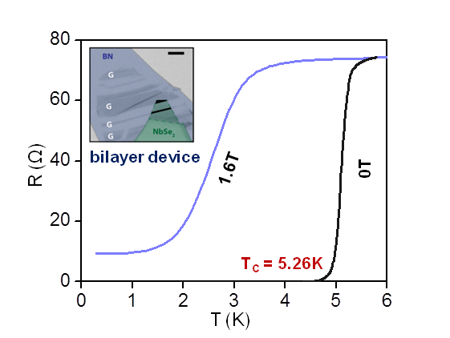
Magnetic field tuned quantum metal in 2D NbSe₂
A. W. Tsen, B. Hunt, Y-D Kim, J. Hone, P. Kim, C. R. Dean, A. N. Pasupathy
Notes:
Layered superconducting transition metal dichalcogenides such as NbSe₂ have generated intense interest as new atomically thin quantum materials. However, they are extremely sensitive to oxidation in the ambient environment. We have developed a technique to protect NbSe₂ with flakes of hexagonal boron nitride in inert atmosphere, preventing their oxidation. Flakes of graphene are used to bridge between metal electrodes and the NbSe₂ to achieve multi-terminal contact, allowing four-terminal resistivity measurements. We observe a clear superconducting transition in a bilayer device close to that of the bulk crystal. The application of a small perpendicular magnetic field induces a transition to a quantum metallic state. In this phase, the resistance obeys a unique power-law scaling relation with field, which has not been observed in previous studies of 2D superconductors.

