Slide 1
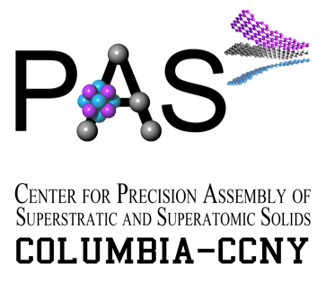
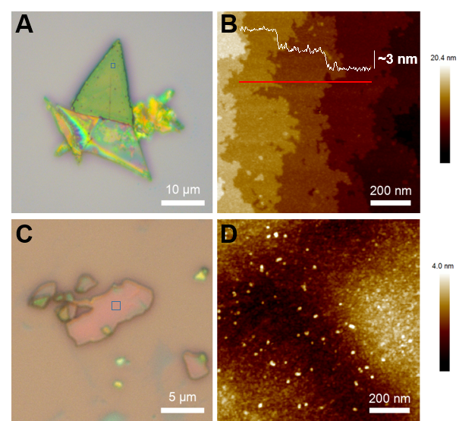
Van der Waals Solids from Self-Assembled Nanoscale Building Blocks B. Choi, D. W. Paley, J. Yu, C. H. Lee, P. Kim, M. L. Steigerwald, C. Nuckolls, X. Roy
Submitted
Notes:
Van der Waals materials have recently undergone a renaissance with the discovery of methods to exfoliate the bulk solids to create atomically thin sheets. Unfortunately, fullerenes, one of the prototypical nanoscale allotropes of carbon, cannot be exfoliated because it crystallizes into a three dimensional lattice as a result of its quasi-spherical shape. We have developed a method to organize fullerenes into close packed monolayers using a nanoscale template built on a molecular cluster platform. The template and the fullerene layer form a van der Waals interface that can be exfoliated with single layer precision. The template consists of a molecular cluster decorated with a ligand set that forms a buckybowl to host and organize C₆₀ into a the layered solid ([Co₆Se₈phen₆][C₆₀]₅). The crystal structure of this material can be described as an intergrowth comprising two distinguishable trigonal layers: a layer of C₆₀ (FL) and an array with stoichiometry [Co₆Se₈phen₆][C₆₀]₂ (CF). The [Co₆Se₈phen₆][C₆₀]₅ crystals can be exfoliated in the same way as traditional atomic 2D van der Waals materials and the step height in exfoliated layers is in very good agreement with the height of a superatomic monolayer (Layer CF + Layer FL) calculated from the crystal structure. Moreover, these materials exhibit in-plane electrical transport with an activation energy in the mid-IR.

