Slide 1
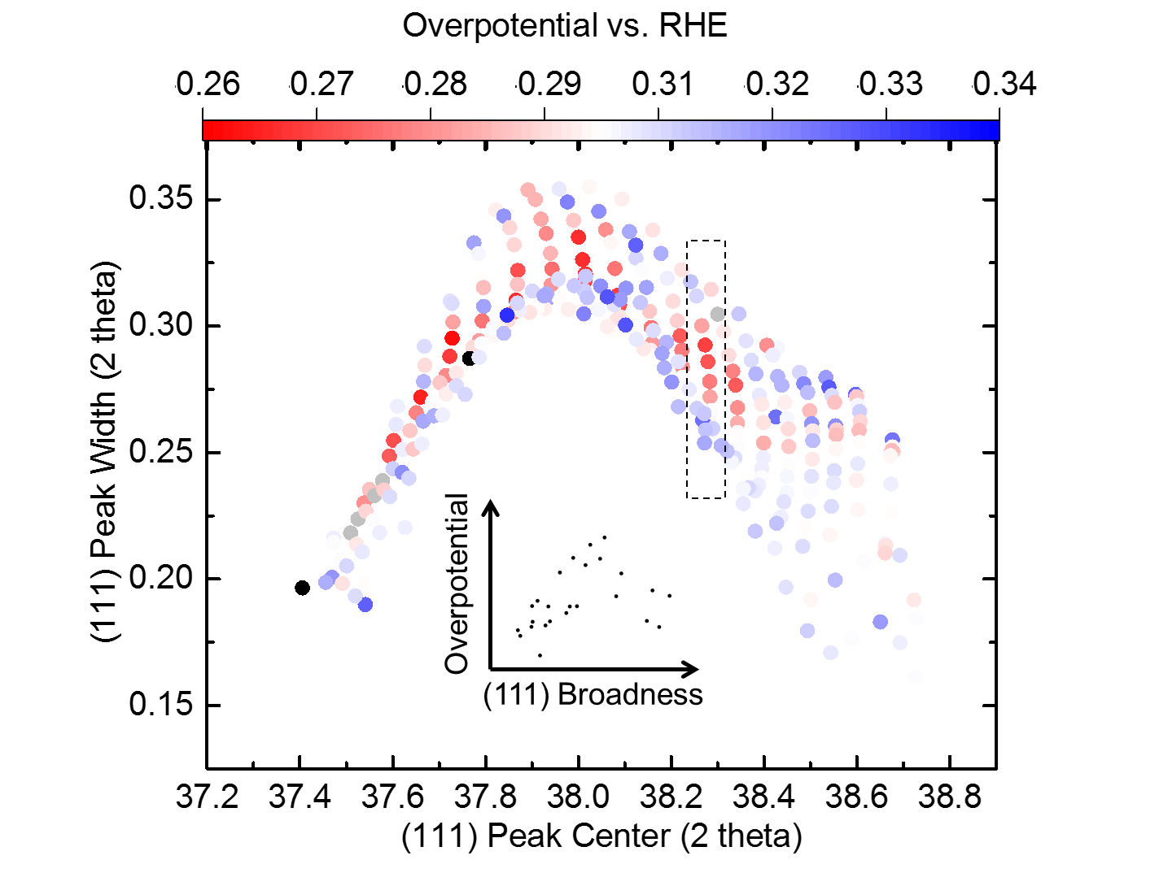
Combinatorial screening of metallic glass electrocatalysts for the oxygen reduction reaction
MRSEC NSF 1119826
2017
Due to enormous challenges associated with theoretical modeling of multicomponent alloys, there are no reliable theoretical predictions available for their composition-dependent properties and structures. Taylor and Schroers have proposed to use combinatorial materials science to address this challenge, allowing for the rapid experimental screening of a large number of compositionally varying samples for desirable properties, coupling synthesis to high-throughput characterization.
For the important oxygen reduction reaction, they studied the performance of combinatorial Pd-Au-Ag-Ti thin film alloys using high-throughput measurements and correlated the electrochemical behavior to crystallographic properties. The parabolic correlation between strain and electrical overpotential describes a fine control over the strain induced in an alloy, which in turn affects the electrochemical catalytic activity; this control is realized through the combinatorial alloying approach.
Andre Taylor and Jan Schroers, Yale University
Peak width plotted over the (111) peak center as obtained from fitting a simplified Cauchy function. The inset shows that the lowest overpotential is measured at intermediate peak width or strain.
J. Li, et al., Journal of Materials Chemistry A 5, 67, 2017
Notes:
A Pd-Au-Ag-Ti thin film library (340 measurement areas) was investigated for potential high activity ORR candidates in the alkaline regime using a scanning droplet cell. The study reveals that the lowest overpotential region is shown to be around a quaternary composition region with 30 at. % Au and >7 at. % Ag. However, the highest current from chronoamperometry was observed to be around 40% Au with >7 at. % Ag. A composition of Pd-Au-Ag-Ti of 4:3:2:1 is shown to have both promising overpotential and plateau current.
The abundant data provided by SDC and the first study on the quaternary Pd-Au-Ag-Ti thin film library could be applied in other fields of studies of electrocatalysts and provide guidance for potential nanomaterials synthesis. A systematic volcano-like correlation between strain and overpotential is shown that could serve as a guideline for the optimization of new ORR catalysts.

