Slide 1
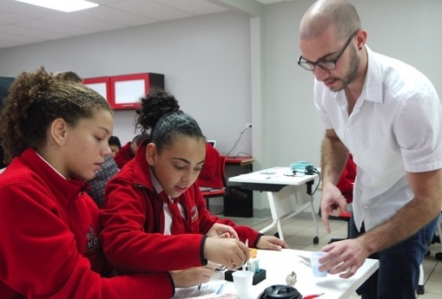
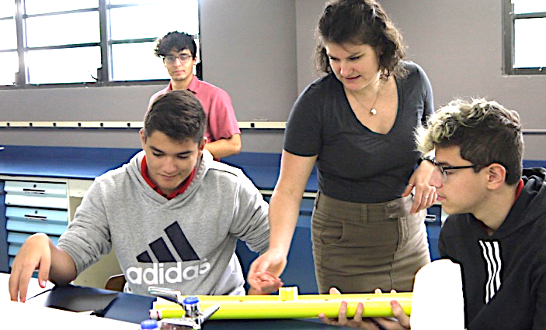
Materials Research Science and
Engineering Centers
MRSEC DMR-1719875
2019
Teaching and Inspiring Students in Puerto Rico
Graduate student Omar Padilla Velez, an NSF Graduate Research Fellow, wants to be a role model for students back home in Puerto Rico. He explains, “I believe that students greatly benefit from seeing and hearing from someone who grew up on the island, and faced the same struggles from lack of resources in the public schools and limited English language.”
Omar gathered a team of Cornell scientists working in fields from Chemistry to Physics, to bring science to students from middle to undergraduate schools in Puerto Rico.
The middle and high school students built microscopes and created and tested their own batteries. The team traveled to Universidad Ana G. Méndez to present their research to undergraduates. Prof. Mitk’El B Santiago Berrios noted, “The presentations were awesome. We learned a lot from the Cornell students.”
Cornell Center for Materials Research: an NSF MRSEC
Graduate students (top) Omar Padilla Velez teaching high school students at Escuela Cedin about batteries with electrochemistry lab and (bottom) Berit Goodge presenting how to build a microscope using pvc pipes and lenses at Sebastian Bilingual High School in Puerto Rico.

