Slide 1
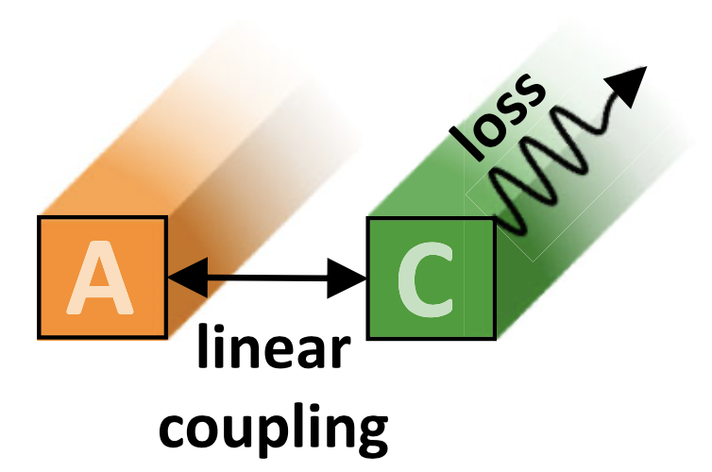
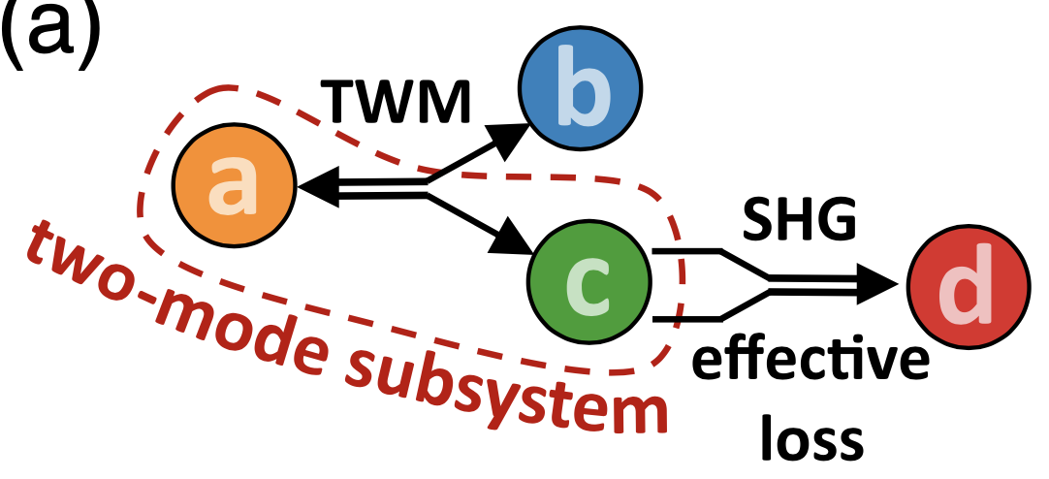
Cornell University MRSEC
DMR-1719875
Lossless Removal of Unwanted Waves from Photonic Devices
J. Moses (Cornell Univ.)
Normally, unwanted oscillations are removed from a dynamical system through the introduction of energy loss. In materials used for moving photons between light waves of different frequencies – a key process, e.g., for transfer of information between nodes of a quantum network – unwanted oscillations between photon populations can limit device efficiency and cause instability and noise.
In this work, we demonstrate that these oscillations can be removed without the need for energy loss. Instead, a second, simultaneous photon exchange process between light fields of different frequencies is introduced. The approach mimicks loss while preserving the optical power in the device. These findings suggest a new approach for the engineering of dynamics where energy recovery is of importance that could be significant for photonic materials, quantum information, and laser science.
(i)
(ii)
(iii)
undamped
underdamped
unbroken PT symmetry
overdamped
broken PT symmetry
(i) Oscillations of power between light waves in nearby waveguides can be removed by loss. (ii) The same principle can be used to eliminate oscillations of photon population in a three-wave mixing (TWM) process (a → b,c). However, rather than using loss, a second-harmonic generation (SHG) process can coherently move photons to a fourth wave (c → d). (iii) This process can be used to achieve under- or over-damped behavior, corresponding to unbroken or broken parity-time-symmetric phase.
N. Flemens and J. Moses, Physical Review Letters 129, 153901 (2022)
Notes:
What Has Been Achieved: We have introduced a new concept that allows nonlinear frequency conversion devices to be more efficient. We have shown that a secondary nonlinear wave mixing process can mimic loss, allowing the elimination of unwanted oscillations via damping while preserving optical power. Though there is no loss, we show that the physics of the photon exchange corresponds to that of a lossy material.
Importance of the Achievement: Our work shows that a material useful for nonlinear frequency conversion can possess the beneficial behaviors resulting from the presence of loss, without there actually being any loss. Generally speaking, this can greatly aid the engineering of useful frequency conversion devices.
How is the achievement related to the IRG, and how does it help it achieve its goals? One of the main aims of our IRG is to produce highly efficient frequency conversion devices based on new photonic material structures that can aid future quantum information networks. Optical loss is often a primary obstacle to achieving such devices. By demonstrating a new concept in which loss can be eliminated from a device while keeping its benefits, we have increased the space for successful device design.
Where the findings are published: N. Flemens and J. Moses, “Hermitian Nonlinear Wave Mixing Controlled by a PT-Symmetric Phase Transition,” Phys. Rev. Lett. 129, 153901 (2022). https://doi.org/10.1103/PhysRevLett.129.153901

