Slide 1
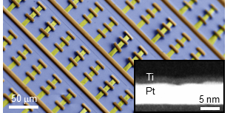
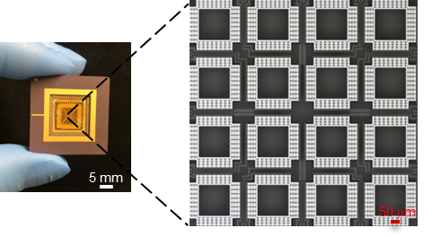
Cornell University MRSEC
DMR-1719875
Breakthrough in Artificial Cilia Materials Opens the Door to Programmable Microfluidic Manipulation
Paul McEuen (Cornell), Itai Cohen (Cornell), David Muller (Cornell)
Many organisms use cilia to control fluids at the microscale. Engineering a cilia platform with comparable capabilities, however, has remained elusive. Now, Cornell researchers have taken a step towards such systems by creating electronically-actuated artificial cilia that can create arbitrary flow patterns in liquids near a surface. The team first created voltage-actuated cilia that can drive surface flows at tens of microns per second with only 1 volt applied. In a second demonstration, they fabricated robotic cilia that can be controlled locally to generate and switch between desired surface flow patterns. Finally, they integrated the cilia with a light-powered clock circuit on a chip and demonstrated wireless operation. With this circuit the team was able to drive the cilia in the wave-like pattern that is characteristic of natural cilia and underlies their efficiency. These results, demonstrated experimentally and confirmed using theoretical computations, illustrate a new pathway to microfluidic manipulations, with applications that include microfluidic pumping and microrobotic locomotion.
Top: Electron microscope image of released artificial cilia arrays. The image of a cilium cross-section showing the platinum (white) and titanium (black) is in the bottom-right inset.
Bottom: The cilia metasurface consists of a chip with 4 x 4 arrays of cilia units.
Wang et. al., Nature 605, 681 (2022)
Notes:
What Has Been Achieved: Electronically-controlled artificial cilia have been demonstrated.
Importance of the Achievement: The cilia can produce arbitrary flow patterns in liquids near a surface. Such cilia will allow manipulation of fluids on the microscale, with applications ranging from fluid pumping to microrobot locomotion.
How is the achievement related to the IRG, and how does it help it achieve its goals? This work is direct progress toward the main goal of the IRG, which is to develop microscale actuators for applications.
Where the findings are published: W. Wang, Q. Liu, I. Tanasijevic, M. F. Reynolds, A. J. Cortese, M.Z. Miskin, M. C. Cao, D. A. Muller, A. C. Molnar, E. Lauga, P. L. McEuen, and I. Cohen, Nature 2022 (DOI: 10.1038/s41586-022-04645-w)

