Slide 1
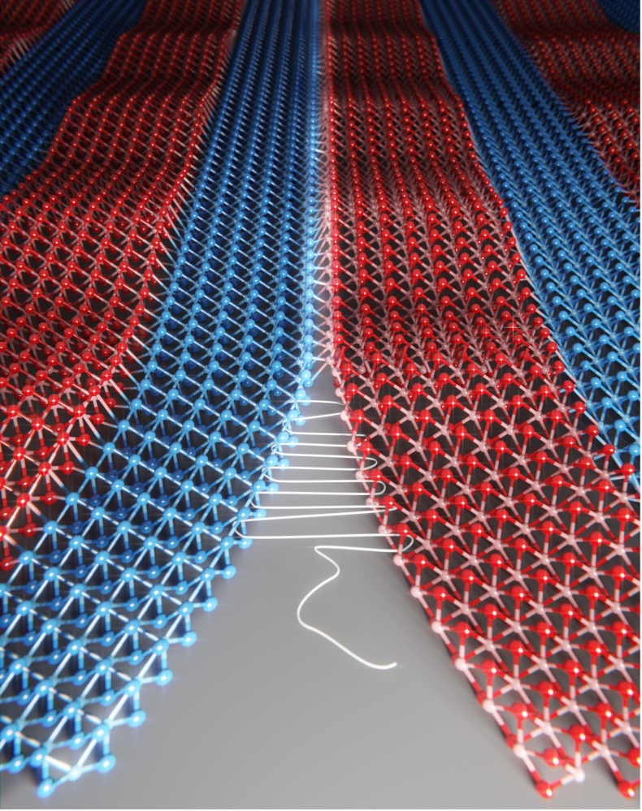
Three-atom-thick fabrics made by seamless stitching of single-layer crystals
MRSEC DMR-1420709, 17198975
2018
Chicago Materials Research Center
& Cornell Center for Materials Research: 2 NSF MRSECs
Atomically-thin superlattices will
enable advanced optoelectronic devices
Joining different materials can lead to all kinds of breakthroughs. In electronics, this produces heterojunctions — the most fundamental components in solar cells and computer chips. The smoother the seam between two materials, the better the electronic devices will function.
The U. Chicago and Cornell teams revealed a technique to ‘sew’ different patches of crystals, or lattices, seamlessly together at the atomic level to create atomically-thin fabrics. Such perfectly-meshed lattices allow for broadly tunable optical properties as well as ultra-efficient light emitters based on these materials. The demonstration of “seamless atomic fabrics” could boost new interdisciplinary research and the realization of application such as flexible electronics.
Schematic of atomically-thin superlattices where two different transition-metal dichalcogenide monolayers are “seamlessly stitched together” without dislocations at the interfaces.
S. Xie et al., Science 359, p. 1131-1136 (2018)

