Slide 1
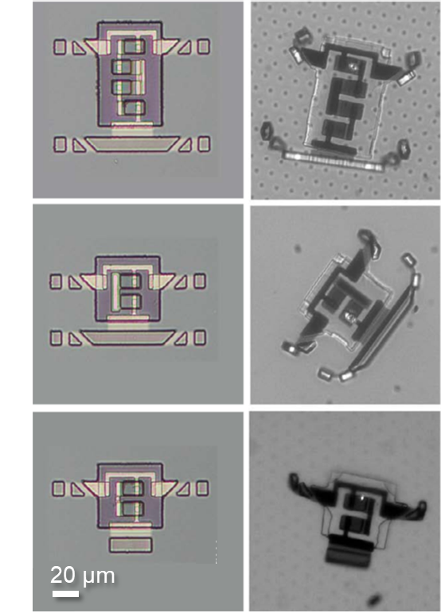
Materials Research Science and
Engineering Centers
MRSEC DMR-1719875
2020
Breakthrough in materials for actuators paves way to electronically integrated microscopic robots
Cornell Center for Materials Research: an NSF MRSEC
Fifty years of Moore’s Law scaling in microelectronics have brought remarkable opportunities for the rapidly-evolving field of microscopic robotics. Electronic, magnetic, and optical systems now offer an unprecedented combination of complexity, small size, and low cost, and could readily be appropriated to form the intelligent core of microscopic robots. But one major roadblock exists: there is no micron-scale actuator system that seamlessly integrates with semiconductor processing and responds to standard electronic control signals. Researchers at Cornell have now overcome this materials challenge by developing a new class of voltage-controllable electrochemical actuators that operate at low voltages (200 mV), and are completely compatible with silicon processing. The actuators are made of a 7-nm thin film of platinum capped on one side by titanium dioxide. When voltage is applied to the titanium, ions from the surrounding solution adsorb onto its uncapped surface causing surface stresses that bend the film. To demonstrate their potential, standard silicon fabrication was employed to make prototype sub-100-micron walking robots with these actuators. These results establish a clear pathway to mass-manufactured, complex and functional robots too small to be resolved by the naked eye.
M. Z. Miskin et al., Nature (in Review)

