Slide 1
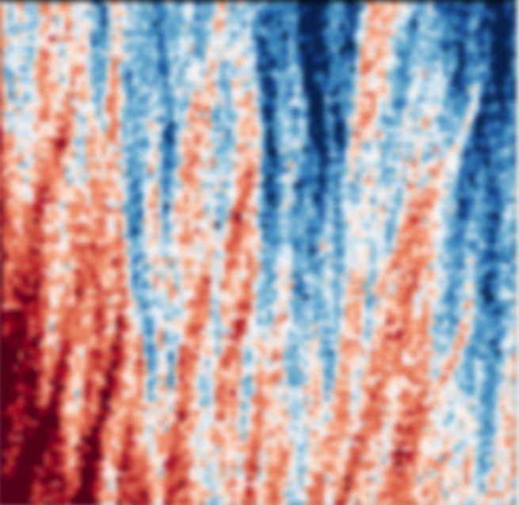
Imaging Magnetic and Electric Fields with an Electron Microscope
A new high-speed detector for electron microscopes uses every transmitted electron to measure electric and magnetic fields
Electron microscopes excel at imaging small structures —even individual atoms! — but they are nearly blind to the important electric and magnetic fields within these structures. For example, they cannot easily “see” the magnetic fields that record information in magnetic storage media. Scientists have long known that electric and magnetic fields create tiny shifts in electron microscopy images, but the shifts are too small to be measured with conventional electron detectors.
Researchers at Cornell University have developed a new type of imaging electron detector that is 100 times faster than conventional detectors and that can detect from 1 to 1,000,000 electrons per pixel — a 1000x improvement in dynamic range. As a result, scientists can now measure the tiny shifts on every electron that passes through a sample! The result is a rapid, accurate and quantitative map of electric and magnetic fields on the nanoscale. The technique is well-suited to imaging nanostructures, and is easier to interpret and less sensitive to noise and artifacts than previous electron microscope methods.
An image of magnetic ripples in a thin film of cobalt recorded in 65 seconds with the new pixel array detector.
M. W. Tate, et al., Microscopy Microanal. (2016)
doi: 10.1017/S1431927615015664.
Notes:
We have developed and tested a new detector for electron microscopes that enables quantitative measurements of electric and magnetic fields across multiple length scales and down to atomic resolution. The device is an adaptation of a solid state x-ray detector technology we have developed over the last fifteen years, now modified to function as a high-speed, high dynamic range electron diffraction camera. The resulting electron microscope pixel array detector (EMPAD) records an image frame in under a millisecond, and can detect from 1 to 1,000,000 primary electrons per pixel per image frame. This is 1000x the dynamic range, and 100x the speed of conventional electron image sensors. These properties allow us to record the entire unsaturated diffraction pattern in scanning mode, and simultaneously capture bright field, dark field, and phase contrast information, as well as being able to analyze the full scattering distribution, opening the way for new multichannel imaging modes. From the analysis of the spatially-resolved diffraction patterns we can extract local strains, tilts, rotations, polarity and even electric and magnetic fields.
Funding
Electron microscope data acquisition (K.X.N., D.A.M.) was supported by the Cornell Center for Materials Research, an NSF MRSEC under grant DMR 1120296.
PAD development in SMG’s lab is supported by the U.S. Department of Energy, grant DE-FG02-10ER46693 and by CHESS, which is supported by the U.S. National Science Foundation and the U.S. National Institutes of Health-National Institute of General Medical Sciences via grant DMR-1332208. The PAD architecture used was developed as an x-ray detector over the last decade and a half as a collaboration between SMG’s group and Area Detector Systems Corp. (Poway, CA) under NIH grant R44 RR014613 and DOE grant DE-FG02-97ER62443.
The adaptation of the x-ray PAD to the STEM was supported by the Kavli Institute at Cornell for Nanoscale Science.
Paul Fischione of Fischione Instruments provided the base annular dark field detector housing.

