Slide 1
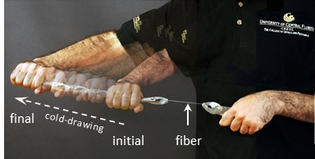
IRG-I Controlled Fragmentation of Multimaterial Fibers Via Polymer Cold-Drawing
Center for Materials Science and Engineering DMR 14-19807
2016
Massachusetts Institute of Technology
Intellectual Merit: The discovery of cold-drawing at DuPont in the 1930s was fundamental to the development of synthetic fibers, such as polyester and nylon. In such industrial applications, tensile stress reduces the fiber diameter and orients the polymer chains.
MIT MRSEC researchers have demonstrated for the first time a selective cold drawing process in multi-material fibers in which one material undergoes cold-drawing while the others do not. By exploiting a mechanical-geometric instability associated with neck propagation upon cold-drawing, they are able to controllably and sequentially fragment embedded cores into uniformly sized rods along meters of fiber or films.
ductile
fragile
100 µm
Top: Photograph of a cylindrical polymer fiber undergoing cold-drawing under axial stress at a speed of approximately 5 mm/s. Multiple shots taken over 1 min are overlaid to highlight the extent of fiber elongation. Bottom: Transmission optical micrograph of a multimaterial cylindrical fiber after undergoing cold-drawing, as shown in the top panel. The fiber consists of a brittle glass core (diameter ~ 10 – 20 microns) embedded in a larger diameter ductile polymer cladding ( diameter ~ 1 mm).
Shabahang, S., Tao, G.M., Kaufman, J.J., Qiao, Y.Y., Wei, L., Bouchenot, T., Gordon, A.P., Fink, Y., Bai, Y.L., Hoy, R.S., and Abouraddy, A.F. “Controlled fragmentation of multimaterial fibres and films via polymer cold-drawing.” Nature 534, 529 (7608): June 2016. <DOI: 10.1038/nature17980>
Notes:
Top panel:
Photograph of a cylindrical polymer fiber undergoing cold-drawing under axial stress at a speed of approximately 5 mm/s. Multiple shots taken over 1 min are overlaid to highlight the extent of fiber elongation.
Bottom panel:
Transmission optical micrograph of a multimaterial cylindrical fiber after undergoing cold-drawing, as shown in the top panel. The fiber consists of a brittle glass core (As₂Se₃; diameter ~ 10 – 20 microns) embedded in a larger diameter ductile polymer cladding (polyethersulfone: PES; diameter ~ 1 mm). Initially, the fiber extends for meters with an intact continuous core. Axial stress is applied as in the top panel, necking is initiated and the fiber is cold-drawn, after which the axial stress is removed. In the optical micrograph of the fiber shown, the neck has not reached the sections to the left and the right, whereupon the fiber core remains intact as in the initial fiber. In the middle section that has undergone necking, a fractured core is found with an approximately periodic arrangement of fragments. Core fragmentation takes place in the shoulder of the propagating mechanical-geometric instability associated with cold-drawing and necking. The cylindrical core has fragmented into micro-rods that remain embedded in the polymer cladding and may be extracted by selective dissolution of the cladding polymer. The length of the fragmented rods is proportional to the initial core diameter with a proportionality constant that depends on the relative Young’s moduli of the core/cladding materials. This phenomenon has been observed with core diameters extending up to hundreds of microns and down to tens of nanometers from a very broad range of materials (see next slide), and is thus truly universal.

Slide 2
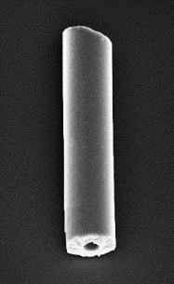
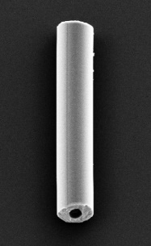
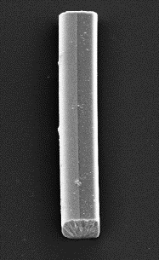
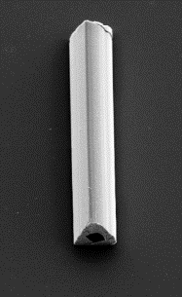
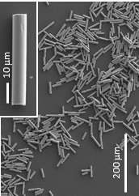
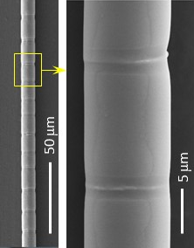
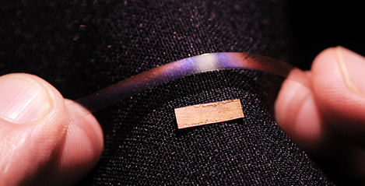
IRG-I Controlled Fragmentation of Multimaterial Fibers Via Polymer Cold-Drawing
Center for Materials Science and Engineering DMR 14-19807
2016
Massachusetts Institute of Technology
Broader Impact: This new fragmentation process enables the scalable fabrication of nano- and micro-particles of complex shape and from a broad range of materials including crystalline semiconductors, bio-degradable polymers, gold, silk, and even ice. Micro-rods are obtained after cold-drawing and dissolving the cladding (top images).
When coupled with a thermal restoration process, self-healing (middle images) of the fragmented structure can be achieved.
Films subject to the same process can be used to produce large-area nano-photonic structures with mechanically induced diffraction gratings (bottom images).
Cross-section maintained
10 µm
cold-drawing
thermal restoration
Thermal self-healing
intact
fragmentation
self-healed
100-nm-thick gold cold-drawn on PES
Large-area photonic meta-surfaces
Notes:
Top: After cold-drawing, dissolving the cladding reveals fragmented micro-rods. SEM micrographs of micro-rods produced by the fragmentation process associated with cold-drawing occurring as shown in the first slide. The rods maintain the initial core structure, which opens the path for fabrications multimaterial rods of complex architecture limited only by our ability to produce arbitrarily structured fiber cores. Single rods having four different structures are shown. From left to right: hollow glass rod (a polymer inner core that undergoes cold-drawing but not fragmentation was selectively dissolved); hollow cylindrical Janus rod; parallelepiped Janus rod; and triangular rod with square hole. Scale bars are all 10 microns. Schematics above the SEM micrographs show cross-sections of the structures, with As₂S₃ colored orange and (As₂Se₃)₉₉Ge₁ colored black.
Middle: Remarkably, self-healing of glass fragments is possible after thermal restoration of the polymer cladding. That is, the fragmentation is thermoreversible: heating the drawn fiber above its glass transition temperature results in self-healing of the fragmented core as the initial fiber dimensions are restored. Upon heating the fiber to its softening temperature, the tensile stress is released and the polymer fiber contracts to its initial length via an imperfect shape-memory effect (SME). As voids between the fractured glass segments are eliminated, the segments fuse together (self-heal) and re-form an intact longitudinal core. This effect is not a SME because— by definition—SME can occur only in samples with continuous strain histories.
Left: SEM of the initially intact brittle glass core after dissolving the polymer.
Right: If the fiber is heated above its glass transition temperature without removing the cladding, the fragments are healed, as confirmed after selectively dissolving the cladding at this stage.
In combination with a flat fiber containing an opaque brittle glass film, cold-drawing can help control the optical properties of a macroscopic composite structure through dynamical and thermoreversible nanoscale mechanical processes; in effect, a nanoscale Venetian-blind effect that could lead to dynamical camouflaging.
Bottom panel: Photograph showing a polymer film (PES) with gold (Au) deposited on it before (section resting at the bottom) and after cold-drawing (section held by hand and having a colored appearance). We initially deposit a 70-nm-thick layer of gold onto a centimeter-scale PES film, and then apply an axially stress to the film to induce cold-drawing. The resulting polymer-gold bilayer film appears colorful with optical angular-spectral diffraction commensurate with a diffraction grating of period ~ 2.2

