Slide 1
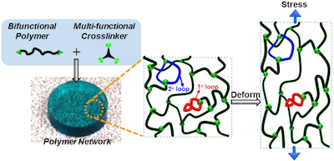
IRG-II Understanding Loops in Polymer Networks Results in an Improved Theory for Rubbery Materials
Center for Materials Science and Engineering DMR 14-19807
2016
Massachusetts Institute of Technology
Intellectual Merit: The rubbery properties of elastomers are critical for materials used in many of the items encountered in daily life. Despite nearly a century of research, a quantitative theory of elasticity was not available. This gap was due to the fact that all real rubbery networks possess “loop” defects that have eluded characterization (see figure). Thus, the impact of these defects on bulk elasticity was largely unknown until 2016.
MRSEC researchers have used newly developed loop counting methods to precisely measure the storage moduli and loop fractions of a range of rubbery gels. When these data were compared to the classical affine and phantom network theories of elasticity, poor agreement was observed. A new theory, called Real Elastic Network Theory (RENT) was derived that describes how loop defects affect bulk elasticity.
A
Figure: (A) Amorphous polymer networks inevitably possess topological “loop” defects whose impact on elasticity (stress vs. strain behavior of the bulk material) was unknown.
Zhong, M.†; Wang, R.†; Kawamoto, K.†; Olsen, B.D.; Johnson, J.A. “Quantifying the impact of molecular defects on polymer network elasticity” Science, 353, 1264-1268, 2016. †equal contribution

Slide 2
IRG-II Understanding Loops in Elastomers Results in an Improved Theory for Rubbery Materials
Center for Materials Science and Engineering DMR 14-19807
2016
Massachusetts Institute of Technology
Broader Impact: The development of an improved theory of rubbery materials opens new avenues in the understanding of how molecular structure, and in particular defects, in amorphous materials translates into bulk properties.
MRSEC researchers prepared a video about their work on this project, which can be viewed at:
https://www.youtube.com/watch?v=omEKWZLRvAo
This video has been viewed over 1700 times and has enabled the broad dissemination of the research results. Furthermore, the work was presented in over 35 invited lectures around the world.
Zhong, M.†; Wang, R.†; Kawamoto, K.†; Olsen, B.D.; Johnson, J.A. “Quantifying the impact of molecular defects on polymer network elasticity” Science, 353, 1264-1268, 2016. †equal contribution

