Slide 1
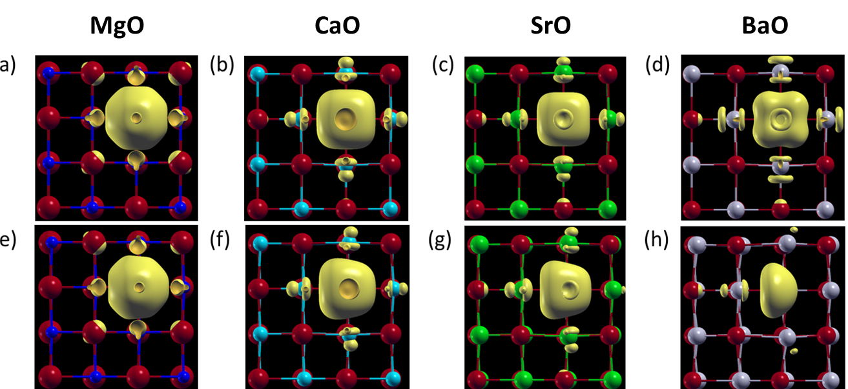
IRG-III Strong Electric Fields Tune the Stability of Ionic Defects in Oxides
Center for Materials Science and Engineering DMR 14-19807
2017
Intellectual Merit: No ceramic crystal is perfect, and structural imperfections including point defects are responsible for many technologically desirable properties of ceramics. Applications such as modern computer memories rely on controlling defects inside a crystal by exposing them to large electric fields. High field effects on defective crystals, however, remain challenging to control and address.
MIT MRSEC researchers have demonstrated that strong electric fields can tune the stability of ionic defects in semiconducting or insulating oxides. Combining density functional theory and the modern theory of polarization, they were able to formulate and predict the effect of electric fields on charged defects in oxides. By applying this approach to simple binary oxides, they elucidated the rich thermodynamics underlying the free energy landscape of oxygen vacancies.
Bilge Yildiz and Krystyn Van Vliet
Massachusetts Institute of Technology
Figure 1. Visualizations of the charge density of the two electrons trapped in an oxygen vacancy at zero field in (a) MgO, (b) CaO, (c) SrO, and (d) BaO. Similar visualizations at a field of 22 MV/cm in the +x direction are shown for (e) MgO, (f), CaO, (g) SrO, and (h) BaO. Red, blue, cyan, green, and grey spheres represent O, Mg, Ca, Sr, and Ba ions, respectively.
Youssef, M., Van Vliet, K.J and Yildiz, B. “Polarizing oxygen vacancies in insulating metal oxides under high electric field.” Physical Review Letters, 119, 126002, 2017.

Slide 2
IRG-III Strong Electric Fields Tune the Stability of Ionic Defects in Oxides
Center for Materials Science and Engineering DMR 14-19807
2017
Bilge Yildiz and Krystyn Van Vliet
Massachusetts Institute of Technology
Broader Impacts: The ability to predict electric field effects in semiconducting oxides will guide the design of optimal conditions to promote desirable forms of electronic and ionic defects in electronic or electrochemical applications. For example, accounting for electric field effects is necessary for a better understanding and modeling of the performance of ultra-fast, low-energy redox based memristive device performance, as well as of photo-electro-chemical energy conversion devices to produce clean fuels. In addition, advancements in electrocaloric refrigeration and field assisted ceramic sintering will benefit from accurate theories of how electric fields redistribute and move ionic defects in related materials.
Figure 2. A resistive switching memory, a type memristor; oxygen vacancies generated through redox mechanism under high electric fields, high n-type electronic conduction localized near oxygen vacancy filaments
Figure 3. A photo-electro-chemical solar hydrogen production reactor based on electrode systems similar to flat-plate photovoltaic panelshttps://energy.gov/eere/fuelcells/hydrogen-production-photoelectrochemical-water-splitting). Technologies
that utilize large electric fields include memristive memories and logic, photo-electro-chemical hydrogen production devices, electrocaloric refrigeration, and field assisted sintering of ceramics.
Youssef, M., Van Vliet, K.J. and Yildiz, B. “Polarizing oxygen vacancies in insulating metal oxides under high electric field.” Physical Review Letters, 119, 126002, 2017.

