Slide 1
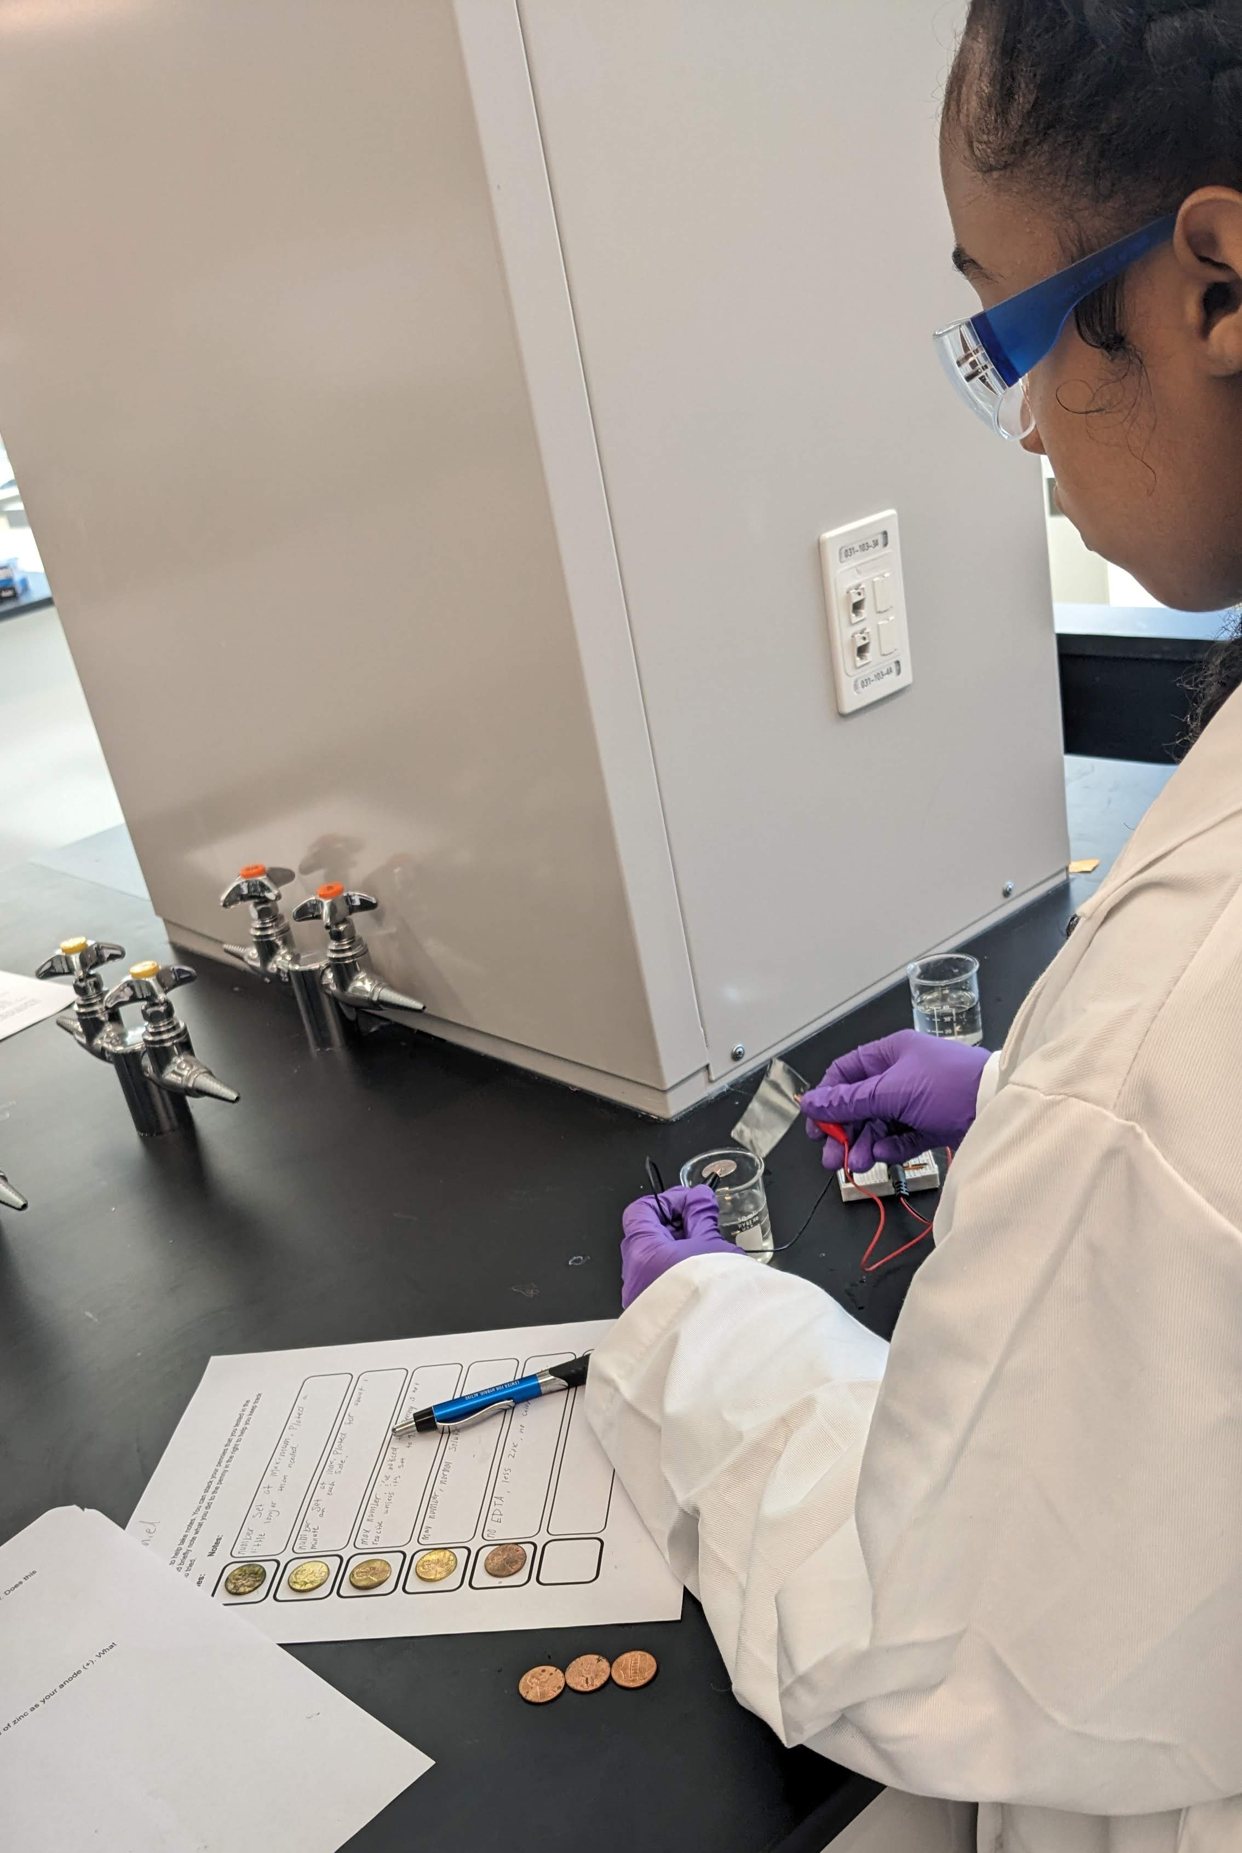
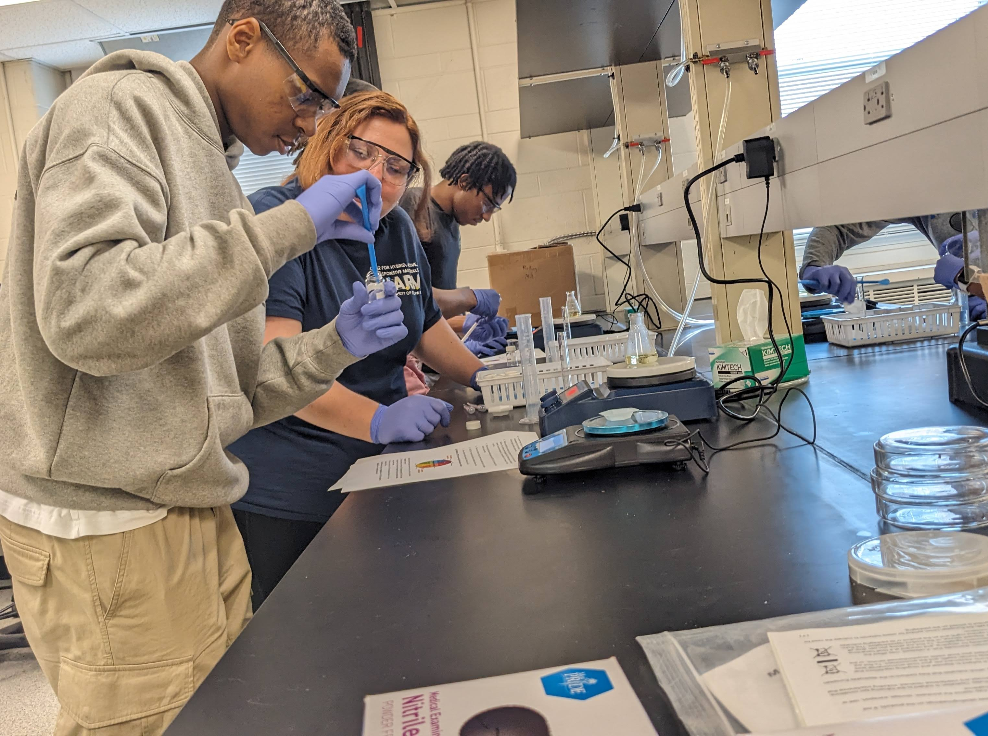
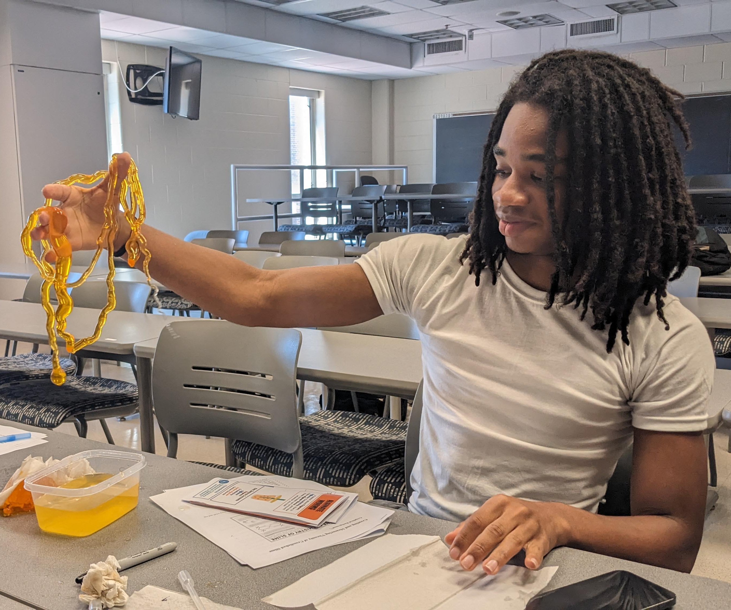
University of Delaware MRSEC
DMR-2011824
FORGES: Foundations of Outreach for Recruitment of Great Engineers & Scientists
Gwen Gregory, Allie Landry, Joseph Madanat, April Kloxin, LaShanda Korley
University of Delaware
STEM exposure & experience summer program for high schoolers
CHARM partnered with academic departments and local industry at the University of Delaware to provide experiential exposure to STEM fields, collegiate lab settings, and industry settings and equipment to students historically underrepresented in STEM. Students visited one department or industry partner for one day per week, for 7 weeks.
Participants engaged in a variety of hands-on activities, including:
Tested tensile strength of different materials in Materials Science & Engineering
Used industrial equipment & observation to identify a mystery polymer at Chemours
Used electrolysis to brass plate a penny in Chemistry & Biochemistry
Edited genes using CRISPR in the Christiana Care Gene Editing Institute
Conducted a mock ELISA to detect illness in Chemical & Biomolecular Engineering
Separated and observed gametes of sea urchins in Biological Sciences
Used computers and laser cutters to make keychains in the UD Makerspace
UD faculty, students, and industry partners participated in developing and delivering programming, with participation from CHARM graduate students and postdocs. Three local teachers participated in the program which provided them with STEM education resources that will benefit their own lesson preparations.
Ten students historically underrepresented in STEM participated in the Summer 2024 program and were featured in the UDaily article ‘Forging STEM’s Next Generation’
10 students participating in the FORGES 2024 summer program engaged in many different hands-on demonstrations and activities including electroplating, electrolyte assessment, and creating sodium alginate “worms”.
Notes:
What Has Been Achieved: An outreach program led by CHARM brought ten selected students onto the University of Delaware campus to engage in hands-on activities and demonstrations, through partnership with UD STEM departments and industry partners. These high school students participated in seven days of STEM experiences, including lab tours, discussions with students and faculty, and hands-on activities and demonstrations. The program was supported through partnership with UD’s departments of Chemical & Biomolecular Engineering, Materials Science & Engineering, Biological Sciences, Chemistry and Biochemistry, and UD MakerSpace, along with industry partners Chemours and Christiana Care Gene Editing Institute.
Importance of the Achievement: Inequitable access to STEM instruction, training, and exposure can result in a lack of awareness of and confidence in academic and career pathways in the STEM field, as well as prevent students from pursuing these pathways. Based on post-program external assessment, this program provided new exposure and experiences that increased students’ confidence in their capacity for STEM, comfortability with and knowledge of collegiate level research and work, and interest in pursing STEM as an academic or career pathway.
How is the achievement related to the IRG, and how does it help it achieve its goals? N/A
Where the findings are published: https://www.udel.edu/udaily/2024/august/science-technology-engineering-mathematics-outreach-high-school/

