Slide 1
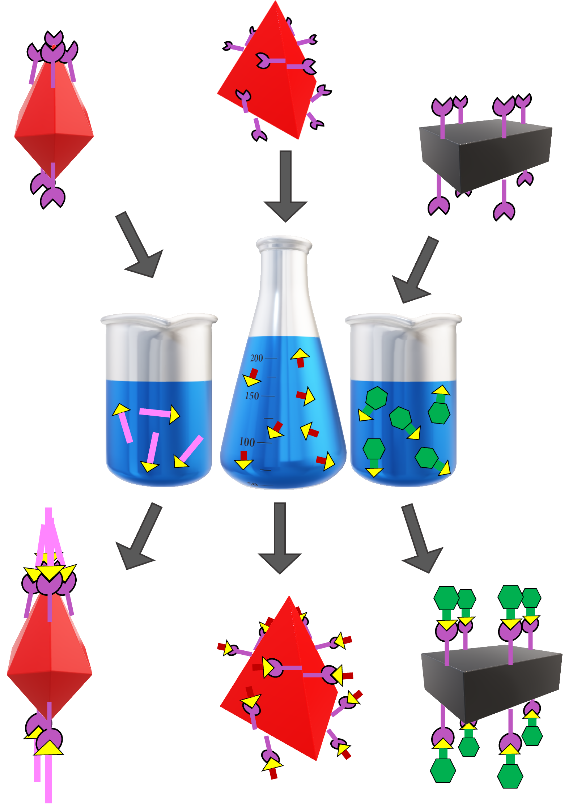
University of Delaware MRSEC
DMR-2011824
Rapid Modification of Porous Cages with Click Chemistry
M. Dworzak, C. Montone, N. Halaszynski, G. Yap, C. Kloxin, E. Bloch (University of Delaware )
Straightforward and rapid modification techniques allow for the use of porous coordination cages in network solids, flexible adsorbents, and stimuli-responsive, peptide-based materials.
Porous coordination cages represent simple molecular versions of complex solid-state materials. While tunable, their modification remains challenging. This work details a new toolkit for the rapid modification of these cages.
We have shown, for the first time, that click chemistry can be used to functionalize multiple families of porous cages.
Incorporation of certain functional groups onto porous cages has been challenging, this approach can be used to dramatically expand the chemistry of porous cages.
Utilization of porous cages as building blocks in peptide-based materials (IRG 1) was contingent on the development of modification techniques for the cages.
With this toolkit in hand, work toward the development of higher-dimensional peptide bundlemers is progressing rapidly.
Porous cages containing modifiable functional groups (top) are subjected to rapid modification chemistry (center). This process, a subset of reactions referred to as click chemistry, is catalyzed by copper and proceeds in as little as 5-30 minutes to afford functionalized cages (bottom). Analogous modification chemistry can take as long as 48 hours and is plagued by compatibility and stability issues.
Notes:
What Has Been Achieved: We have shown that copper-catalyzed click chemistry can be used to modify multiple families of porous coordination chemistry. The approach is tunable, robust, and serves as an important new route to modify these interesting molecular adsorbents. Through a combination of spectroscopy, gas adsorption, and crystallography, we confirm the solution persistence of these cages and monitor the rate of modification.
Importance of the Achievement: Although click chemistry has been used to modify MOFs and one subset of cages, this is the first time it has been reported for the cobalt and zirconium cages that we investigate. We also detail a wide range of functional group tolerance for the approach.
How is the achievement related to the IRG, and how does it help it achieve its goals? We have proposed porous cages as building blocks for peptide-based materials, contingent on the development of modification routes for the cages. This route, which is based on the same modification methods that have been reported for bundlemers, is easily translatable to bundlemer chemistry.
Where the findings are published: Chem. Commun. 2023, 59, 8977-8980. DOI: 10.1039/D3CC02015K

