Slide 1

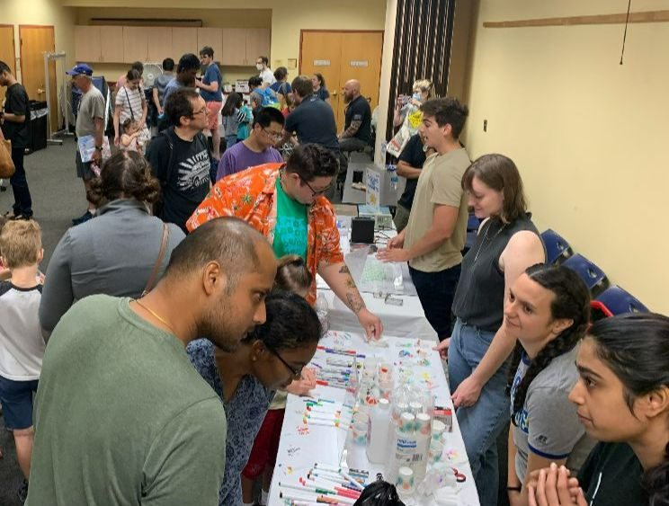
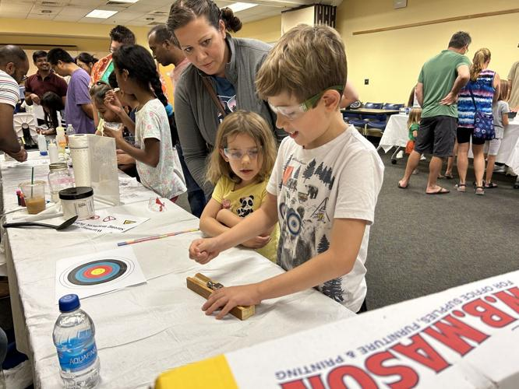
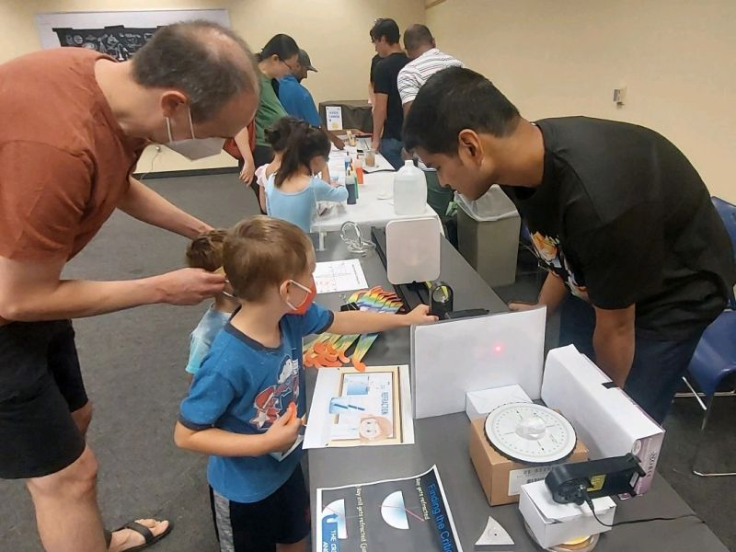

University of Delaware MRSEC
DMR-2011824
Meet a Scientist Day: hands-on demos for preK-8 students
Gwen Gregory, Joseph Madanat, Zach Stillman, April Kloxin, Benjamin Jungfleisch
University of Delaware
Community education and outreach event with hands-on STEM demos
CHARM partnered with the Newark Free library to engage our local community with experiments and demonstrations. PreK and Kindergarten students from our education partner, the University of Delaware Laboratory School, participated in the event.
Participants were engaged in a variety of materials science, chemistry, and physics activities including:
  ‘Wiggly Worms’ – Polymers
  ‘Tickling Tiny Magnets’ – Artificial spin ice/magnetism
  ‘Science Scoop’ – liquid nitrogen ice cream, phase transition
  ‘Color Separation Anxiety’ – Chromatography
  ‘You Spin Me Round’ – Angular Momentum
  ‘Gauss Cannon’ – Magnetism & kinetic energy
  ‘Laser Light Show’ – Reflection, refraction & optics
CHARM graduate students and postdocs led the event and engaged campus student organizations Colburn Club (CHEG) and Materials Research Society student chapter (MSEG). CHARM’s 2023 Summer RET participant Dr. Matt Wilcox ran the demo booth on angular momentum.
Over 200 people attended the 3-hour open house-style event which was featured in the Newark Post article ‘Kids CHARMed by UD Scientists’ lessons’
Community education and outreach event with hands-on STEM demos. Children grades preK-8 visited 7 hands-on demonstration booths to learn about materials science, chemistry and physics concepts.
Notes:
What Has Been Achieved: An outreach event led by CHARM postdocs and grad students drew almost 200 attendees in partnership with a local library. Students aged preK-8 participated in seven hands-on demonstration booths, including several booths that focused on materials science principles. Students from our education partner the University of Delaware Laboratory School were also invited to participate in the event, which was free to the public. Our 2023 Summer RET participant Dr. Matthew Wilcox ran a booth on angular momentum, while two additional UD student organizations, the Colburn Club and the Materials Research Society student chapter also participated.
Importance of the Achievement: Research has found that statistically significant racial, ethnic and gender STEM achievement gaps exist by Kindergarten. These disparities persist through elementary school and then begin to broaden through middle and high school and into the STEM professions. While many efforts to address issues in the STEM pipeline have historically focused on the middle school through university years, it has become increasingly evident that it is necessary to provide high quality STEM experiences beginning with children as early as preschool and continue providing high-quality effective STEM educational experiences from that point forward. Early STEM education is critical for developing the foundation for continued engineering and science learning across the lifespan
How is the achievement related to the IRG, and how does it help it achieve its goals? N/A
Where the findings are published: https://www.newarkpostonline.com/news/kids-charmed-by-ud-scientists-lessons/article_b17721cc-538c-11ee-93b0-ab03189625b9.html

