Slide 1
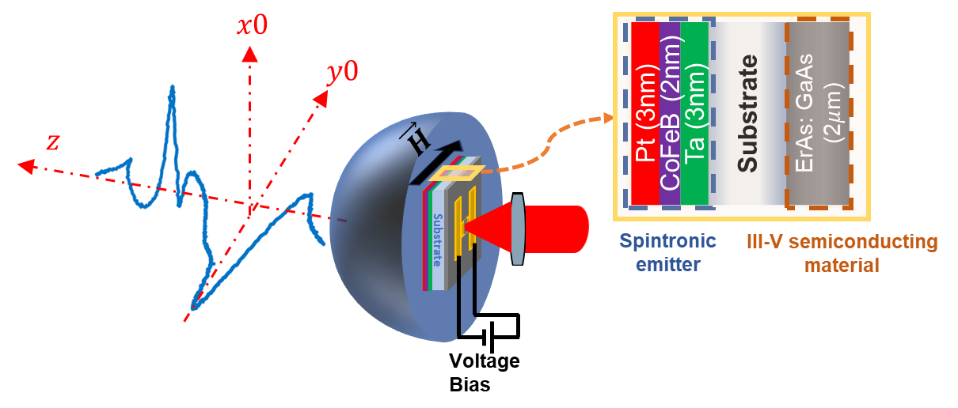
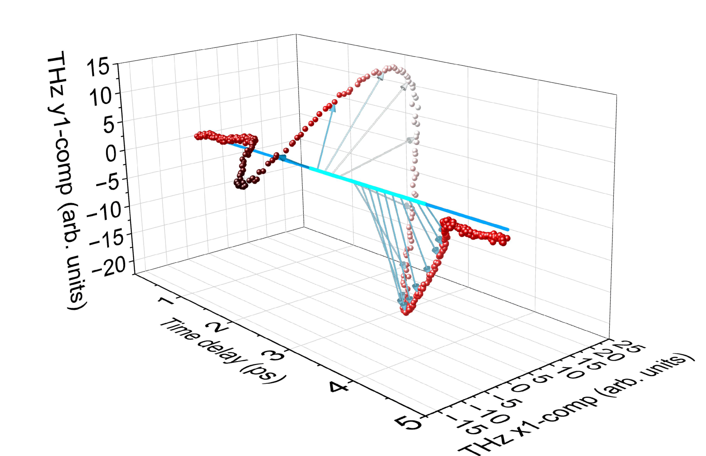
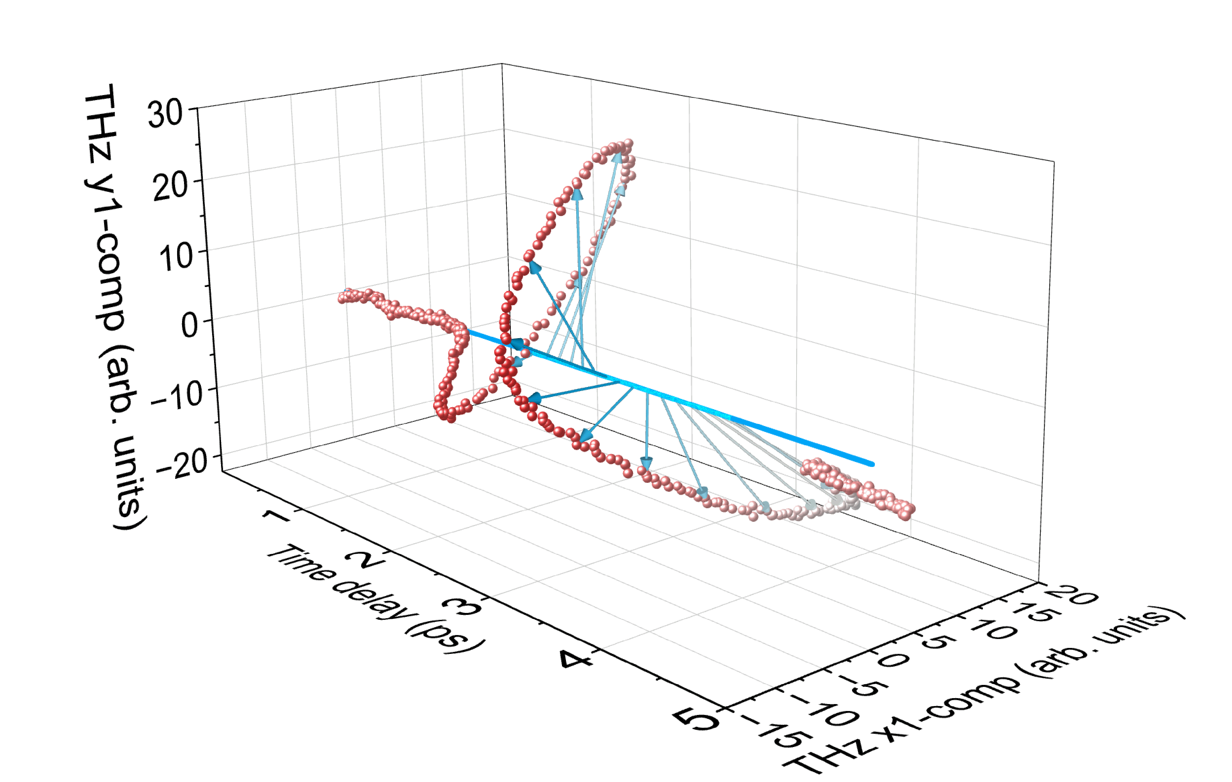
University of Delaware MRSEC
DMR-2011824
Hybrid terahertz emitter for pulse shaping and chirality control
W. Wu¹, W. Acuna², Z. Huang², X. Wang², L. Gundlach³, M. F. Doty², J. M. O. Zide², M. B. Jungfleisch¹
¹Department of Physics and Astronomy, ²Department of Materials Science and Engineering, ³Department of Chemistry and Biochemistry
Realization of a hybrid THz source with improved polarization control that combines the distinct characteristics of two THz emitters integrated into one single device.
This emitter takes advantage of the unique material properties of the spintronic and semiconducting components.
Polarization control between linear and elliptical THz emission and manipulation of the spectrum.
Output THz wave was created by combining the two individual THz pulses, enabling unprecedented pulse shaping and chirality control without external modulators.
(a)
(b)
(c)
$$σ=−1$$
$$σ=+1$$
Fig. (a) Illustration of the spintronic/III-V semiconductor hybrid THz emitter; (b)-(c) Representative THz pulses generated using the hybrid emitter in (a) with left-handed elliptical polarization ($σ=−1$) and right-handed elliptical polarization (($σ=+1$).
Notes:
What Has Been Achieved: We developed and implemented a hybrid THz radiation source that combines a conventional III-V semiconductor-based photoconductive antenna with a spintronic emitter integrated into a single device. This hybrid emitter leverages the unique properties of both components: the wavelength sensitivity of the semiconductor material and the wavelength insensitivity of the spintronic heterostructure. Using this novel hybrid emitter, we achieved unprecedented control over key THz properties, including pulse shape, spectrum, polarization, and chirality, all without the need for external modulators.
Importance of the Achievement: The demonstrated on-chip hybrid THz emitter provides a powerful platform for engineered THz radiation with wide-ranging potential applications.
How is the achievement related to the IRG, and how does it help it achieve its goals? One of the primary goals of this IRG is to understand and control the integration of different material classes to tailor emergent THz functionalities. By combining the unique properties of semiconducting and magnetic materials, we successfully manipulated key THz functionalities such as THz pulse shape and chirality.
Where the findings are published: Adv. Optical Mater. 2024, 2402374. https://doi.org/10.1002/adom.202402374.

