Slide 1
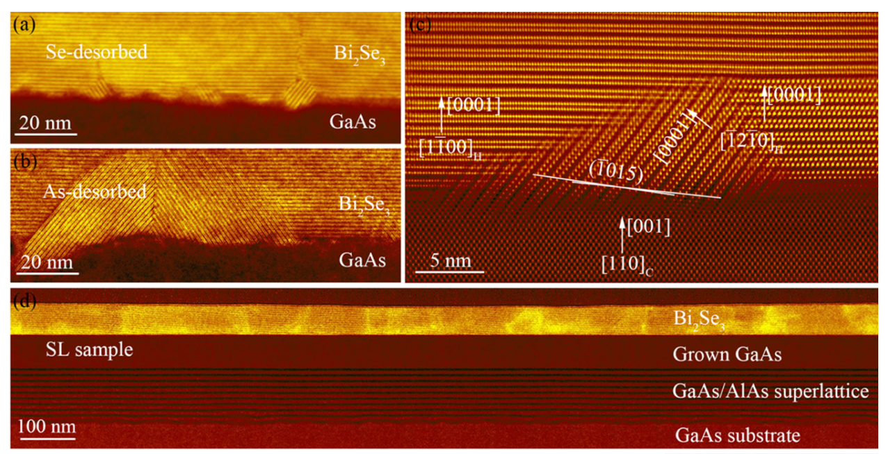
University of Delaware MRSEC
DMR-2011824
Bi₂Se₃ Growth on (001) GaAs Substrates for Terahertz Integrated Systems
Y. Liu¹, W. Acuna¹, H. Zhang², D. Q. Ho¹, R. Hu¹, Z. Wang¹, A. Janotti¹, G. Bryant², A. V. Davydov², J. M. O. Zide¹, and S. Law¹ (¹ University of Delaware (UD); ² NIST)
This work demonstrates that the TI vdW material Bi₂Se₃ can be grown as a single-crystalline single-orientation film on semiconductor substrates with appropriate substrate pre-treatment conditions.
Understanding how to grow smooth, single-orientation Bi₂Se₃ films on technologically relevant III−V materials and understanding the chemical nature of the interface between them is critical for the creation of a THz integrated system design.
This work involved contributions by more than 10 graduate students and advisors in 4 different groups. All these groups are involved in IRG2 of the UD MRSEC. This IRG provided the opportunity for us to collaborate and finish this work together.
Cross-section STEM images for samples with different pre-growth treatment. (a) Sample desorbed in Se overpressure. (b) Sample desorbed in As overpressure. (c) Zoom-in image of As-desorbed sample. (d) GaAs/AlAs superlattice smoothing layer grown before Bi₂Se₃ thin film growth.
Liu, Y. et al. Bi₂Se₃ growth on (001) GaAs substrates for Terahertz Integrated Systems. ACS Applied Materials & Interfaces 14, 42683–42691 (2022). https://doi.org/10.1021/acsami.2c11135
Notes:
What Has Been Achieved: This work demonstrates that the TI vdW material Bi₂Se₃ can be grown as a single-crystalline single-orientation film on semiconductor substrates with appropriate substrate pre-treatment conditions. In particular, atomically flat substrates are needed to grow smooth, single-crystalline films, and this condition can be achieved through the use of smoothing SLs after thermal oxide desorption. Using DFT calculations, we determine that the interface is most likely selenium-terminated with a van der Waals gap between the film and substrate. This conclusion is supported by STEM imaging.
Importance of the Achievement: Understanding how to grow smooth, single-orientation Bi₂Se₃ films on technologically relevant III−V materials and understanding the chemical nature of the interface between them is critical for the creation of a THz integrated system design. More broadly, the ability to integrate van der Waals materials with good crystal quality on common, commercially available substrates is necessary if we wish to create next-generation optoelectronic devices using these materials. This result is the first step toward that realization.
How is the achievement related to the IRG, and how does it help it achieve its goals? This work is done by 4 different research groups in NIST and University of Delaware. All the groups are involved in the UDel MRSEC IRG2. The IRG2 provide the opportunity to gather these groups and collaborate through the experiments, theoretical calculation, and article writing.
Where the findings are published: Liu, Y., Acuna, W., Zhang, H., Ho, D. Q., Hu, R., Wang, Z., Janotti, A., Bryant, G., Davydov, A. V., Zide, J. M., & Law, S. (2022). Bi₂Se₃ growth on (001) GaAs substrates for Terahertz Integrated Systems. ACS Applied Materials & Interfaces, 14(37), 42683–42691. https://doi.org/10.1021/acsami.2c11135

