Slide 1
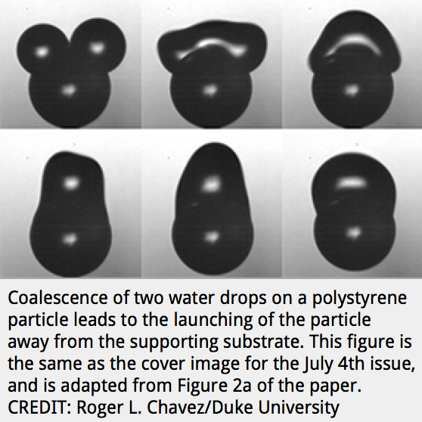
Self-Propelled Bouncing Droplets Remove Contaminants
Researchers at Duke University and the University of British Columbia are exploring whether surfaces can shed dirt without the use of fragile superhydrophobic coatings. In a recent publication in Applied Physics Letters, they investigate the self-propulsion phenomena that occur when two droplets come together, catapulting themselves and any potential contaminants off the surface of interest. According to RT-MRSEC investigator, Chuan-Hua Chen, “When droplets coalesce, or come together on a solid particle, they release energy - analogous to the release of biochemical energy of a human body on a pogo stick. The energy is then converted through the interaction between the oscillating liquid drop and the solid particle - analogous to the storage and conversion of energy by the spring mechanism of the pogo stick.”
RT-MRSEC graduate student fellow, Roger Chavez, inkjet-printed two droplets on a solid particle, which rests on a supporting substrate. As the droplets coalesce, the merged drop not only jumps away from the supporting substrate, but also carries the solid particle along with it. In this case, neither the solid particle nor the supporting substrate are superhydrophobic. This demonstrates the feasibility of engineering self-cleaning, water-repelling surfaces without the extremely fragile nanostructures of superhydrophobic coatings.
R. L. Chavez*, F. Liu*, J. J. Feng, C. H. Chen, "Capillary-inertial colloidal catapults upon drop coalescence," Applied Physics Letters, vol. 109, no. 011601 (2016).
Acknowledgement: NSF RT-MRSEC DMR-1121107

