Slide 1
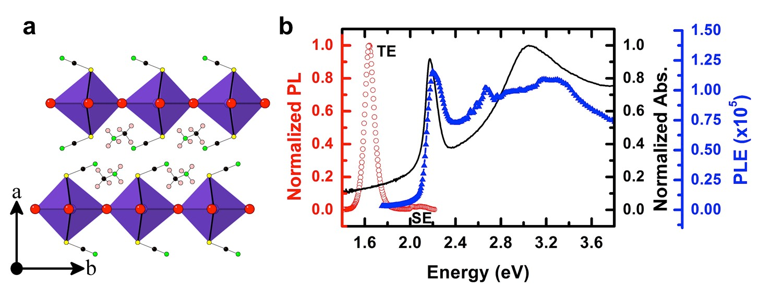
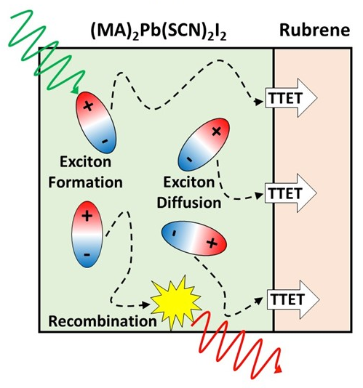
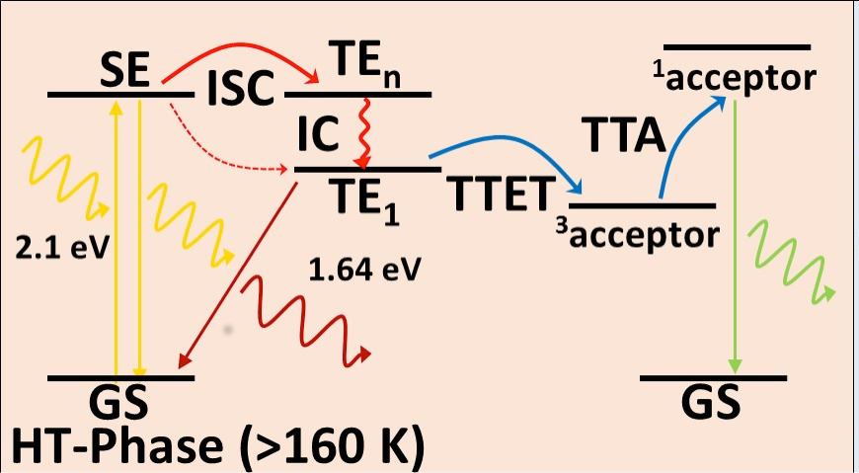
Efficient Generation of Long-lived Triplet Excitons in 2D Hybrid Perovskites
MRSEC 1121107
2016
Triplet Excitons in Hybrid Perovskites
Most recent work on hybrid organic-inorganic perovskites is focused on solar cell applications. Hybrid perovskites, however, provide a flexible platform for materials design, with prospects for many different applications. MAPb(SCN)₂I₂ is a 2D layered perovskite structure, with thiocyanate anions replacing some of the halide ions from the standard structure. Interestingly, optical absorption in this material results in triplet exciton generation with high efficiency. We show that these triplet excitons can diffuse across the material for about 150 nm and can be collected by a triplet acceptor molecule adsorbed on the surface. Moreover we observe annihilation of triplet excitons to form singlets in the upconverting molecules. These observations suggest perovskites may be used in applications such as triplet sensitizers and singlet oxygen generation for photodynamic therapy.
Stefan Zauscher, Director, Research Triangle MRSEC
Top Panel: Crystal Structure and normalized absorption, photoluminescence emission spectra of the proposed perovskite.
Bottom Panel: Left: Proposed mechanism for efficient inter-system crossing for the HT-Phase and LT-Phase. Right: Schematic outlining the exciton diffusion and TTET at the perovskite/rubrene interface.

Slide 2
Efficient Generation of Long-lived Triplet Excitons in 2D Hybrid Perovskites
MRSEC 1121107
2016
Stefan Zauscher, Director, Research Triangle MRSEC
We hosted a group of high school students in our labs at NC State University. The goal of the outreach was to promote careers in scientific areas, with specific emphasis on condensed matter physics and material science.
45 students from diverse backgrounds split into groups and visited labs and performed experiments with the guidance of graduate students. They learned about superconductivity, photovoltaics, light emitting diode processing, laser spectroscopy and friction at the nanoscale.

