Slide 1
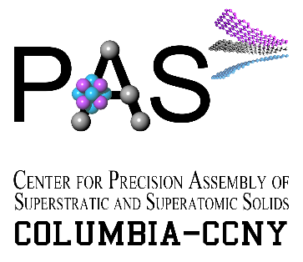
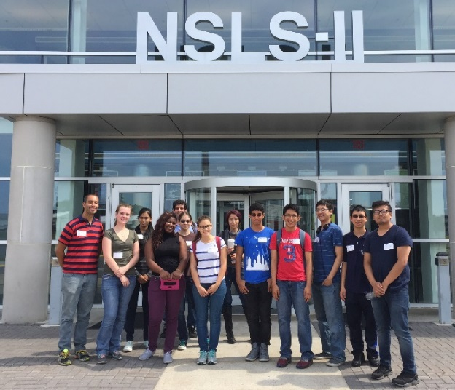
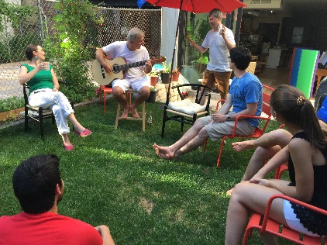
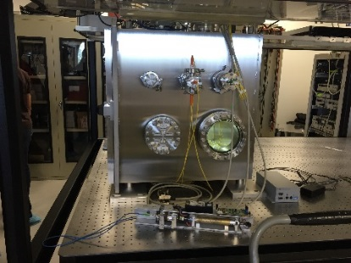
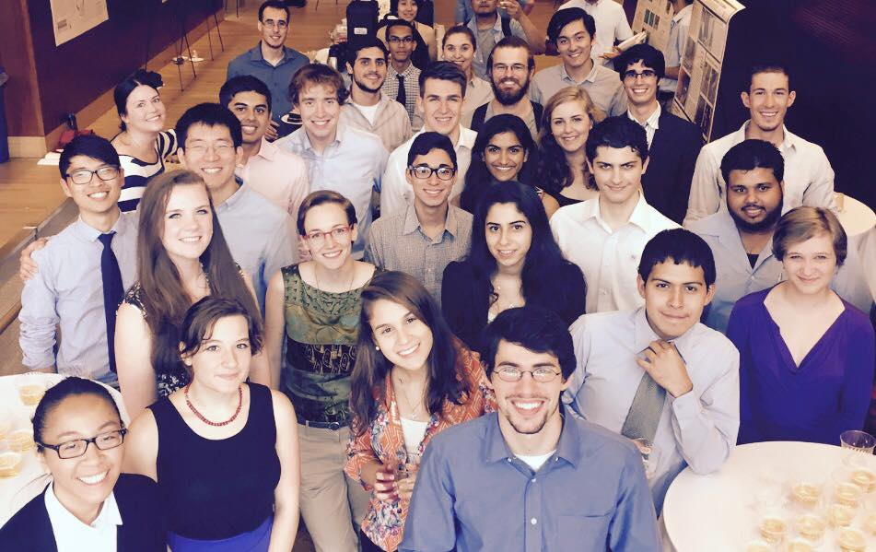
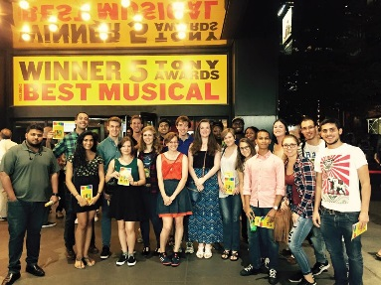
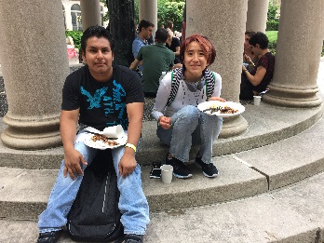
Summer MRSEC outreach and education programs at Columbia University / CCNY
The center seeks to provide graduate and postgraduate training in research and other professional skills; to guide hands-on education about materials and Materials Science, provide support for local teachers, and encourage student research at the secondary level.
Research Experiences for Teachers (RET)
Research Experiences for Undergraduates (REU)
Engineering the Next Generation (ENG)
ENG trip to Brookhaven National Laboratory
LaGuardia Community College
Columbia Secondary School (K-12 school)
REU Symposium Day
Notes:
Please add notes explaining activities (see other highlight slides)

