Slide 1
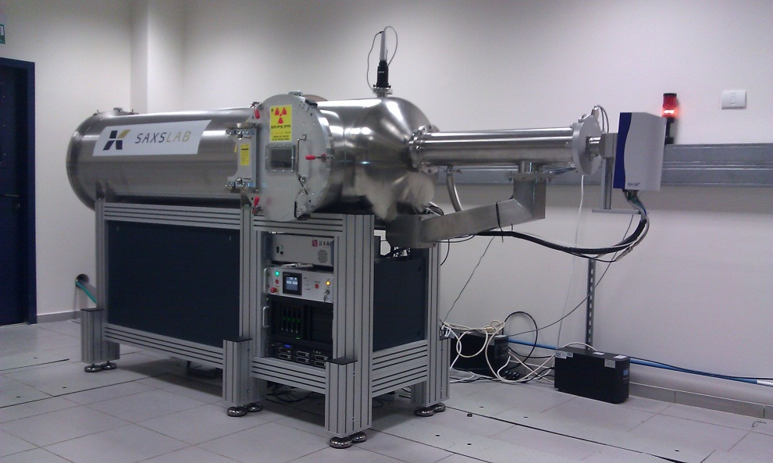
Triangle Small Angle X-Ray
Scattering Facility
Anton Paar SAXSess MC²
With Autosampler
SAXSlab GANESHA 300XL+
In an effort, spearheaded by Triangle MRSEC, we received support through the NSF-MRI program for the purchase of Small Angle X-Ray Scattering (SAXS) instrumentation. The state-of-the-art instruments will serve the greater Research Triangle community for research and education, and will be housed in Duke's Shared Materials Instrumentation Facility (SMIF).
Two, complementary instruments are on order: a slit-collimated SAXSess MC² from Anton Paar, and a point collimated GANESHA 300XL+ from SAXSlab. The SAXSess MC² instrument has very high flux at the sample and will be used for scattering from solutions. The GANESHA 300XL+ is fully automated to cover a broad q-range, and will be used for SAXS, MAXS (medium angle X-ray scattering), WAXS (wide angle X-ray scattering), and GISAXS (grazing incidence X-ray scattering) measurements.
Notes:
Nanodays at the Museum of Life and Science in Durham
A major objective of the ΔMRSEC program in public education is to provide informal educational opportunities about soft matter and nano materials science to the broader public. To this end, ΔMRSEC has partnered with the NC Museum of Life and Science (MLS) in Durham. Through the MLS, which serves as ΔMRSEC’s principle outreach partner, ΔMRSEC can leverage MLS’s projects in the Nanoscale Informal Science Education Network (NISE Net). On March 24, 2012, seventeen ΔMRSEC Fellows, ΔMRSEC Director Lopez, executive Director Boutaud, and Education Director Zauscher, participated in the MLS NanoDays (March 24, 2012). ΔMRSEC was able to reach hundreds of children and adults by presenting ΔMRSEC relevant experiments from the 2012 NanoDays kits. The ΔMRSEC participants were trained by museum staff under leadership of Brad Herring (MLS). Enabled by native Spanish speakers in the ΔMRSEC, some NanoDay kits were presented in Spanish. The activities found enthusiastic reception by Fellows, NCLMS staff, and visitors alike, and form the foundation for additional outreach activities.

