Slide 1
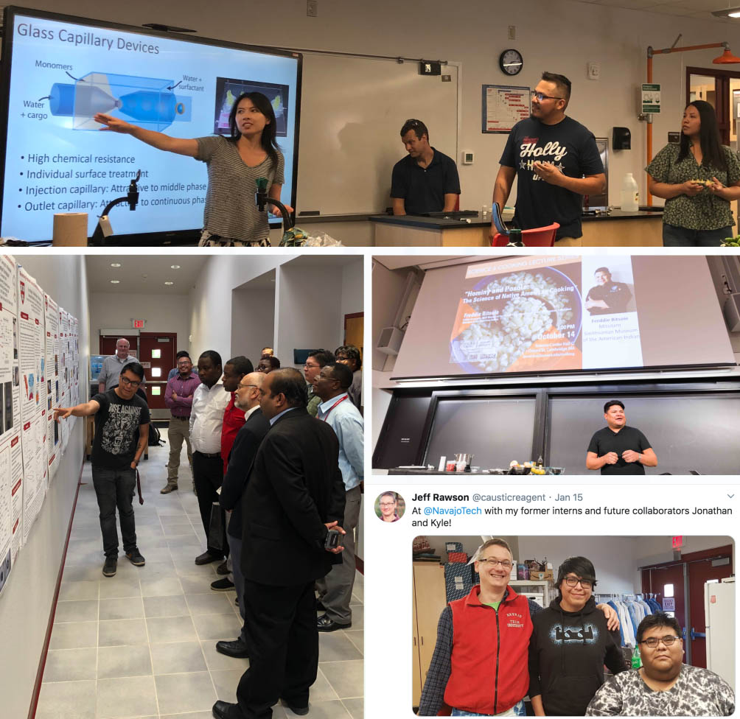
Building Enduring Pathways in STEM: Incorporating Traditional Ways of Knowing in Materials Research Seed PREM: Navajo Tech University – Harvard MRSEC
Harvard MRSEC
DMR-1420570
2019-2020
David A. Weitz (Physics and AppPhy) and
Thiagarajan Soundappan (Navajo Tech Univ, Chem)
This unique partnership between Navajo Technical University (NTU) and the Harvard MRSEC builds enduring pathways for undergraduate Native American students into STEM by including traditional Navajo perspectives and methods of scientific inquiry in materials science research and education. The collaborations between NTU and the MRSEC engages students in materials science research that can be used to address health and environment issues relevant to the Navajo Nation. In 2019-2020, Harvard hosted 7 students in the summer research program, and NTU has brought Harvard postdoctoral fellows and graduate students to the NTU campus for workshops on soft robotics and microfluidics.
Top: Graduate student Yuting (Tina) Huang, postdoctoral fellow Jörg Werner, and NTU REU students Josh Platero and Breanna Thompson lead a workshop on microfluidics at NTU in August 2019. Middle right: Navajo Chef Freddie Bitsoie of Mitsitam Cafe gives a Science & Cooking lecture at Harvard. Bottom right: Postdoctoral fellow during a soft robotics workshops planning visit at NTU. Bottom left: NTU student Jonathan Chinana presents his work at NTU to Dr. Debasis Majumdar of the NSF/PREM program.

