Slide 1
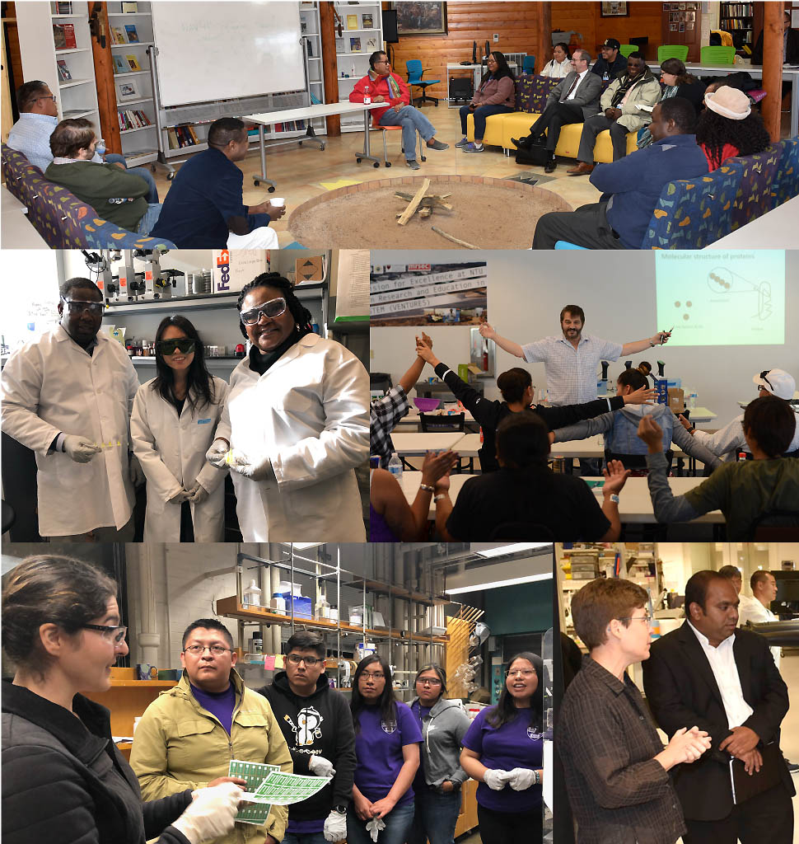
Building Enduring Pathways in STEM: Incorporating Traditional Ways of Knowing in Materials Research Seed PREM: Navajo Tech University – Harvard MRSEC
Harvard MRSEC
DMR-1420570
2018-2019
This unique partnership between Navajo Technical University (NTU) and the Harvard MRSEC will build enduring pathways for undergraduate Native American students into STEM by including traditional tribal perspectives and methods of scientific inquiry in materials science research and education. This new Seed PREM award enables collaborations between NTU and the MRSEC in microfluidics and low-cost sensing to engage students in materials science research that can be used to address health and environment issues relevant to the Navajo Nation. NTU is rapidly growing its STEM undergraduate programs, and the partnership will support research exchanges, internships, and development of classroom and K12 outreach activities that incorporate Navajo traditional ways of knowing.
David A. Weitz (Physics and AppPhy) and
Thiagarajan Soundappan (Navajo Tech Univ, Chem)
Top: Wesley Thomas of the Diné Studies program meets with Dean Frank Doyle (Harvard SEAS), NTU faculty, and Harvard team at the NTU Hooghan. Middle left. NTU faculty Monsuru Ramoni and Irene Anyangwe learn microfluidic techniques from Yuting Huang at Harvard. Middle right. David Weitz presents on science & cooking at NTU. Bottom left. Maral Mousavi of the Whitesides group leads a training on paper electrochemical devices for NTU students. Bottom right: Jennifer Lewis speaks with NTU-PI Thiagarajan Soundappan.

