Slide 1
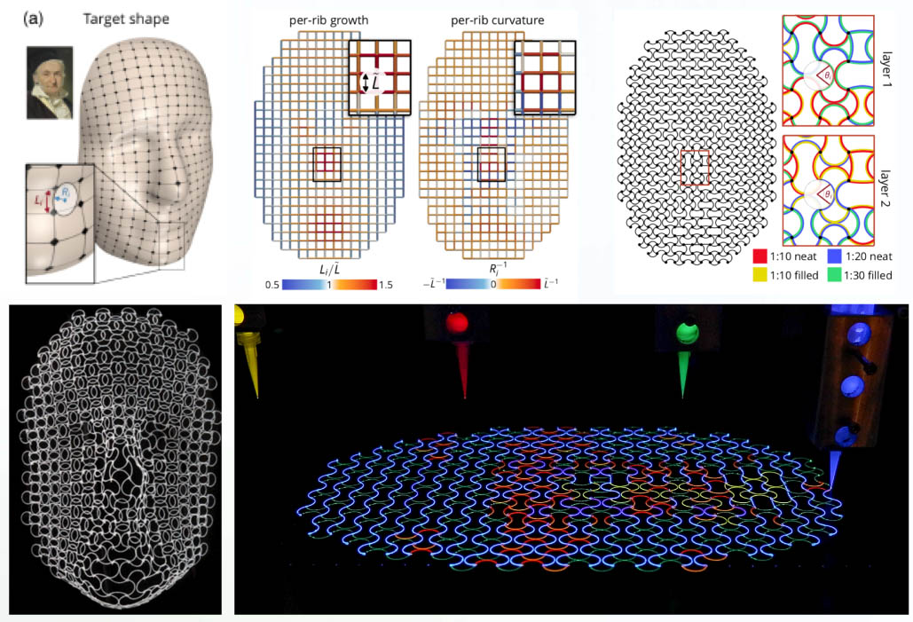
Shape-Shifting Lattices via Multimaterial 4D Printing
Harvard MRSEC
DMR-1420570
2019-2020
L. Mahadevan (Applied Math) & J.A. Lewis (MatSci & BioEng)
A team at the Harvard MRSEC led by Mahadevan and Lewis has created shape-shifting lattices by combining predictive design and multimaterial 4D printing. Inks composed of elastomeric matrices with tunable cross-link density and anisotropic fillers that enable precise control of their elastic modulus (E) and coefficient of thermal expansion (α) are printed in the form of lattices with curved bilayer ribs, whose composition geometry is locally programmed to achieve control over the metric tensor. By patterning bilayer ribs composed of four materials, the team can encode a wide range of 3-dimensional (3D) shape changes in response to temperature. As an exemplar, they designed and printed multimaterial planar lattices that morph into a human face (Gauss) that is geometric complex (see figure).
(top) Predictive design method used to guide multimaterial 4D printing (bottom left) Transformed 3D shape of a human face (Gauss) and (bottom right) Image of lattice with bilayer ribs composed of four different materials of varying stiffness and thermal expansion behavior.
Boley, J.W., W.M. van Rees, C. Lissandrello, M.N. Horenstein, R.I. Truby, A. Kotikian, J.A. Lewis, and L. Mahadevan, “Shape-shifting structured lattices via multimaterial 4D printing,” PNAS 116 (42), 20856-20862 (2019).
Notes:
Guided by predictive design, Mahadevan and Lewis created shape-morphing structured materials by exploiting a combination of multiple materials, geometry, and 4-dimensional (4D) printing as reported in PNAS (citation below). They first created printable inks composed of elastomeric matrices with tunable cross-link density and anisotropic filler that enable precise control of their elastic modulus (E) and coefficient of thermal expansion (α). The inks are printed in the form of lattices with curved bilayer ribs whose geometry is individually programmed to achieve local control over the metric tensor. For independent control of extrinsic curvature, we created multiplexed bilayer ribs composed of 4 materials, which enables us to encode a wide range of 3-dimensional (3D) shape changes in response to temperature. As an exemplar, they designed and printed multi-material planar lattices that morph into a human face (Gauss) that is geometric complex.
Published in PNAS:
Boley, J.W., W.M. van Rees, C. Lissandrello, M.N. Horenstein, R.I. Truby, A. Kotikian, J.A. Lewis, and L. Mahadevan, “Shape-shifting structured lattices via multimaterial 4D printing,” Proceedings of the National Academy of Sciences 116 (42), 20856-20862 (2019), doi: 10.1073/pnas.1908806116.

