Slide 1
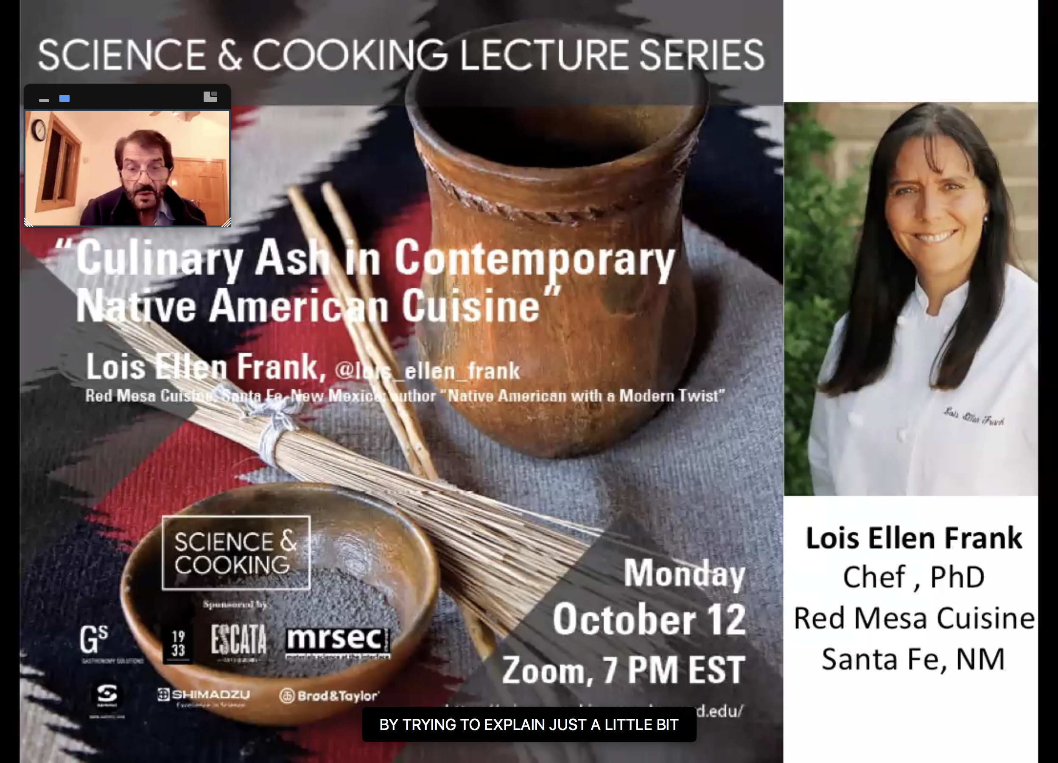
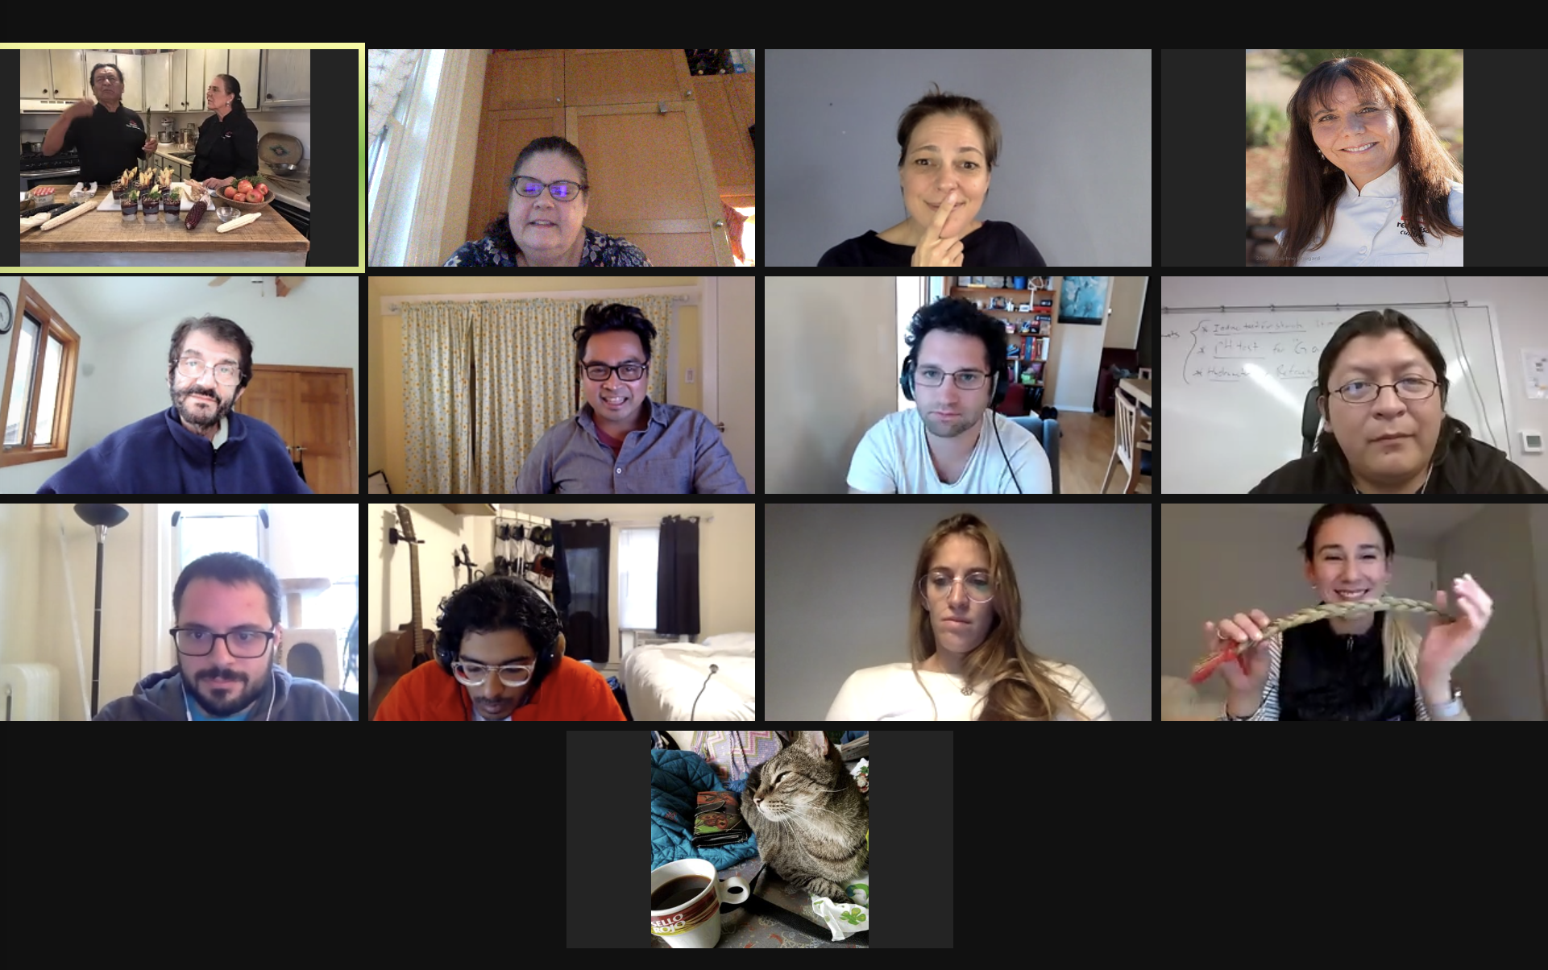
Science and Cooking: Highlighting Indigenous Scientific Innovations and Traditions
Harvard MRSEC
DMR 2011754
2020-2021
The Harvard MRSEC is partnering with Navajo Technical University to develop robust pathways to scientific careers for Native American students. The partnership strives to bring to the forefront scientific traditions and innovations of indigenous peoples. This two-way collaboration has both increased research and education infrastructure at Navajo Tech and influenced course content and community outreach at Harvard University. One example is the inclusion of Native American chefs in the Science and Cooking: From Haute Cuisine to Soft Matter undergraduate course and the associated public lecture series. In October 2020, Chef Lois Ellen Frank, Native American chef, activist, and community leader, worked with Weitz, Brenner, and Pia Sorensen to develop a lesson and public lecture on nixtamalization. Nixtamalization, a technology developed by the indigenous peoples of the Americas, is the process of adding an alkaline solution to corn to release nutrients such as niacin. Navajo Tech students attended the public lecture and course. They are now developing Navajo-specific classroom and outreach activities on nixtamalization.
David A. Weitz (Physics and Applied Physics) and Michael Brenner (Applied Math)
Weitz introduces Chef Lois Ellen Frank during lecture.
Pia Sorensen explains science of burning culinary ash.
Navajo Tech students join small group discussion after class to discuss collaborating in developing nixtamalization activities.

