Slide 1
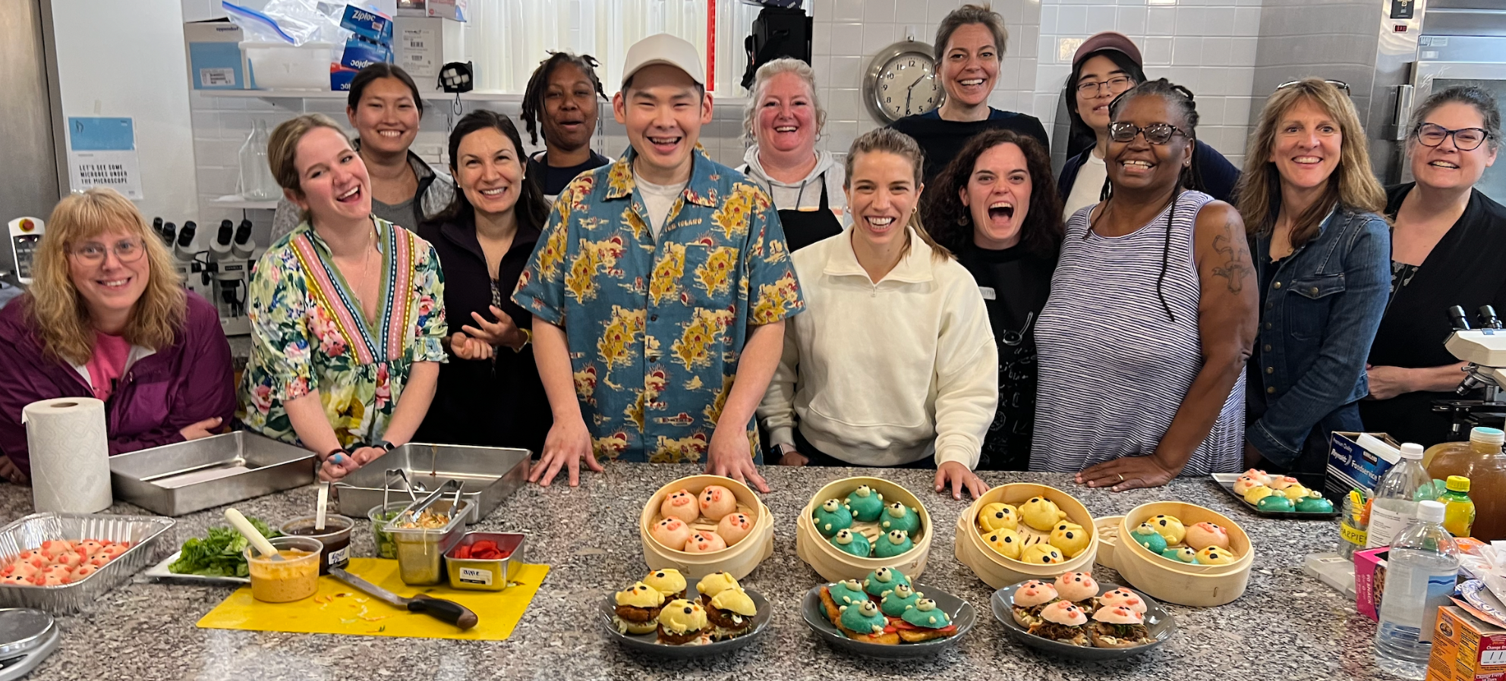
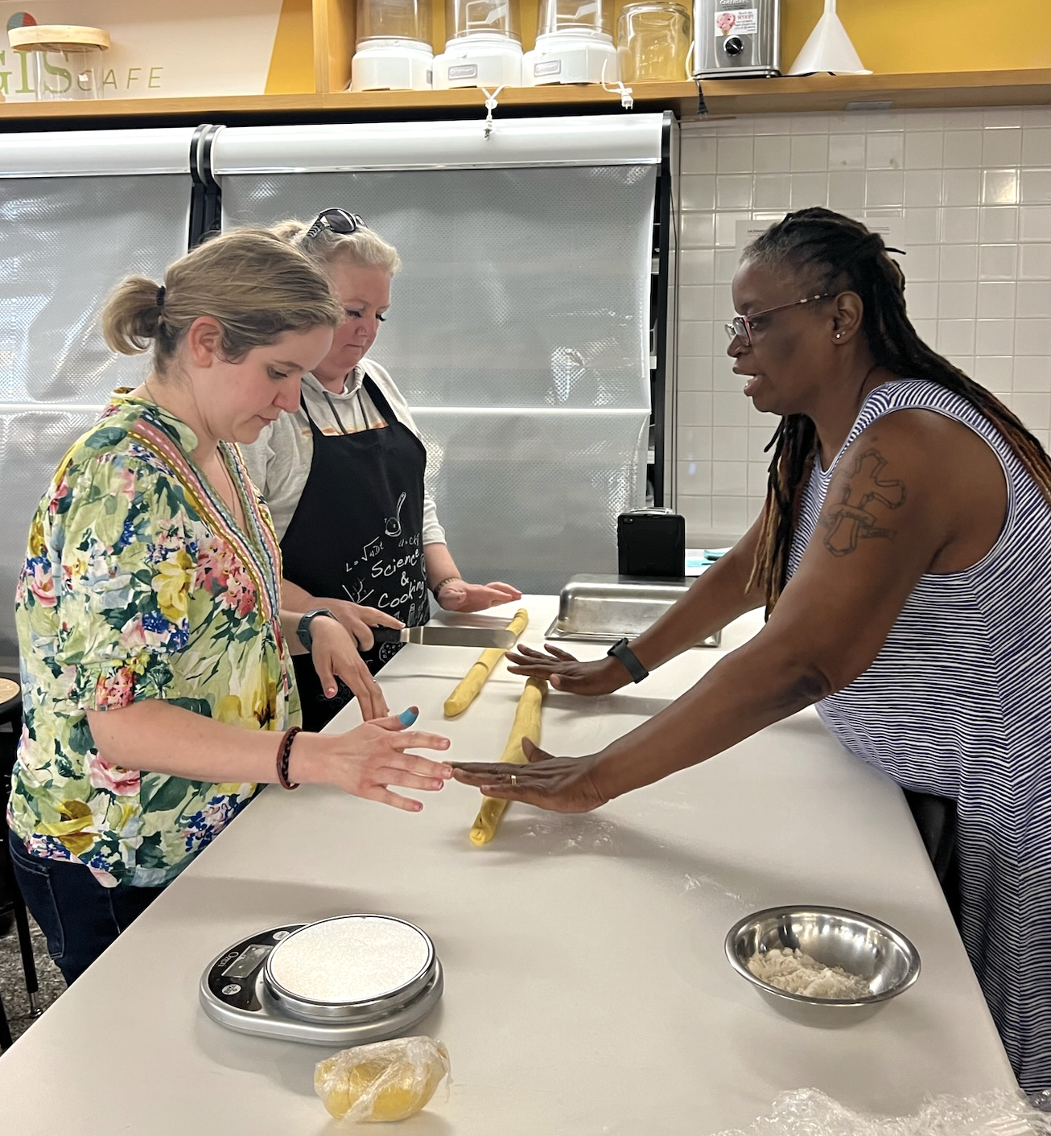
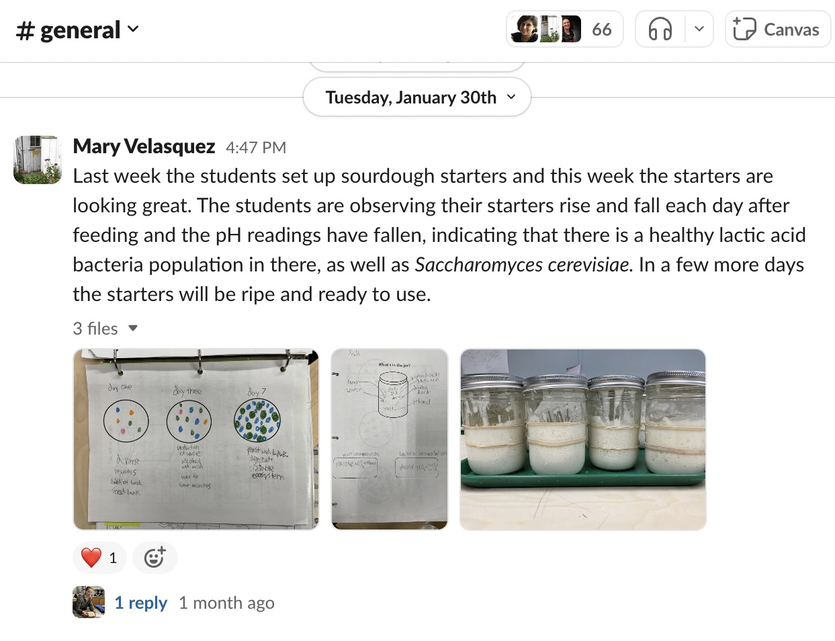
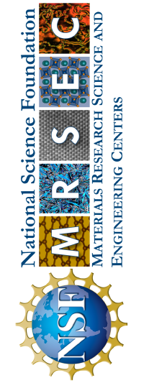
Harvard MRSEC
DMR-2011754
Making soft matter accessible:
Teacher workshops on science & cooking
David Weitz, Kathryn Hollar, Pia Sörensen, and Kate Strangfeld
The Harvard MRSEC engages K-12 teachers and students through the science of everyday materials. Through a collaboration with Bite-Scized Education, led by teacher Kate Strangfeld, the MRSEC co-develops workshops for teachers and after-school programs for K-12 students that are modeled on the Science and Cooking course developed by David Weitz and Michael Brenner and teach science through food and cooking.
In 2023, this partnership grew substantially, offering 5 in-person and virtual workshops and engaging 56 teachers from 25 states. By December 2023, 64% of workshop participants overall and 100% of participants from the in-person workshop implemented at least one lesson in their classroom, with an average of 2.5 lessons implemented, engaging over 620 students. Follow-up support through post-workshop zoom meetings and Slack™ discussions helped drive classroom implementation.
Top: Teachers learn about the science of bao with local chef Jason Doo during summer 2023 in-person teacher workshop. Bottom left: Teachers work in teams to make bao during summer workshop. Bottom right: Teachers share implementation strategies over Slack™.
“The experience my students had doing this science and cooking class was awesome.”
Notes:
What Has Been Achieved: The MRSEC has established a series of teacher workshops that provide hands-on content, both in-person and virtually, for K-12 teachers and students.
Importance of the Achievement: These workshops are highly accessible, and effectively teach students and teachers science concepts through everyday materials – food. The team also includes cultural background, to highlight the historical technical contributions of various cultures in the cultivation and use foods and food preparation techniques.
How is the achievement related to the MRSEC, and how does it help it achieve its goals? Workshops link back to current MRSEC research and education programs, showing novel pathways into materials science.
Where the findings are published: Findings have been disseminated at teacher workshops at the National Science Teachers Association.

