Slide 1
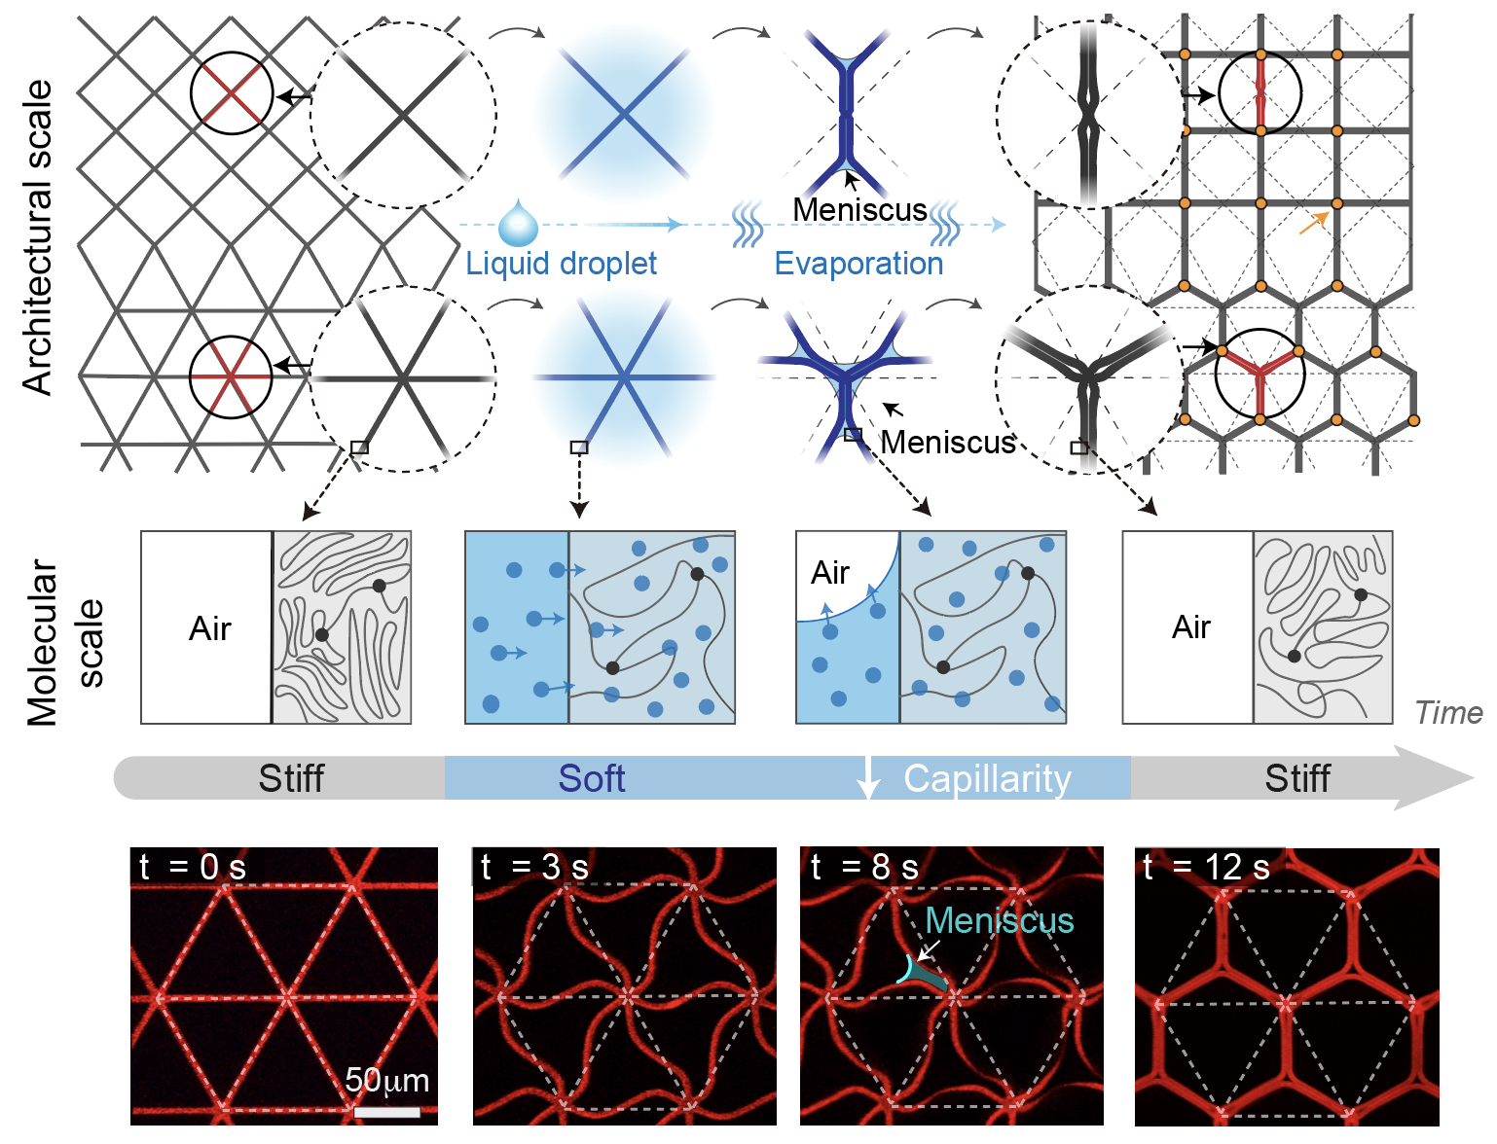
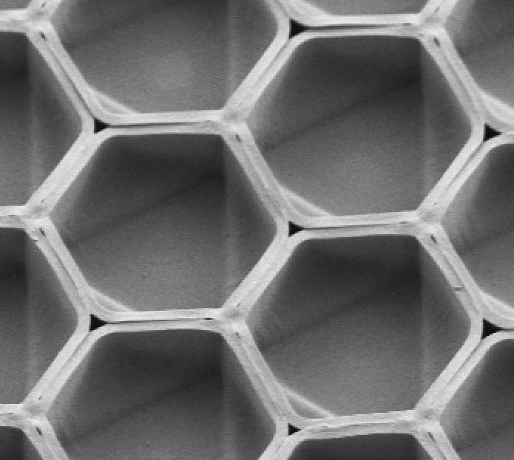
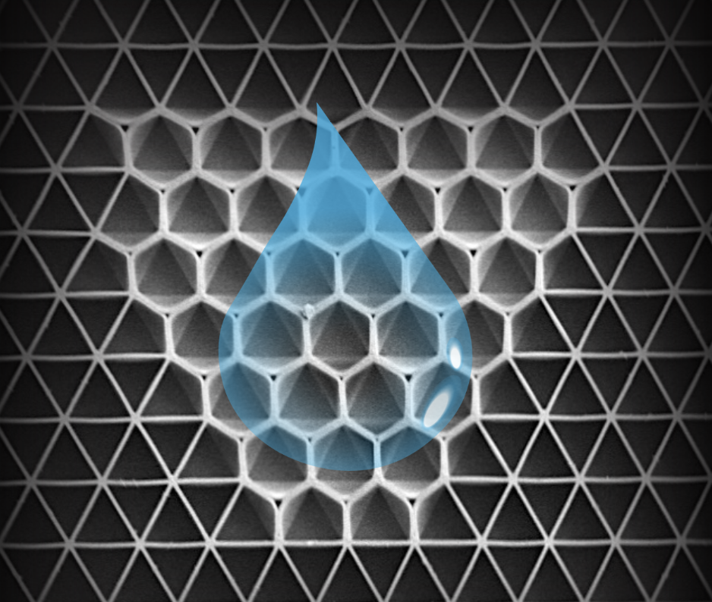
Liquid-induced Topological Transformations of Cellular Microstructures
Harvard MRSEC
DMR 2011754
2020-2021
Joanna Aizenberg (Chemistry and MatSci) and
Katia Bertoldi (MechE)
A team at the Harvard MRSEC led by Aizenberg and Bertoldi has developed a dynamic design strategy to achieve topological transformations of two-dimensional polymeric cellular lattices in a reversible and controllable manner through exposure to different liquids. Guided by a theoretical model that connects lattice geometry, material stiffness, and capillary forces, they created lattices with programmed shape transformations that undergo fast global or localized deformations in response to different liquids. The observed shape changes provide a platform for studying material–topology–dimension interactions and open new avenues to applications in information encryption, selective particle trapping and bubble release, as well as tunable mechanical, chemical and acoustic properties.
100 µm
(left) Strategy of topological transformation occurring at the architectural scale and the molecular scale and corresponding experimental fluorescent confocal images. (top right) Scanning electron microscope images of tilted views of the assembled hexagonal structure. (bottom right) Regional triangular–hexagonal transformations through localized assembly.
Li, S.; Deng, B.; Grinthal, A.; Scheneider-Yamamura, A.; Kang, J.; Martens, R.; Zhang, C.; Li, J.; Yu, S.; Bertoldi, K.; Aizenberg, J.; “Liquid-induced topological transformations of cellular microstructures”, Nature 2021 (in press).

