Slide 1
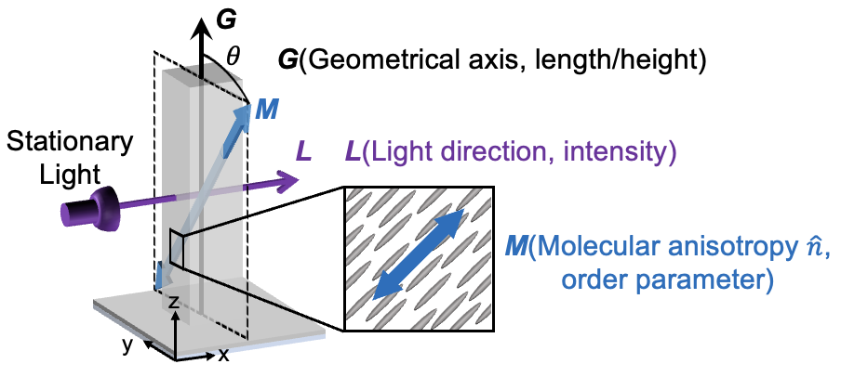
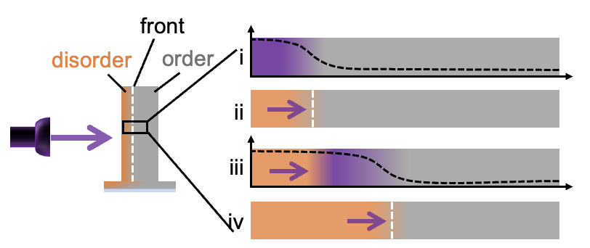
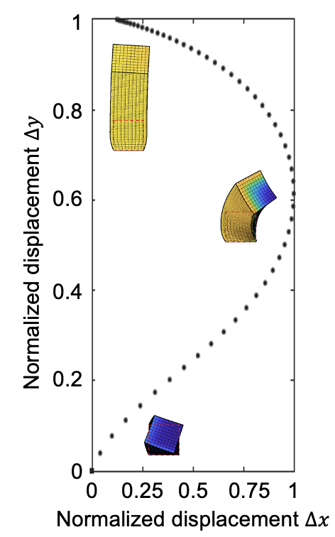
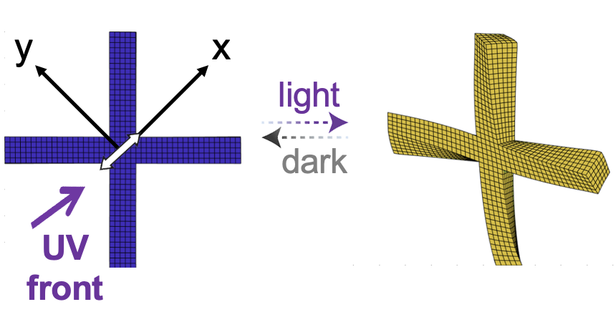
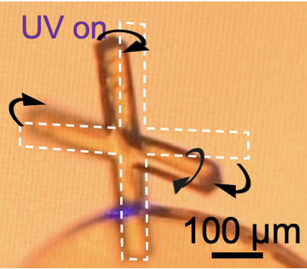
Self-Regulated Non-Reciprocal Motions in Liquid Crystal Elastomer Pillars
Harvard MRSEC
DMR 2011754
2021-2022
Joanna Aizenberg (Chem and MatSci) and Katia Bertoldi (MechE)
Living cilia stir, sweep, and steer via swirling strokes of complex bending and twisting paired with distinct reverse arcs. Efforts to mimic their dynamics rely on multi-material designs, since programming arbitrary motion is difficult in single materials.
A team at the Harvard MRSEC led by Bertoldi and Aizenberg has developed an approach to achieve a diverse trajectories from a single-material system via self-regulation: when a photoresponsive liquid crystal elastomeric pillar with mesogen alignment is exposed to light, it ‘dances’ dynamically as light initiates a traveling order-to-disorder transition front that twists and bends via opto-chemo-mechanical feedback. Guided by a theoretical model, a wide range of trajectories are realized by tailoring light illumination, molecular anisotropy, and geometry. Furthermore, higher order dynamics emerge in micro-pillar arrays and jointed geometries, with broad implications for autonomous actuators used in soft robotics, biomedical devices, and energy transduction materials.
A
Three non-colinear axes
B
Transient propagating bimorph
trans-
cis-
C
D
E
Mirrored stroke
FE
Self-sorting
Jointed microactuators
UV off
UV on
50 μm
(A) Design principle to achieve diverse deformation trajectories: misalignment of molecular anisotropy (M), microstructure geometry (G), and light (L). (B) Formation of a transient propagating bimorph in a single material by directional light-activation with a stationary light source. (C) Upon irradiation from opposite sides, the same microstructure displays mirrored right- and left-handed curved stroke-like trajectories, which are captured by FE modeling. (D) Spontaneous self-organization of strings of microposts into an undulating line. Modeling results on the right. (E) Simulation and experimental results of X-shaped jointed compositionally uniform microactuators exhibit twisting/rotation of the stem and amplified sway motion of the horizontal arms.
S. Li, M.M. Lerch, J.T. Waters, D. Deng,R.S. Martens, Y. Yao, D. Kim, K. Bertoldi, A. Grinthal, A.C. Balazs, and J. Aizenberg, “Self-regulated non-reciprocal motions in single-material microstructures”, Nature (accepted Feb. 2022).
Notes:
A team at the Harvard MRSEC led by Bertoldi and Aizenberg has developed an approach to achieve a diverse trajectories from a single-material system via self-regulation: when a photoresponsive liquid crystal elastomeric pillar with mesogen alignment is exposed to light, it ‘dances’ dynamically as light initiates a traveling order-to-disorder transition front that twists and bends via opto-chemo-mechanical feedback. Guided by a theoretical model, a wide range of trajectories are realized by tailoring light illumination, molecular anisotropy, and geometry.
This work was funded in part by the Harvard MRSEC and recently accepted for publication:
Li, S.*, M.M. Lerch*, J.T. Waters, B. Deng, R.S. Martens, Y. Yao, D. Kim, K. Bertoldi, A. Grinthal, A.C. Balazs, and J. Aizenberg, “Self-regulated non-reciprocal motions in single-material microstructures,” Nature (accepted Feb 2022).

