Slide 1
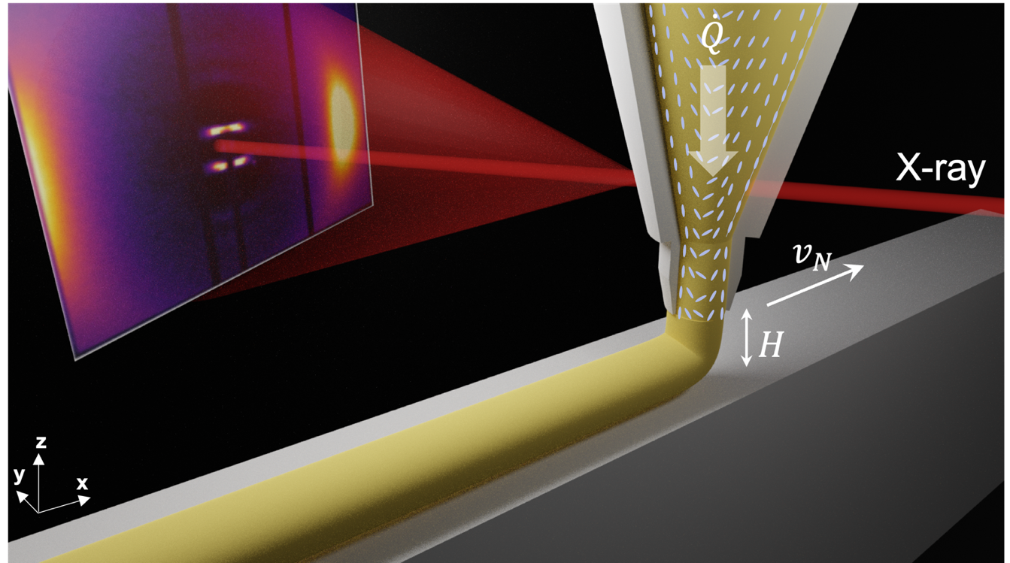
Spatially Programmed Alignment and Actuation
in Printed Liquid Crystal Elastomers
Harvard MRSEC
DMR-2011754
Jennifer Lewis, Caitlyn Cook (LLNL) and Ronald Pindak (BNL)
Aligned liquid crystal elastomers (LCEs) are soft materials that exhibit reversible actuation akin to human muscles when thermally cycled above their nematic-to-isotropic transition temperature. Lewis and collaborators studied the effects of LCE ink composition, nozzle geometry, and printing parameters on director alignment. By combining rheological measurements, in-operando microbeam X-ray scattering, and simulation, we show that the dimensionless Weissenberg (Wi) number, which characterizes ink flow through tapered and hyperbolic nozzles, directly correlates with director alignment in printed LCE filaments. By altering the value of Wi on-the-fly during printing, one can fabricate monolithic LCE actuators with spatially programmable alignment, stiffness, and actuation strains.
Telles, R., A. Kotikian, G. Freychet, M. Zhernenkov, P. Wąsik, B.M. Yavitt, J.L. Barrera, C.C. Cook, R. Pindak, E.C. Davidson, and J.A. Lewis, “Spatially programmed alignment and actuation in printed liquid crystal elastomers,” Proceedings of the National Academy of Sciences 122 (3), e2414960122 (2025). DOI: 10.1073/pnas.2414960122. Data are available at doi.org/10.1073/pnas.2414960122.
A B B
C
Figure 1. (A) In operando X-ray characterization of LCE alignment during printing. (B) Radially-resolved alignment for LCE filaments printed at Wi_{max} = 0.5 (top images) and orientational order parameter across LCE filament radius (bottom plot). (C) Average orientational order parameter in printed LCEs as a function of Wi_{max} alongside compared to theory. (D) Tensile stress as a function of strain. (E) Actuation strain measured parallel to print path versue temperature.
Notes:
What Has Been Achieved: Fundamental understanding of the effects of LCE composition, nozzle geometry, and printing parameters on director alignment in LCEs via in operando microbeam x-ray scattering and simulation.
Importance of the Achievement: This work represents the first in operando characterization of the role of shear and extensional flow on LCE director alignment.
How is the achievement related to the IRG, and how does it help it achieve its goals? This work strongly aligns with the IRG1 goal of synthesizing soft matter with programmable multiscale architectures and functionality
Where the findings are published: Telles, R., A. Kotikian, G. Freychet, M. Zhernenkov, P. Wąsik, B.M. Yavitt, J.L. Barrera, C.C. Cook, R. Pindak, E.C. Davidson, and J.A. Lewis, “Spatially programmed alignment and actuation in printed liquid crystal elastomers,” Proceedings of the National Academy of Sciences 122 (3), e2414960122 (2025). DOI: 10.1073/pnas.2414960122. Data are available at doi.org/10.1073/pnas.2414960122.

