Slide 1
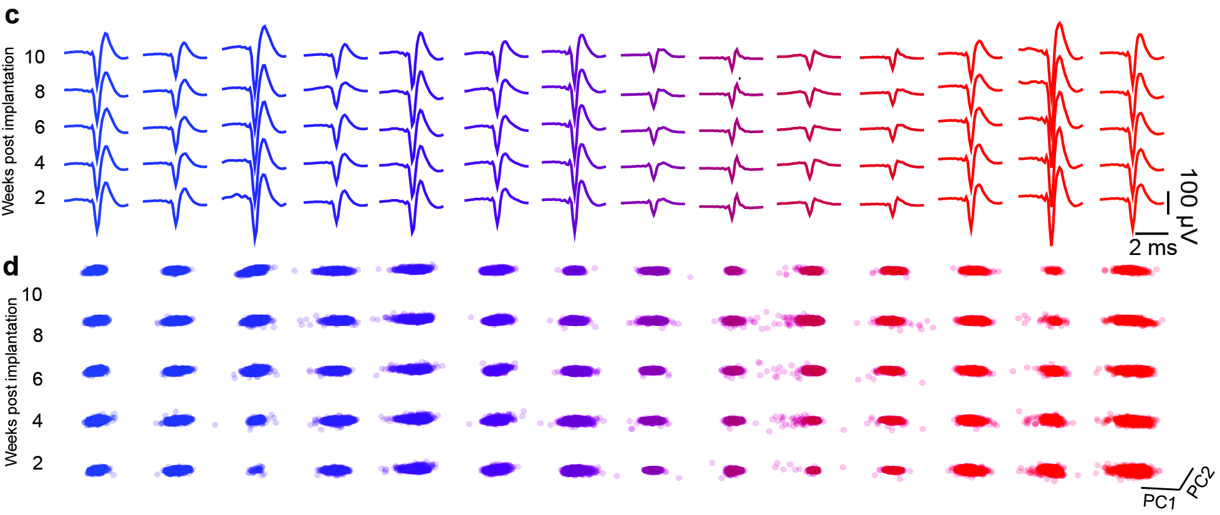
Harvard MRSEC
DMR-2011754
Soft bioelectronics for in vivo neural probes
Jia Liu, Katia Bertoldi, Boris Kozinsky, and Zhigang Suo
Existing high-resolution neural recording devices cannot achieve simultaneous scalability on both spatial and temporal levels due to a trade-off between sensor density and mechanical flexibility. A team lead by Liu, Bertoldi, Kozinsky, and Suo have introduced a three-dimensional (3D) stacking implantable electronic platform, based on perfluorinated dielectric elastomers and tissue-level soft multilayer electrodes, that enables spatiotemporally scalable single-cell neural electrophysiology. The 3D integrated multilayer soft electrode array retains tissue-level flexibility, reduces chronic immune responses when implanted in neural tissues, and reliably tracks electrical activity in a mouse brain over months.
Le Floch, Zhao, Liu, Molinari, Medina, Shen, Wang, Kim, Sheng, Partarrieu, Wang, Sessler, Zhang, Park, Gong, Spencer, Lee, Ye, Tang, Wang, Bertoldi, Lu, Kozinsky, Suo, and Liu, “3D spatiotemporally scalable in vivo neural probes based on fluorinated elastomers,” Nature Nanotechnology (2024).
Soft bioelectronic neural probes. (a) Schematic view of neural probe placement in brain tissue and scalability comparison, (b) Image of neural probe array, (c) Representative average and (d) clusters of waveforms from 2-10 weeks post-implantation.
Notes:
What Has Been Achieved: A new soft photoresist based on perfluorinated dielectric elastomers for 3D stacking implantable electronic platform that enables spatiotemporally scalable single-cell neural electrophysiology in the nervous system.
Importance of the Achievement: This method enables the photopatterning of tissue-level soft electronics into a scalable platform to increase both spatial coverage and longevity of neural recording for the next-generation flexible brain-computer interfaces.
How is the achievement related to the IRG, and how does it help it achieve its goals? This achievement is supported by seed grant and successfully promote the collaborations among several faculty members supported by IRG.
Where the findings are published: P. Le Floch, S. Zhao, R. Liu, N. Molinari, E. Medina, H. Shen, Z. Wang, J. Kim, H. Sheng, S. Partarrieu, W. Wang, C. Sessler, G. Zhang, H. Park, X. Gong, A. Spencer, J. Lee, T. Ye, X. Tang, X. Wang, K. Bertoldi, N. Lu, B. Kozinsky, Z. Suo and J. Liu, “3D spatiotemporally scalable in vivo neural probes based on fluorinated elastomers,” Nature Nanotechnology (2024); https://www.nature.com/articles/s41565-023-01545-6.

