Slide 1
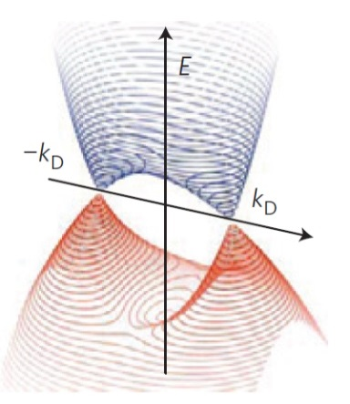
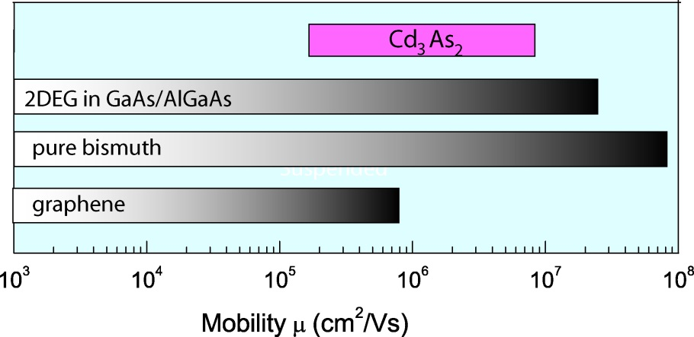
Ultrahigh Electron Mobility in a Dirac semimetal
IRGA: Princeton Center for Complex Materials (DMR-0819860) T. Liang, Q. Gibson, M. Ali, M. Liu, R. J. Cava, N. P. Ong
A
B
C
Figure (A) Back scattering of electrons degrades mobility. (B) Schematic of the dispersion of the bulk Dirac states in Cd₃As₂. (C) Comparison of the mobilities (at 4 K) in Cd₃As₂ , the 2DEG in GaAs/AlGaAs quantum wells, in pure bismuth and graphene.
What limits the conductivity in a metal? At 4 K, the electron mobility, which measures the current carried per electron, is limited only by scattering from impurities (Fig. A). Currently, the highest mobilities achieved are 30 million cm²/Vs in the 2D electron gas (2DEG) in GaAs-AlGaAs quantum wells, 90 million cm²/Vs in ultrapure bulk bismuth, and 1 million cm²/Vs in suspended graphene (Panel C). Research on topological materials sheds new light on this question. In topological insulators (e.g. Bi₂Se₃), the quantum properties at the surface can enhance the mobility by “protecting” the electrons against back-scattering events, which reverse their momentum (Panel A). Recently, strong interest has focused on a new class of materials called Dirac semimetals, which are 3D analogs of graphene (Fig. B). Liang et al. reports [1] mobilities in Cd₃As₂ (9 million cm²/Vs) comparable to those seen in GaAs-AlGaAs and Bi, even though the Cd₃As₂ crystals show significant lattice disorder. Although the mechanism that shields the electrons from back scattering in Cd₃As₂ is still not understood, the experiments show that it is rapidly suppressed when a magnetic field is applied. The research may lead to future applications in ultralow-dissipation electronics.
T. Liang et al., “Ultrahigh mobility and giant magnetoresistance in a Dirac semimetal, Cd₃As₂,” Nature Materials, 14, 280 (2015), DOI: 10.1038/NMAT4143
Research supported by U. S. National Science Foundation and the Army Research Office.

