Slide 1
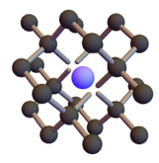
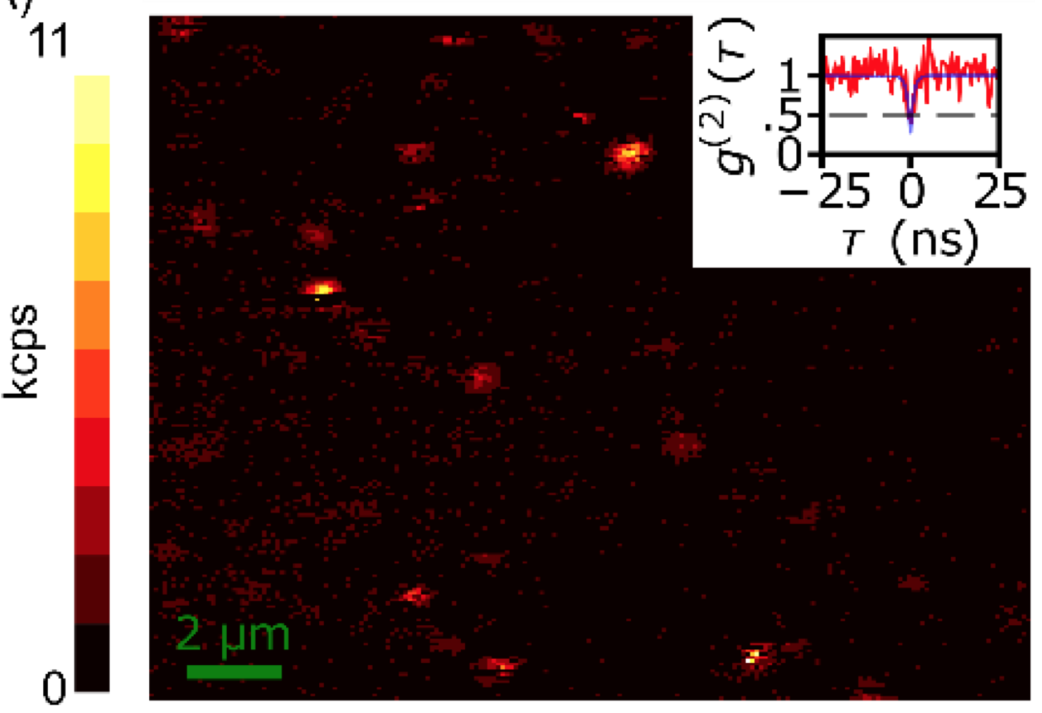
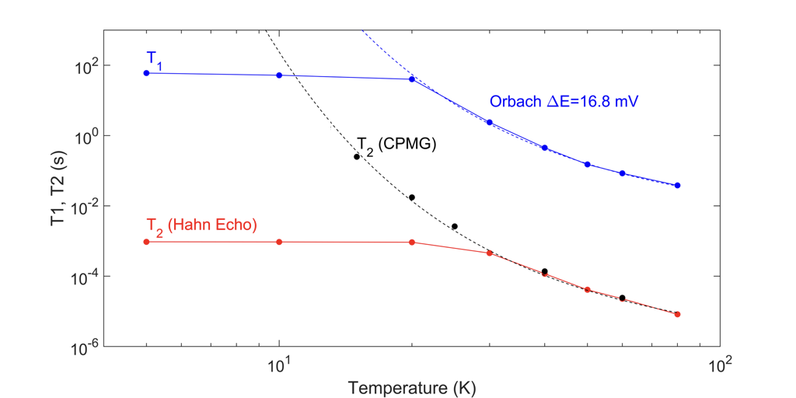
New color centers in diamond for quantum information science
DMR 01420541
2016
Nathalie P. de Leon and Stephen A. Lyon
Princeton University
Color centers in diamond are a promising platform for quantum information science, as they can serve as solid state quantum bits with efficient optical transitions. Much recent attention has focused on the negatively charged NV center in diamond, which can be measured and initialized optically, exhibits long spin coherence times at room temperature, and has narrow, spin-conserving optical transitions. However, the NV center exhibits a large static and dynamic inhomogeneous optical linewidth, and over 97% of its emission is in a broad, incoherent phonon side band, severely limiting scalability. Alternatively, the negatively charged SiV center exhibits excellent optical properties, with 70% of its emission in the zero phonon line and a narrow inhomogeneous linewidth. However, SiV⁻ suffers from short electron spin coherence times, limited by an orbital relaxation rate (T₁) of around 40 ns at 5 K. Informed by the limitations of NV⁻ and SiV⁻, we have developed new methods to control the diamond Fermi level in order to stabilize the neutral charge state of SiV, thus accessing a new spin configuration. SiV⁰ exhibits a T₁ approaching one minute at 4 K, and >90% of its emission is in its zero phonon line. These properties make it a particularly promising candidate for applications in long distance quantum communication.
Fig. 1 Ball and stick model of SiV⁰ in diamond. The Si atom (blue) sits in an interstitial site, giving rise to an inversion symmetric geometric configuration.
Fig. 2 Scanning confocal microscope image showing photoluminescence from single SiV⁰ centers.
Fig. 3 Time-resolved electron spin resonance measurements of SiV⁰ showing long spin relaxation and coherence times

Slide 2
New color centers in diamond for quantum information science
DMR 01420541
2016
Nathalie P. de Leon and Stephen A. Lyon
Princeton University
As part of the outreach related to color centers in diamond, the de Leon group developed a new public demo to show interesting properties of diamond, and specifically to show the role that defects can play in material properties. This demo was developed in collaboration with Element Six (UK) and Dan Steinberg.
De Leon group students participate in a public demonstration at Nano Day in the Princeton Public Library. The demo, developed with Element Six, shows a large area diamond for “ice cutting,” differently colored diamonds to demonstrate the role of impurities in optical properties, and a diamond heavily doped with NV centers, in which red fluorescence can be seen with the naked eye by shining a green laser pointer on the sample.

