Slide 1
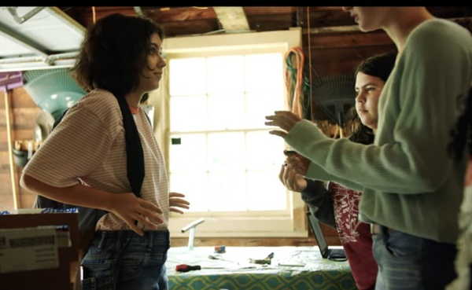
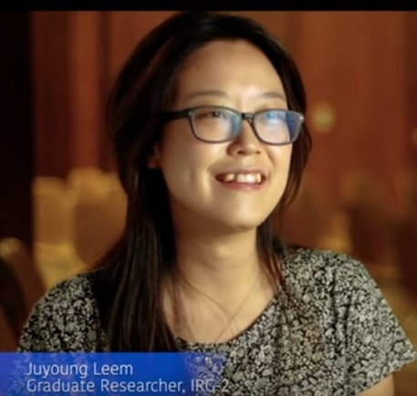
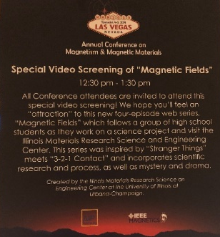
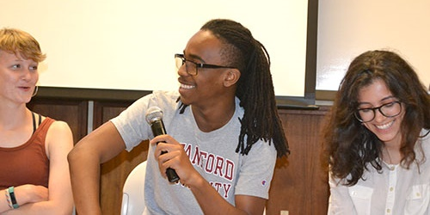
I-MRSEC educational web series: “Magnetic Fields”
Illinois MRSEC
DMR- 1720633
2020
University of Illinois at Urbana-Champaign
In Summer 2019 the I-MRSEC officially released the web series “Magnetic Fields,” which follows middle school aged characters as they encounter a new material at the I-MRSEC, and emphasizes the scientific process, persistence, and the diversity of scientists. The episodes include “Behind the science,” featuring interviews with I-MRSEC researchers sharing their paths in science and advice to those interested in STEM studies.
The series, which involves 21 MRSEC faculty and students, was released onto YouTube and the I-MRSEC website, allowing it to reach a broad audience (the trailer alone has almost 2000 views). On August 1, 2019, the I-MRSEC hosted a campus-wide video release party which included a Q&A with Mason, the director of the series John Isberg, and several actors. “Magnetic Fields” was accepted for inclusion in the Sigma Xi STEM Art & Film Festival in November 2019 in Madison, WI. A screening of “Magnetic Fields” was held during the 2019 MMM Conference in Las Vegas.
b)
a)
d)
e)
c)
Fig. 1: a) Screenshot from episode 2 of series, featuring a cameo by I-MRSEC grad student Oolman. b) Scene in which magnetic materials are illustrated. c) Actors share the impact of participating in the series during the release party on August 1, 2019. d) I-MRSEC grad student Leem discussing her path in science during a post-episode “Behind the science” clip. e) Poster advertising the screening at the MMM Conference in Las Vegas in November 2019.
Watch the trailer here: https://www.youtube.com/watch?v=0pIKyX5aK7g
Series available for streaming via the I-MRSEC YouTube Channel:
episode 1, episode 2, episode 3, and episode 4.
Read more: “Via I-MRSEC’s Magnetic Fields Web Series, Youth Discover Magnetism, Diversity in Science” (9/19/19) http://www.istem.illinois.edu/news/imrsec.magnetic.fields.html

