Slide 1
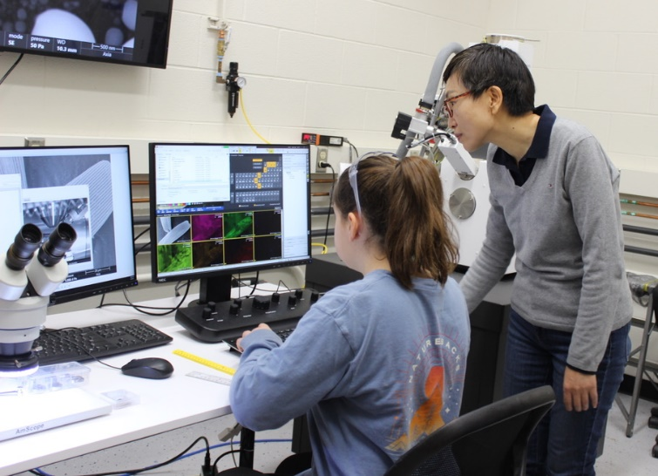
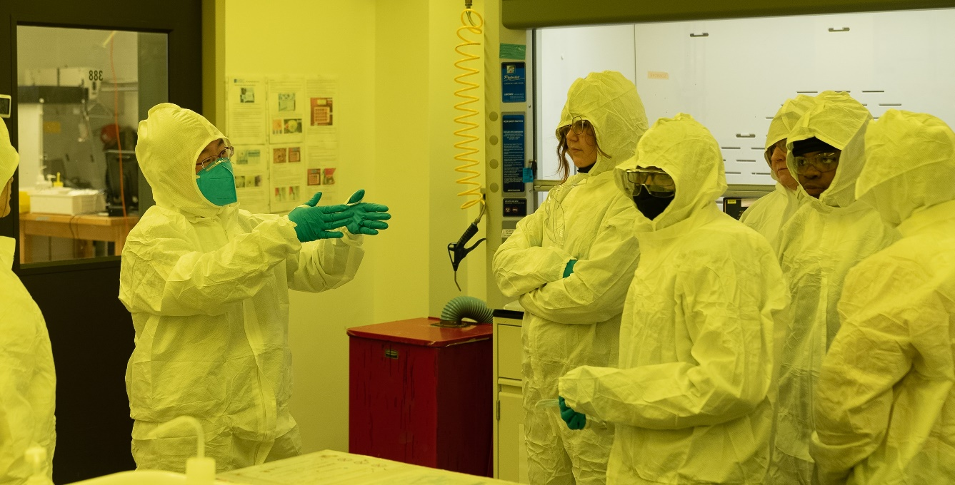
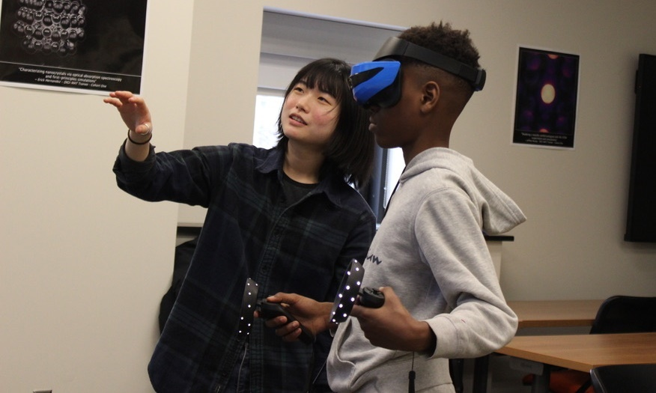
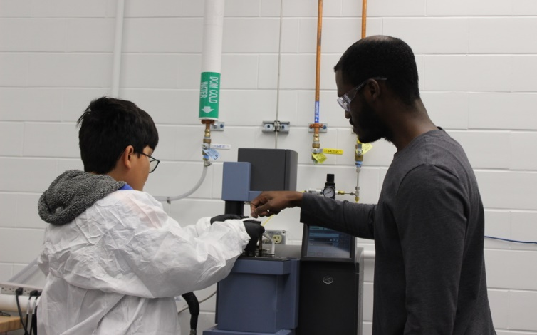
Illinois MRSEC
DMR-1720633
Franklin Middle School Visits the I-MRSEC
In February 2023, the I-MRSEC hosted over 40 middle schoolers and teachers from Franklin STEAM Academy, a Champaign public middle school, at Materials Research Lab for a day of hands-on activities and lab visits. This visit was part of an annual 8-week program that teaches materials science concepts, which students then turn into music or art themed projects to express those concepts.
I-MRSEC students and postdocs led groups through the building between many activities, such as operating a scanning electron microscope to look at butterfly wings, using an x-ray diffractometer to discern between sugar and salt, and experiencing crystal structures through virtual reality. They also suited to tour of the cleanroom.
Program evaluations showed that participants gained knowledge in what materials scientists study and its use in technologies that benefit them.
“The high point of the tour for me was chatting with students on how we do research with the introduced instruments, beyond the demos shown during the tour. Students in my group were very engaged with the demos, and some even wanted to know how our life as a graduate researcher was and what the actual research projects we worked on were.”
-I-MRSEC graduate student
Read more here: https://www.istem.illinois.edu/news/Franklin.MRL.visit.2023.html
Clockwise, from upper left: Middle schooler operating a scanning electron microscope to study a butterfly wing; group of students in the clean room; student using virtual reality to study crystals; student loading a sample into the dynamical material analyzer to study the force to snap a piece of chocolate.
Notes:
What Has Been Achieved: Tour of a materials characterization facility to engage middle schoolers in state-of-the-art science tools and interact with scientists.
Importance of the Achievement: Broadening participation in science to K-12 students.
How is the achievement related to the IRG, and how does it help it achieve its goals? Many of the tools and techniques students encountered are relevant to both IRGs of the I-MRSEC, including x-ray diffraction, scanning electron microscopy, and virtual reality.
Where the findings are published: https://www.istem.illinois.edu/news/Franklin.MRL.visit.2023.html

