Slide 1
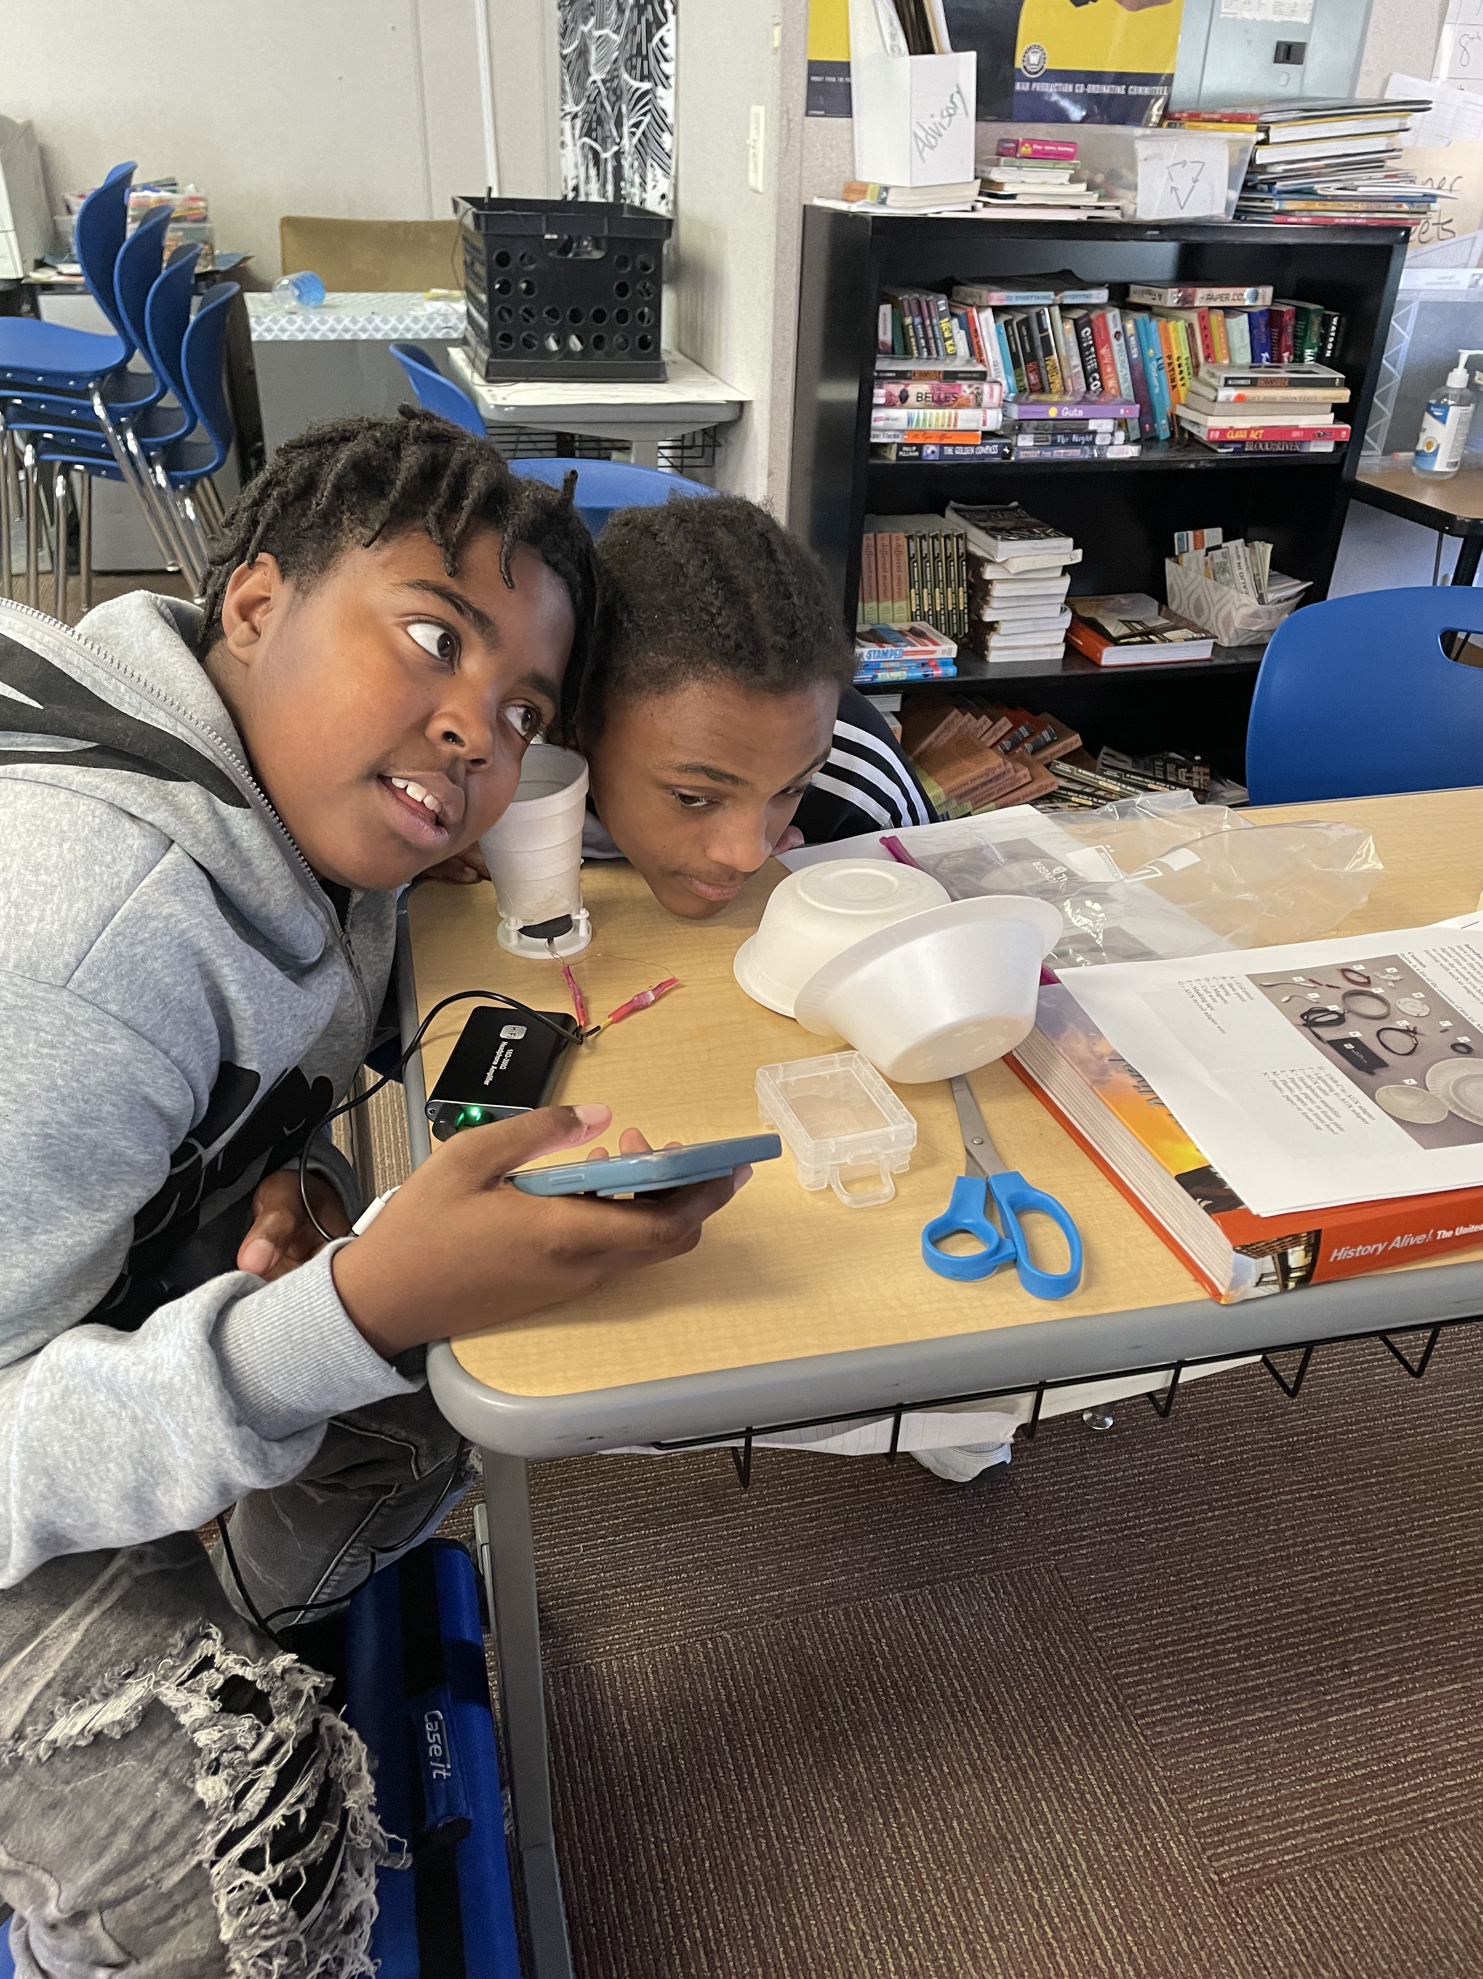
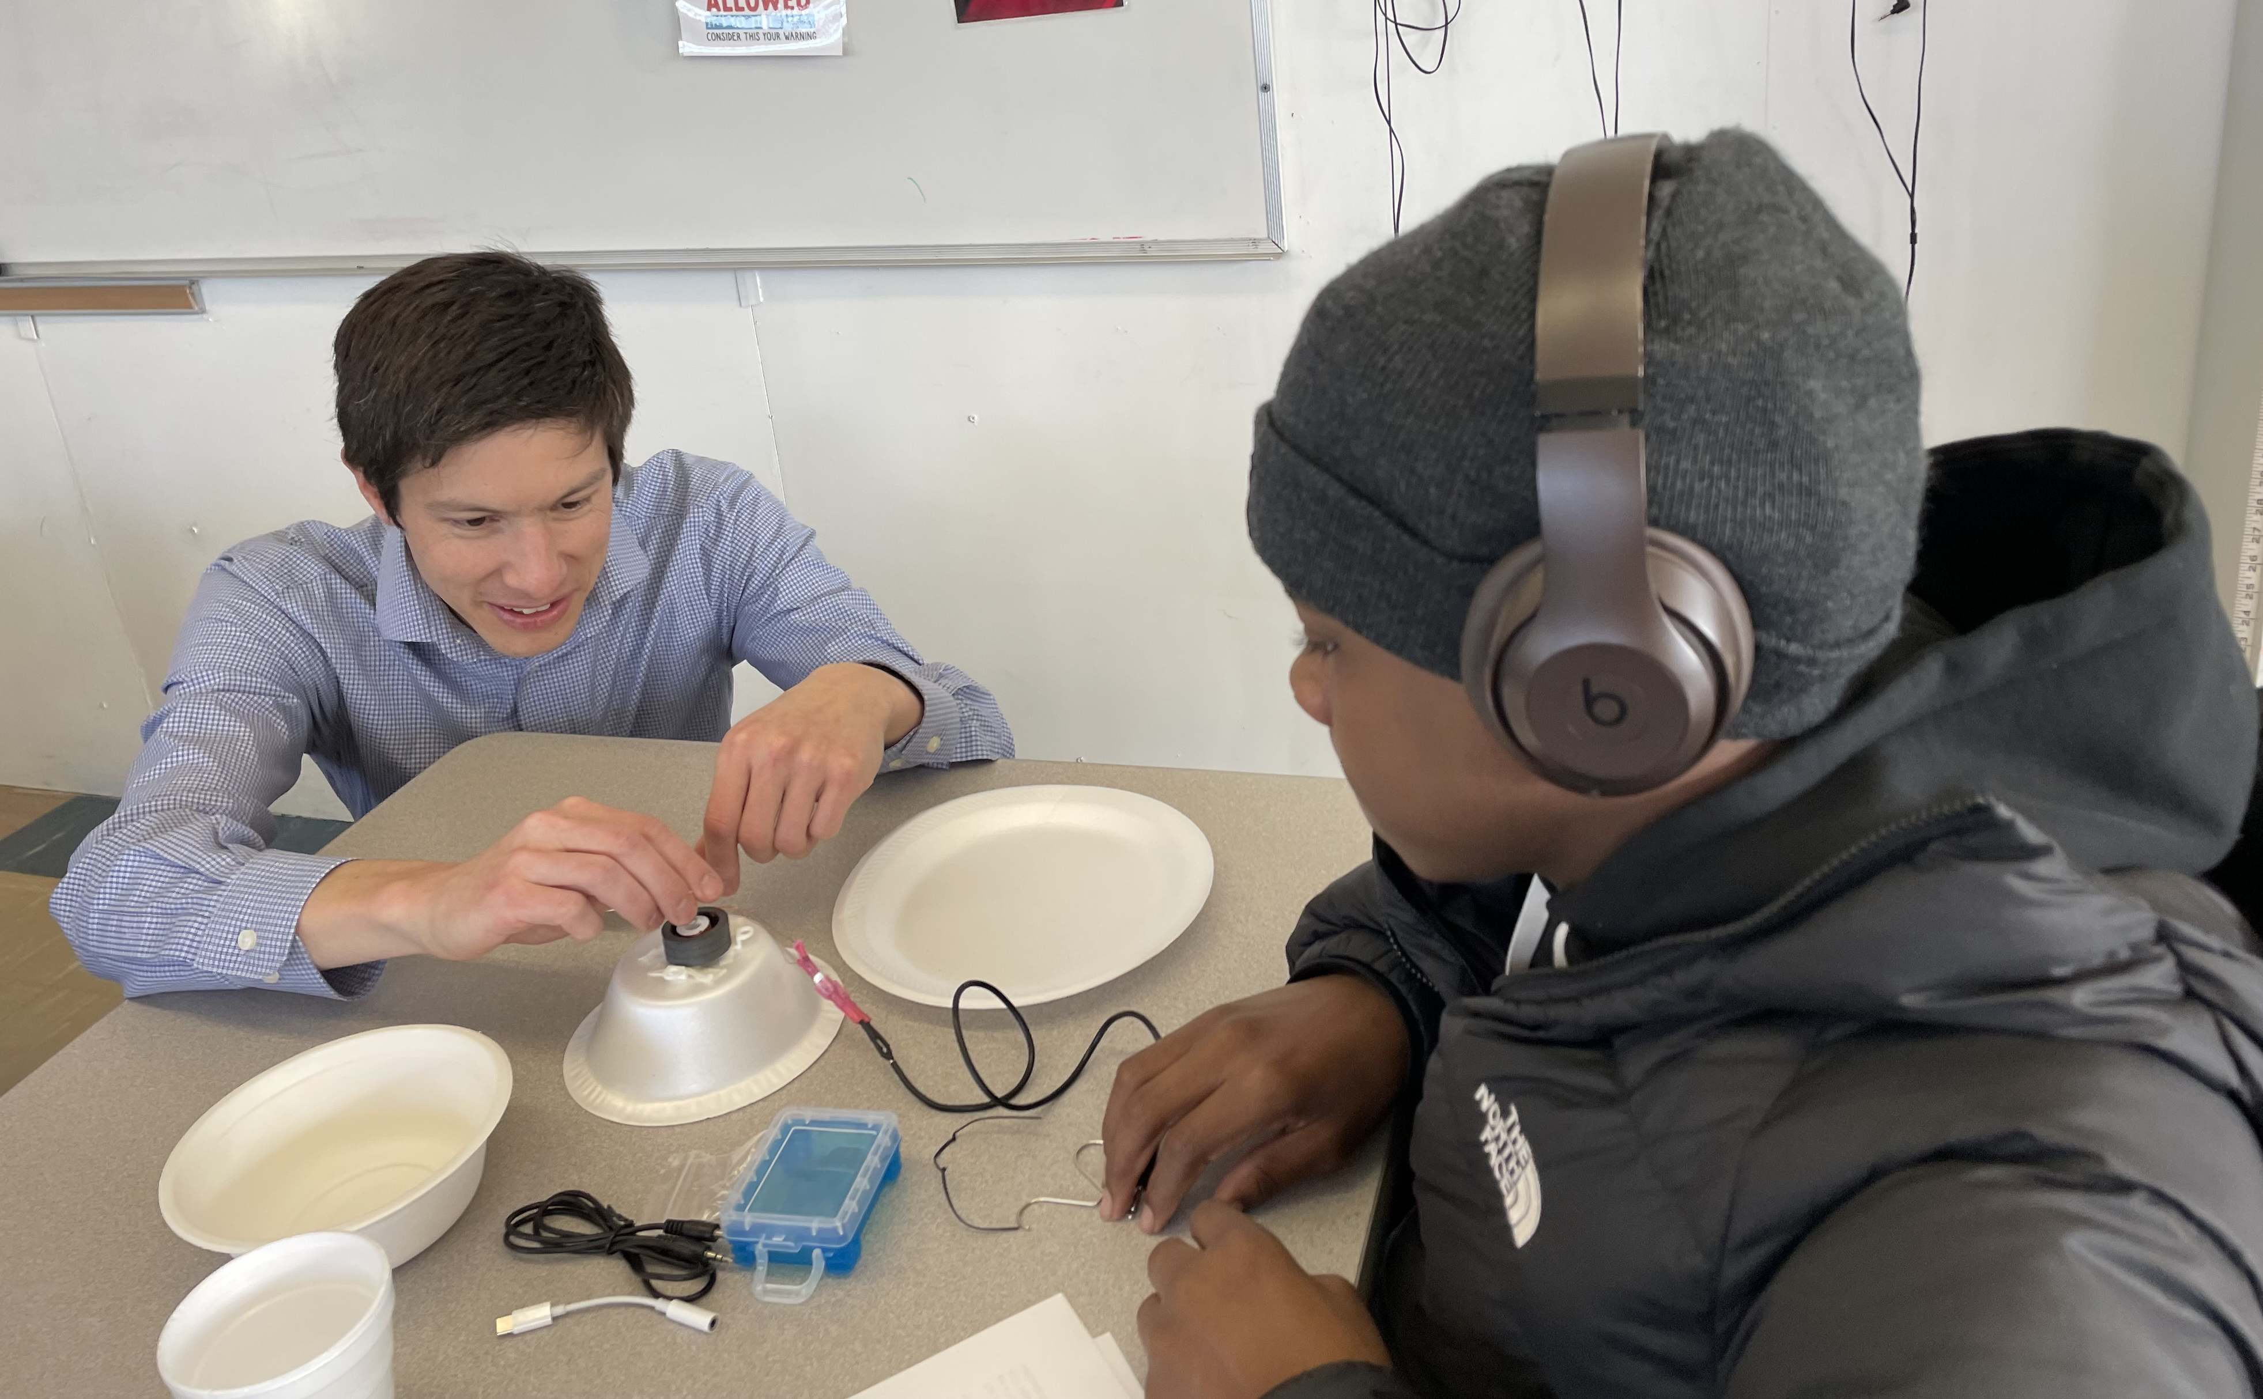
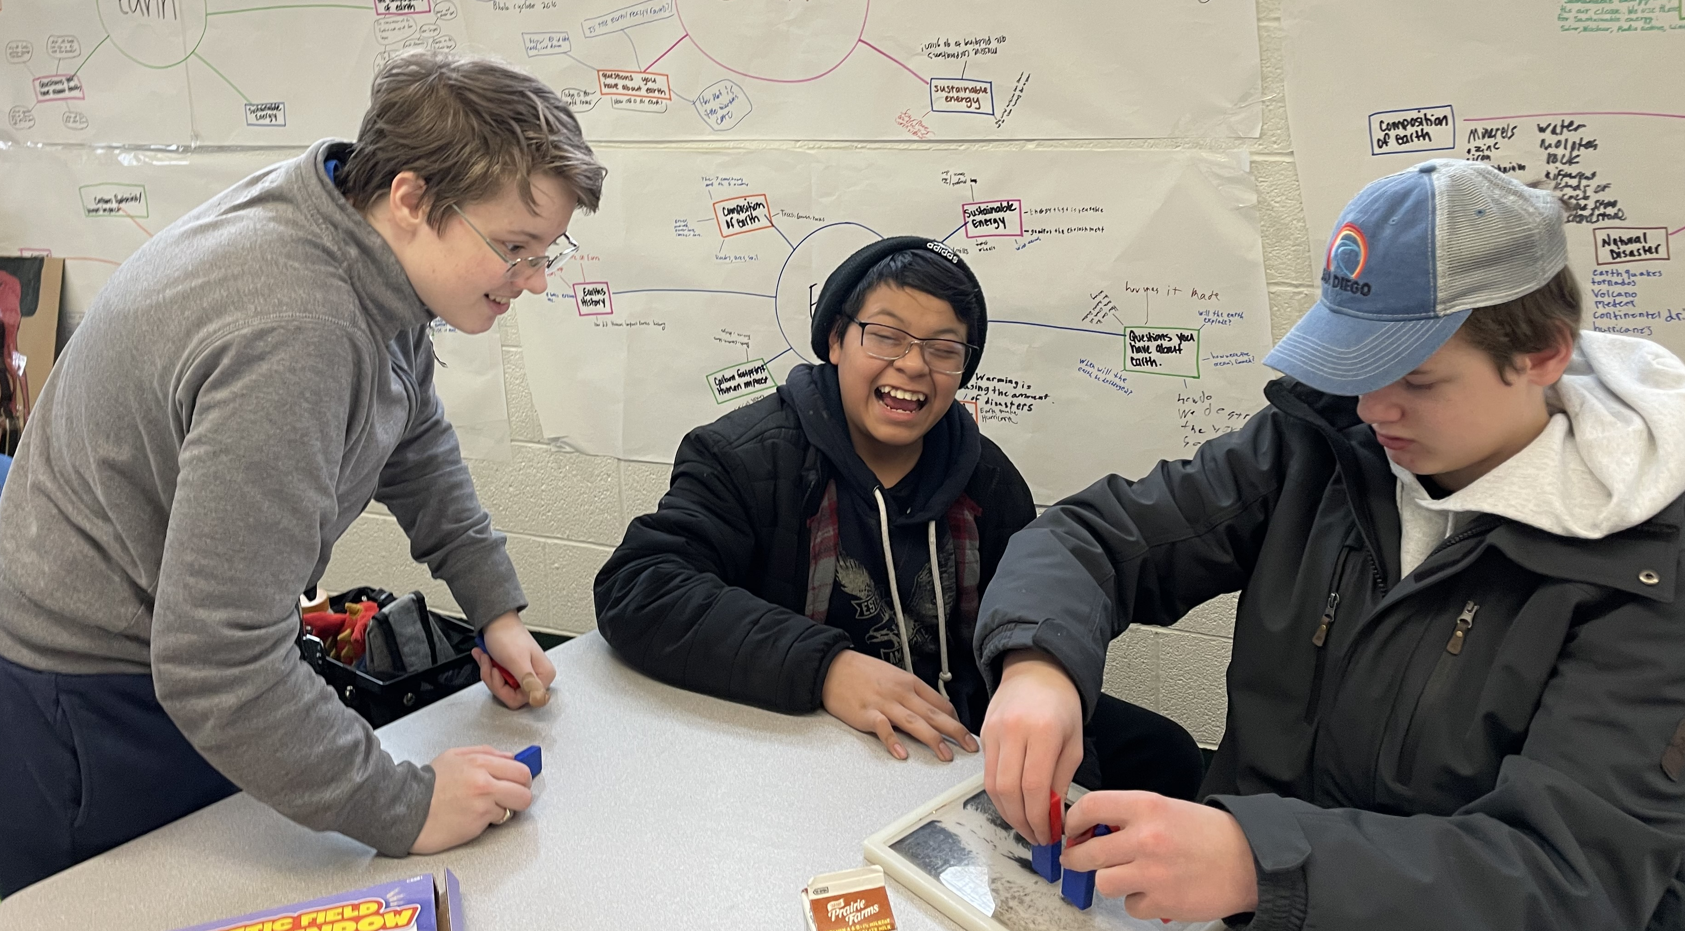
Illinois MRSEC
DMR-1720633
Speaker Kits to Engage Middle Schoolers in Magnetism Science
In February 2024, I-MRSEC investigator Daniel Shoemaker, grad student Emily Waite, and outreach coordinator Pamela Pena Martin taught 35 7th and 8th graders at Franklin STEAM Academy, a Champaign public middle school, about magnetism through a kit they developed, supported by the I-MRSEC and a grant from the APS Group on Magnetism and its Applications (GMAG). This visit was part of an annual 7-week program that teaches materials science concepts through hands-on activities aimed to build interest and confidence in STEM. Waite created the kits, supported by Shoemaker and Pena Martin, and the team led the lesson for two classrooms.
The kits were developed to be suitable for use in classroom settings with limited time, support, and funds. They are based on 3D printed components, designed to make the process easier for students, and the remaining parts are inexpensive and readily available (e.g., styrofoam bowls and cups). The lesson guides, 3D printer files, and supply list are available on the I-MRSEC website for anyone to freely access and use. Waite presented about the project at the 2024 APS March Meeting, supported by the I-MRSEC.
You can read more about the kits and find a link to download the 3D print file, activity guide, and shopping list for implementing this activity on the I-MRSEC website: https://mrsec.illinois.edu/outreach/1128
Clockwise, from upper left: Shoemaker helps a middle school student with their speaker kit; two students listen to music on the speaker they built; Waite uses magnets to illustrate magnetism concepts to two students.
Notes:
What Has Been Achieved: Developed and deployed an optimized speaker outreach kit
Importance of the Achievement: Supports positive connections to STEM for middle schoolers, connects magnetism concepts to the real world
How is the achievement related to the IRG, and how does it help it achieve its goals? Magnetism (antiferromagnetism) is a key component of IRG1 research. It also is included in the middle school science curriculum and NGSS.
Where the findings are published: Waite presented findings of this kit development at the 2024 APS March Meeting (https://meetings.aps.org/Meeting/MAR24/Session/S61.3) and speaker kit materials are freely available for use at the I-MRSEC website: https://mrsec.illinois.edu/outreach/1128

