Slide 1
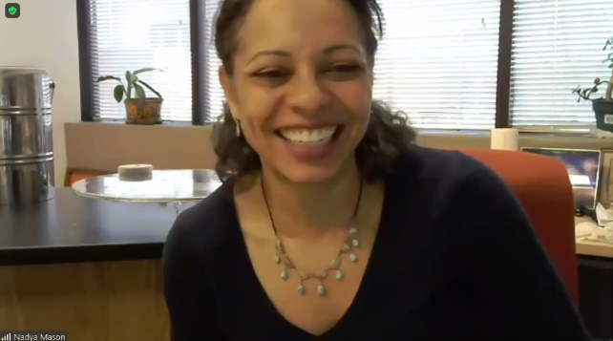
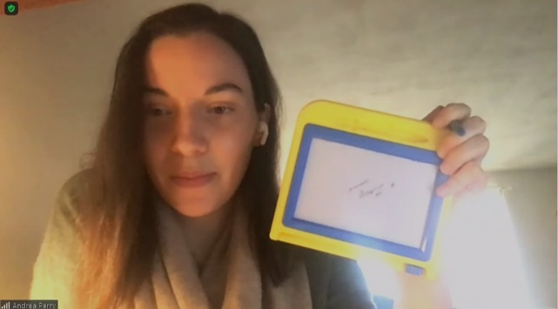
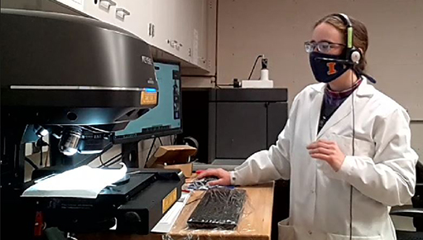
Virtual Musical Magnetism Engages Middle School Students in Materials Science
Illinois MRSEC
DMR- 1720633
2021
Watch atoms
Right up close to my face
Seeing how they change
As I watch the sand
Get hotter and hotter
And start to melt away
-Poem by 7th grader in program
University of Illinois at Urbana-Champaign
a)
b)
The Illinois MRSEC implemented its middle school outreach program “Musical Magnetism” for the third year starting in Feb. 2021, in a six-week, virtual format. The program engages middle school students in materials science demos as they practice creative expression with a science theme. The program reached 50 7th and 8th graders at Franklin STEAM Academy, a school with majority URM students.
Kits distributed to students provided content for hands-on materials science activities. MRSEC Faculty, postdocs, and students led lessons and assisted throughout the program. One of the highlight activities, letting students deconstruct a toy to learn for themselves how it works, was still included. A virtual visit to Materials Research Lab and instrument demo inspired students to write haikus. The virtual format allowed participation of scientist/artist visitors from Chicago and Boston, including a professional tap dancer/materials scientist and a chemist/glass artist. The students produced creative pieces with science themes, including drawings, comics, spoken word story, and poetry.
c)
d)
Fig. 1: a) Director Mason leads a lesson on how temperature affects materials, b) Perry leads students as they take apart a magnetic drawing board, c) Schleife lets students explore atomic structure with a VR lesson; d) Walsh shows the surfaces of a pencil using an optical profiler, then leads students in writing haikus about it, e) a 7th grader’s haiku inspired by examining the pencil (shown in background).
e)
Read more: “Musical Magnetism: Encouraging Franklin Middle Schoolers to Express Science Via the Arts“ (3/25/21), https://www.istem.illinois.edu/news/imrsec.musical.magnetism21.html
“On Her First Foray into STEAM, Kathy Walsh Acquaints Franklin Students with Microscopy, Haiku” (2/17/21) https://www.istem.illinois.edu/news/imrsec.musical.magnetism21.Walsh.html

