Slide 1
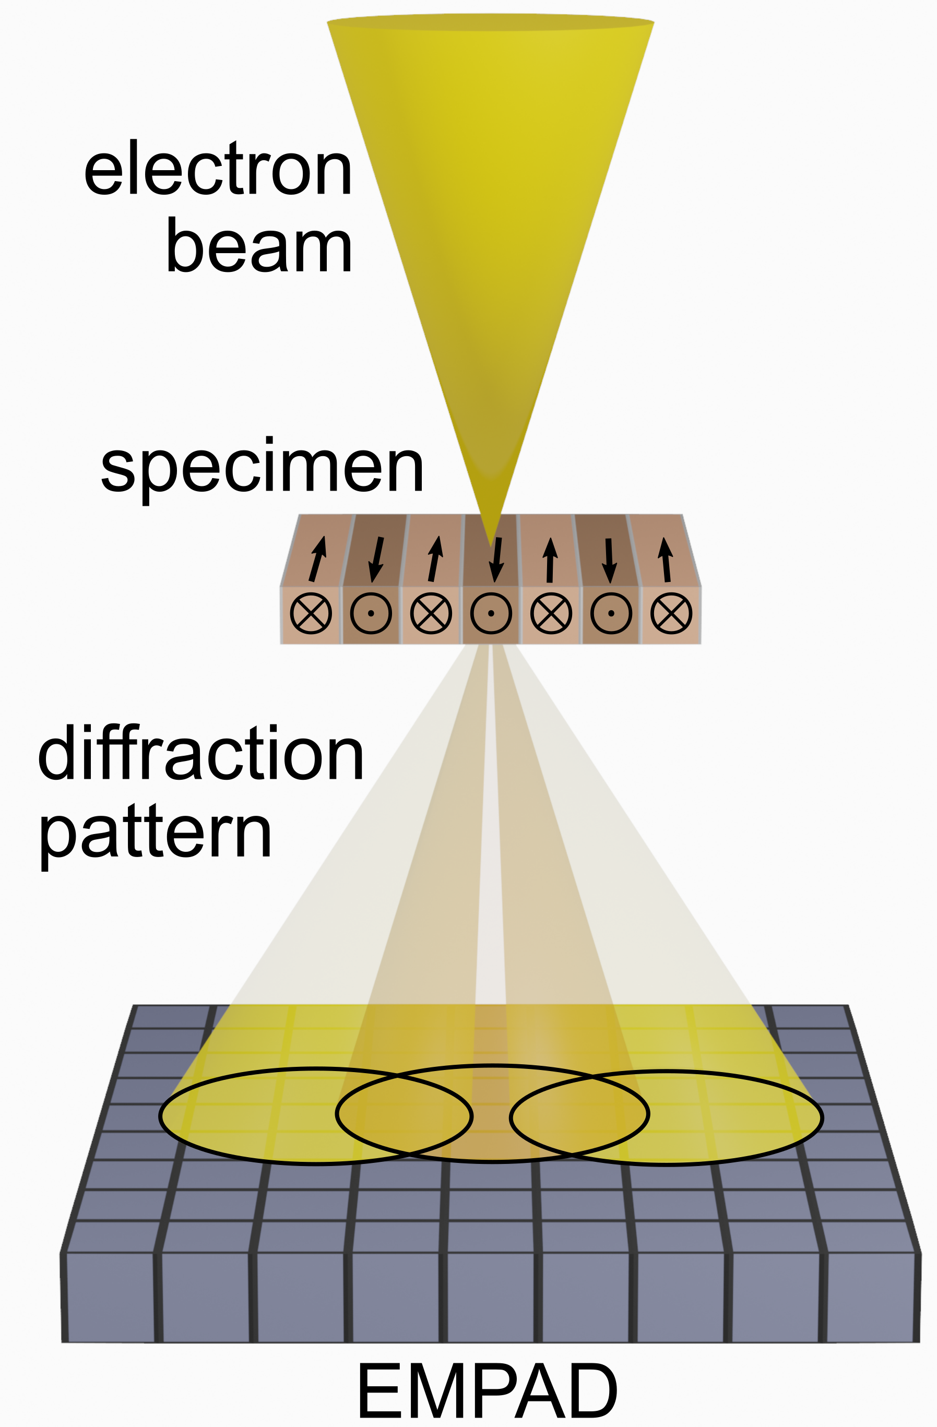
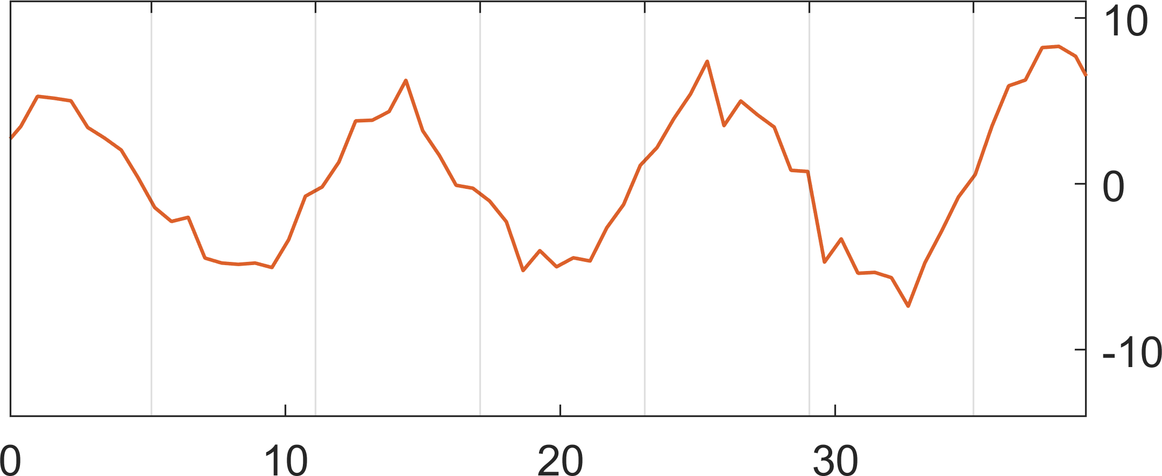

University of Illinois MRSEC
DMR-1720633
Angstrom-scale imaging of antiferromagnetic Fe₂As via 4D-STEM
David G. Cahill, Andre Schleife, Daniel P. Shoemaker, Pinshane Y. Huang, University of Illinois Urbana-Champaign
New electron microscopy technique developed at UIUC show that magnetic order in antiferromagnetic Fe₂As can be resolved at angstrom resolution for the first time.
Understanding magnetization on the angstrom scale is essential for the implementation of real devices based on antiferromagnets. Our work provides important insight into how magnetic order can be probed atom-by-atom, something that has not yet been achieved.
Because the net magnetization of antiferromagnets is zero, developing new probes to image and sense magnetism at the atomic-scale will provide insight to the full magnetic landscape of antiferromagnets – whose structural and magnetic coupling to light or applied field can determine local changes in their dynamics.
https://doi.org/10.1016/j.ultramic.2023.113696
(a)
4D-STEM
(b)
Atomic Structure: Fe₂As
Fe
As
5 Å
(c)
Center of Mass: Magnetism
Deflections (μrad)
Position (Å)
Figure 1: (a) Four-dimensional scanning transmission microscopy (4D-STEM) imaging on antiferromagnet (b) iron arsenide. Using the diffracted beam pattern captured on the electron microscope pixel array detector (EMPAD), (c) magnetic order can be reconstructed at 6 angstrom resolution using a center of mass analysis.
Notes:
What Has Been Achieved: New electron microscopy technique developed at UIUC show that magnetic order in antiferromagnetic Fe₂As can be resolved at angstrom resolution for the first time.
Importance of the Achievement: Understanding magnetization on the angstrom scale is essential for the implementation of real devices based on antiferromagnets. Our work provides important insight into how magnetic order can be probed atom-by-atom, something that has not yet been achieved.
How is the achievement related to the IRG, and how does it help it achieve its goals? Because the net magnetization of antiferromagnets is zero, developing new probes to image and sense magnetism at the atomic-scale will provide insight to the full magnetic landscape of antiferromagnets – whose structural and magnetic coupling to light or applied field can determine local changes in their dynamics.
Where the findings are published: “Angstrom-scale imaging of magnetization in antiferromagnetic Fe2As via 4D-STEM,” KX Nguyen, J Huang, MH Karigerasi, K Kang, DG Cahill, JM Zuo, A Schleife, DP Shoemaker, PY Huang, Ultramicroscopy 247, 113696 and doi.org/10.1016/j.ultramic.2023.113696.

