Slide 1
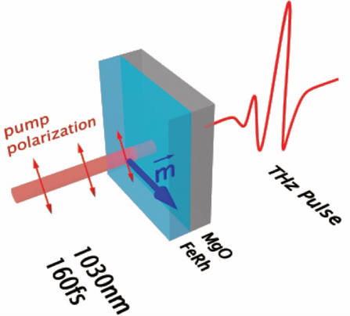
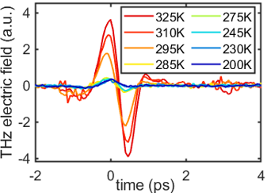
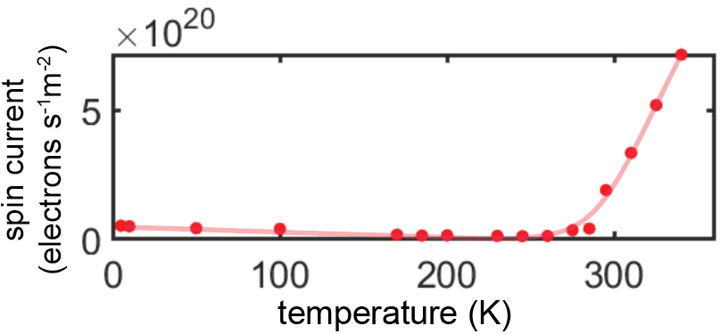
University of Illinois MRSEC
DMR-1720633
Ultrafast THz emission spectroscopy of spin currents in the metamagnet FeRh
A. Hoffmann, N. Mason, and F. Mahmood, University of Illinois Urbana-Champaign
THz emission spectroscopy developed at UIUC is used to investigate spin current generation in the antiferromagnetic metal FeRh under ultrafast laser excitation. The transient spin current in FeRh can be extracted from the emitted THz field.
Developing viable platforms for the transduction between charge and spin current is crucial for spintronic based electronic devices. Our work investigates FeRh as one such platform.
We further present THz emission as a contactless probe of spin current. This probe technique can be extended to study spin dynamics in more exotic condensed matter systems such as SC/FM heterostructures, hybrid magnon systems, and quantum spin liquids which are hard to probe by conventional techniques.
THz emission
spectroscopy
(b)
(a)
THz emission of FeRh across T_{N} = 285K
(c)
Extracted spin current
Figure 1: (a) THz emission spectroscopy of an FeRh thin film grown on MgO substrate. (b) Emitted THz field from FeRh across the metamagnetic transition point. A small, non-zero THz field is observed in the antiferromagnetic FeRh at low temperatures. (c) Extracted spin current inside FeRh from the THz emission data.
Notes:
What Has Been Achieved: THz emission spectroscopy developed at UIUC are used to investigate the spin current generation in FeRh under ultrafast laser excitation. The transient spin current in FeRh can be extracted from the emitted THz field.
Importance of the Achievement: Spin current reveals key information about interplay between spin and other degrees of freedom inside material. This is especially critical for understanding the spin dynamics in materials such as proximity induced spin-triplet superconductors (SC) and quantum spin liquids, which is essential to the progress of spintronics research.
How is the achievement related to the IRG, and how does it help it achieve its goals? We present THz emission as a contactless probe of spin current-- a non-invasive method to detect spin current generation in spintronic materials. This probe technique can be extended to study spin dynamics in more exotic condensed matter systems such as SC/FM heterostructures, hybrid magnon systems, and quantum spin liquids which are hard to probe by conventional techniques.
Where the findings are published: Lv, Yinchuan, Soho Shim, Jonathan Gibbons, Axel Hoffmann, Nadya Mason, and Fahad Mahmood. "Ultrafast THz emission spectroscopy of spin currents in the metamagnet FeRh." APL Materials 12, no. 4 (2024). https://pubs.aip.org/aip/apm/article/12/4/041121/3283184

