Slide 1
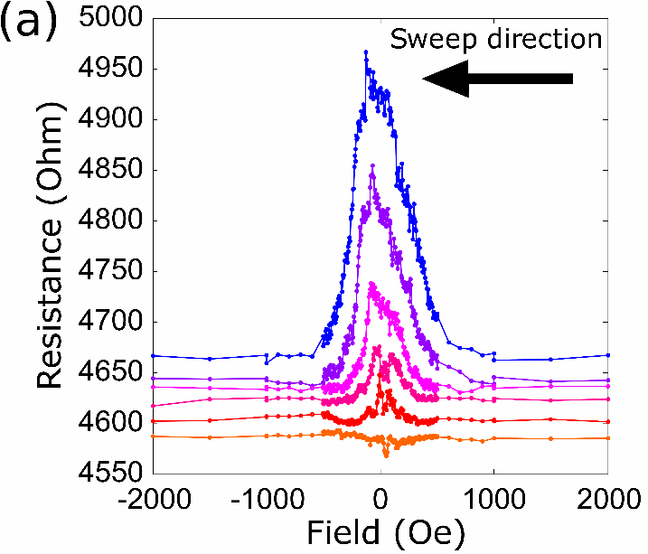
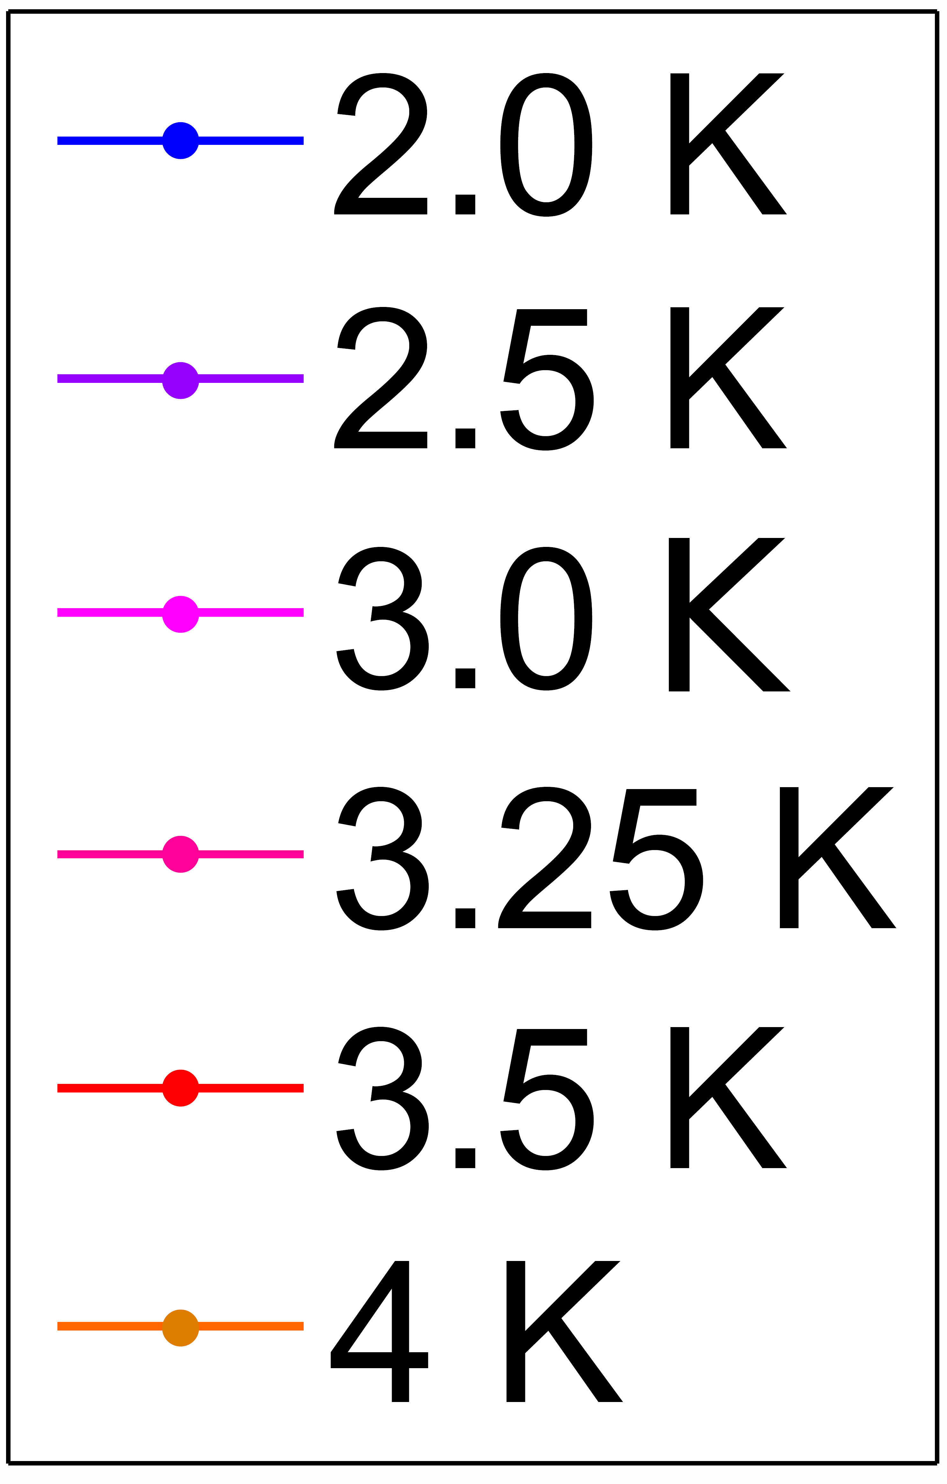
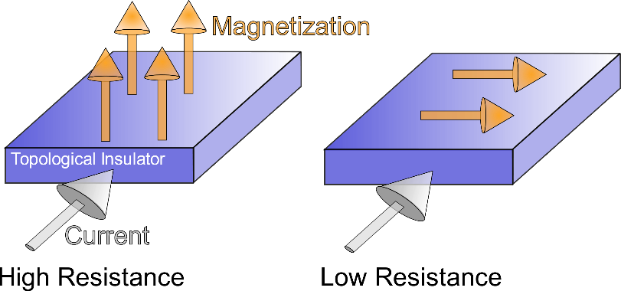
Surface state anisotropic magnetoresistance in proximity magnetized topological insulators
Illinois MRSEC
DMR-1720633
2018
Information stored in magnetic materials is often read-out by measuring changes in magnetoresistance. Large magnetoresistance effects are thus important for establishing well-defined memory states within materials that store information.
The Illinois MRSEC discovered a new and large magnetoresistance effect generated when a topological insulator (TI) is placed on top of an ordinary magnetic insulator. The surface of the TI becomes magnetic and exhibits a so-called surface-state anisotropic magnetoresistance. This effect is two-orders of magnitude larger than previous effects induced in similar materials.
TIs have already been identified as promising materials which can help switch magnetic states, or write information. Now that these same materials can be used as a medium for storing information their technological potential in information technology has considerably increased.
N. Mason, M. J. Gilbert, A. Hoffmann
University of Illinois Urbana-Champaign
Data showing onset of surface-state magnetoresistance peak below 4K (above) and schematic showing origin of magnetoresistance (below)
Notes:
A new and large (~ 6.5%) magnetoresistance effect originates from induced magnetization opening an energy gap between the surface states of the topological insulator. At the lowest temperature measured, this surface-state anisotropic magnetoresistance (SS-AMR) is two-orders of magnitude larger than previous effects induced in spin Hall metals by the same magnetic insulator (YIG). A theory predicting this new resistance was published last year by Chiba et al. where it was suggested that using the magnetic insulator would be ideal for observing this new SS-AMR. By avoiding magnetic dopants used in previous TI magnetoresistance transport experiments, SS-AMR was measured unobstructed from the conventional AMR effect that such dopants introduce. Aside from demonstrating a new and large magnetoresistance in a TI, these measurements importantly allowed the confirmation of perpendicular induced magnetism in the TI from the underlying insulator. Micromagnetics simulations confirmed this model of the surface state magnetoresistance and perpendicular magnetic anisotropy.
For more information, see Y. Zhang, J. Sklenar, Y. Kim, M. Jungfleisch, M. Gilbert, A. Hoffman, and N. Mason, “Surface State Magnetoresistance in Proximity Magnetized Topological Insulators.”

