Slide 1
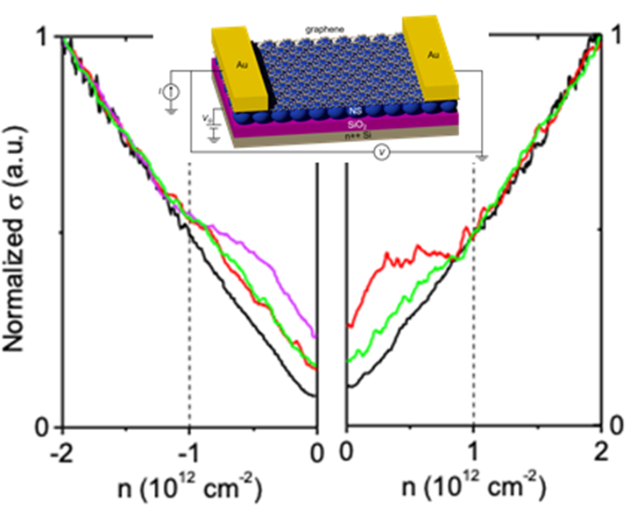
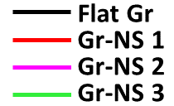
Strain superlattice of graphene on nanospheres
Illinois MRSEC
DMR-1720633
2019
N. Mason, N. Aluru, P. Huang, M. Gilbert
University of Illinois Urbana-Champaign
Strain engineering two-dimensional (2D) materials provides a new way to tailor electronic bandstructures and access novel electronic devices. A key route to strain 2D materials, such as graphene, is via underlying nanostructured substrates.
Building on work showing that graphene can be controllably strained on underlying nanospheres, the Illinois MRSEC team has now demonstrated that this strain dramatically affects the electronic properties of the graphene. Through joint experimental and theoretical work, the team found that conductance dips appear in the graphene-nanosphere “superlattice”, which can be tuned by adjusting the strain in the system. The team also showed that fabricated systems can show similar strain and electronic effects. These results show the promise of strain as a new parameter in tuning 2D electronic systems.
Conductance vs carrier density for different graphene devices. Black curve is flat graphene; colored curves are all on nanospheres. The nanosphere devices all show kink at expected density for strain superlattice created by nanospheres
Y. Zhang et al. njp:2D Materials and Applications 2, 31 (2018)
Hinnefeld et al. Appl. Phys. Lett. 112, 173504 (2018)
Notes:
This work demonstrated electronic transport and tunable band structure engineering in strained graphene on nanospheres. The results show superlattice transport features of Dirac fermion cloning and Hofstadter’s butterfly, which can be tuned by changing the magnitude of strain modulations. The results were corroborated using tight-binding models that simulated the effect of lattice deformation and confirmed the superlattice transport behavior. The designed 2D crystal-nanoparticle heterostructure enables a route to utilize the 3D configurational freedom of the 2D material, to modulate the spatial pattern of strain, and eventually to tailor the electronic band structure of the system.

