Slide 1
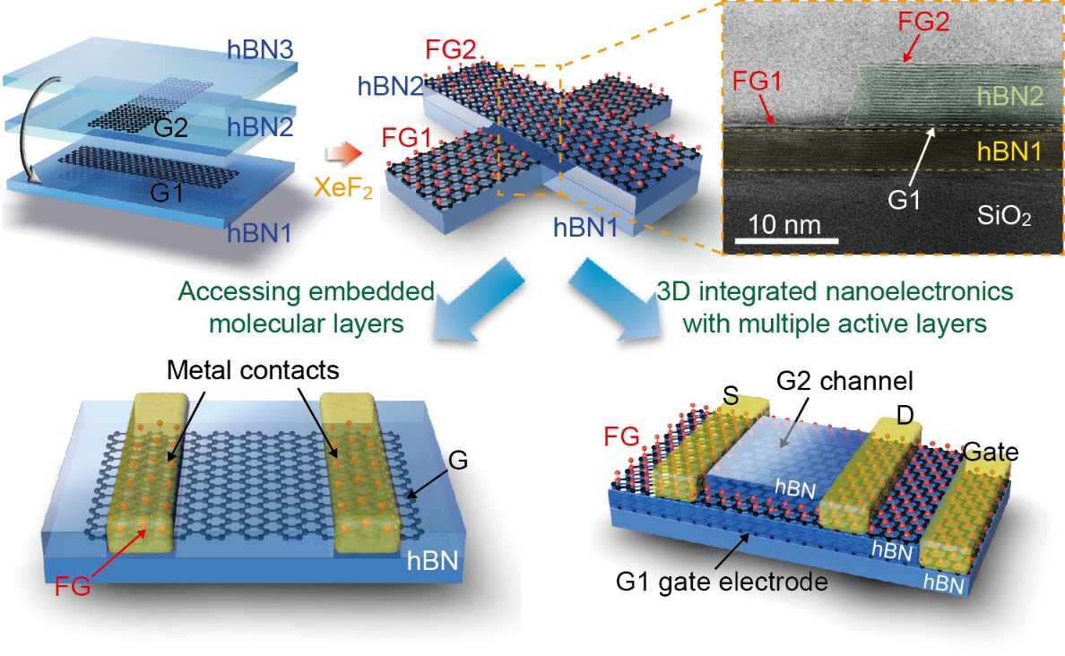
Atomically-precise graphene etch masks for 3D integrated systems from 2D material heterostructures
Illinois MRSEC
DMR-1720633
2018
A. van der Zande, P. Huang, N. Mason, E. Ertekin
University of Illinois Urbana-Champaign
Atomically-precise fabrication methods are critical for the development of next-generation technologies which rely on nanomaterials. New methods are particularly needed in van der Waals (vdW) heterostructures where it is necessary to individually address each molecular layer to form devices with nanometer thicknesses.
The Illinois MRSEC has demonstrated a highly selective etching technique using graphene as a monolayer etch stop within vdW heterostructures. This technique is a versatile and simple nanofabrication process that bridges the challenging technological divide between atomic-precision and wafer scale uniformity. At the same time, it enables a method for accessing buried layers within a 2D heterostructure, thus allowing 3D-integrated nanoelectronic and nanomechanical devices with performance approaching theoretical limits.
(top) Schematic of the selective etching process and false-color cross-sectional STEM image of a 2D heterostructure showing atomic precision of the etched structure. (bottom) Demonstrated applications using this technique: Accessing buried electronic layers within a heterostructure to form low contact resistance and high mobility devices and a 3D integrated device with multiple active layers.
Notes:
Graphene is a highly selective, atomically-thin etch mask and etch stop in making vdW heterostructures. Exposure to XeF₂ gas etches most 2D materials with the exception of graphene; because graphene is impermeable to gases, this etching selectivity enables one-step patterning of heterostructures with atomic precision in etch depth. The team highlighted the advantages of graphene etch masks (GEMs) by fabricating 3D-integrated heterostructure devices with interlayer vias and suspended graphene mechanical resonators. Graphene transistors fabricated with GEM showed high carrier mobilities of 140,000 cm²V⁻¹s⁻¹ at room temperature and low contact resistivity of 80 Ω·$μ$m, approaching theoretical limits.
For more information, please see the following description: Jangyup Son, Junyoung Kwon, SunPhil Kim, Yinchuan Lv, Jaehyung Yu, Jong-Young Lee, Huije Ryu, Kenji Watanabe, Takashi Taniguchi, Rita Garrido-Menacho, Nadya Mason, Elif Ertekin, Pinshane Y. Huang, Gwan-Hyoung Lee, and Arend van der Zande, “Atomically-precise graphene etch masks for 3D integrated systems from 2D material heterostructures” (under review in Nat. Commun. (2018)).

