Slide 1
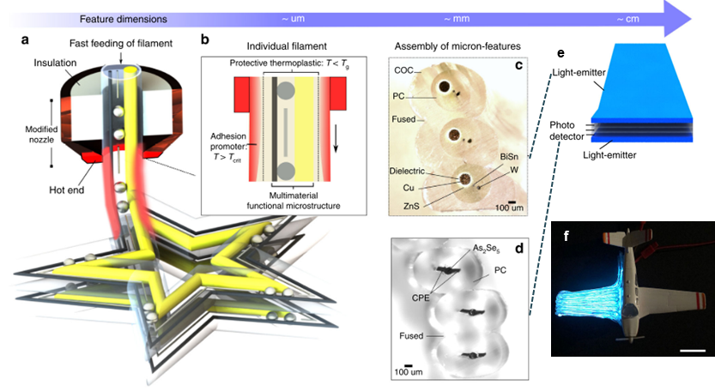
IRG-1. Structured multimaterial filaments for 3D printing of optoelectronics
MIT MRSEC
DMR-1419807
2019
Filament Surface Heating. Functional fibers fabricated by the thermal drawing process can be used as feedstock for 3D printing. By applying an outer cladding with a lower Tg compared to that of the fiber core, the surface of the fiber can be heated to enable fused filament fabrication while the inner core is not affected (see Figure a-c).
Capillary Breakup. The light-emitting fiber consists of BiSn micropheres, electroluminescent ZnS, conductive W, and a COC cladding. The BiSn microspheres are formed using laser-induced capillary breakup. The microspheres are larger than the cladding (shown in Figure b), so they connect the W and ZnS. When an alternating voltage is applied, the ZnS layer emits light.
Localized Detection. The light-emitting fibers are a step toward fabric or 3D-printed displays. Furthermore, the light-emitting and photodetecting filaments can be used together in a structure for the purpose of detecting structural defects (see Figure e, f). The presence of a structural defect reduces the magnitude of the photocurrent measured from an external multimeter. Although 3D printing is demonstrated using optoelectronics, the method of filament surface heating for 3D printing can be applied to multimaterial filaments of a variety of functionalities.
John Joannopoulos and Yoel Fink
Massachusetts Institute of Technology
(a) Functional filament is quickly fed through a short hot end to print a 3D star structure. (b) Filament surface heating allows the outer cladding to be heated above its Tg, while the inner core of the filament is maintained at a lower temperature, preserving its structure. (c, d) Cross-sectional images of fused microstructured filaments, which can be further shaped into 3D cm-scale objects. (e) Schematic of a printed airplane wing with light-emitting and photodetecting functionalities for detecting structural defects. The top and bottom print layers of the airplane wing are light-emitters, and the middle 3 layers are photodetectors. (f) Photograph of printed airplane wing; scale bar, 2 cm. The locations of structural defects can be determined by measuring the magnitude of the photocurrent after defects are made and correlating the photocurrent magnitude with the severed length of the photodetecting filament.
Loke, G., Yuan, R., Rein, M., Khudiyev, T., Jain, Y., Joannopoulos, J., Fink, Y. (2019). “Structured multimaterial filaments for 3D printing of optoelectronics.” Nature Communications, 10(4010):1-10. <doi:10.1038/s41467-019-11986-0>
Notes:
Functional fibers fabricated by the thermal drawing process can be used as feedstock for 3D printing. By applying an outer cladding with a lower Tg compared to that of the fiber core, the surface of the fiber can be heated to enable fused filament fabrication while the inner core is not affected (see Figure a-c). The light-emitting fiber consists of BiSn micropheres, electroluminescent ZnS, conductive W, and a COC cladding. The BiSn microspheres are formed using laser-induced capillary breakup. The microspheres are larger than the cladding (shown in Figure b), so they connect the W and ZnS. When an alternating voltage is applied, the ZnS layer emits light. The light-emitting fibers are a step toward fabric or 3D-printed displays. Furthermore, the light-emitting and photodetecting filaments can be used together in a structure for the purpose of detecting structural defects (see Figure e, f). The presence of a structural defect reduces the magnitude of the photocurrent measured from an external multimeter. Although 3D printing is demonstrated using optoelectronics, the method of filament surface heating for 3D printing can be applied to multimaterial filaments of a variety of functionalities.

