Slide 1
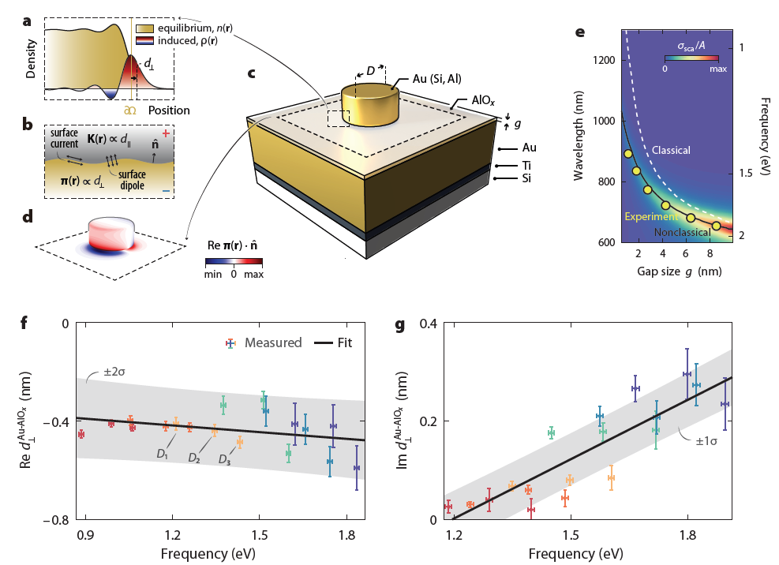
IRG-1. A general framework for nanoscale electromagnetism
MIT MRSEC
DMR-1419807
2019
Local, bulk response functions, e.g. permittivity, and the macroscopic Maxwell equations completely specify the classical electromagnetic problem, which features only wavelength and geometric scales. They have proven extremely successful at macroscopic length scales, across all branches of photonics. Even state-of-the-art plasmonic studies, exemplars of extremely interface-localized fields, rely on their validity.
This classical description, however, neglects the intrinsic electronic scale associated with interfaces. This omission leads to significant discrepancies between classical predictions and experimental observations in systems with deeply nanoscale feature sizes, typically evident below ∼10 – 20 nm.
The d parameters are a convenient parametrization for surface-related, quantum corrections. We establish a systematic approach to measure the d parameter dispersion of a general two-material interface. This approach enables the first measurement of the dispersion of the d parameters of an interface.
John D. Joannopoulos and Marin Soljačić
Massachusetts Institute of Technology
Framework, experimental structure, measured nonclassical shifts, and surface response.
We translate the mesoscopic d parameters (a-b, d) directly into observables—spectral shifting and broadening—and measure them in specially designed plasmonic systems (c) that exhibit pronounced nonclassical corrections (e). The first measured dispersion of the complex d parameters are shown in f and g.
Yang, Y., Zhu, D., Yan, W., Agarwal, A., Zheng, M., Joannopoulos, J. D., Lalanne, P., Christensen, T., Berggren, K. K., and Soljačić, M. “A General Theoretical and Experimental Framework for Nanoscale Electromagnetism.” Nature, 576(7786): 248–252, 2019. <doi:10.1038/s41586-019-1803-1>
Notes:
The d parameters, first introduced by Feibelman, are a convenient mathematical parametrization for surface-related, quantum corrections. They can be derived from a careful analysis of the reflection of an external potential off a planar interface by going beyond the conventional assumptions of local and stepwise material response: the d parameters then introduce the leading-order corrections to the classical reflection coefficients. The Feibelman and parameters play a role analogous to the local bulk permittivity, but for interfaces between two materials. and are equal to the frequency-dependent centroids of the induced charge and the normal derivative of the tangential current, respectively, at an equivalent planar interface. These surface terms can be equivalently incorporated as a set of mesoscopic boundary conditions for the conventional macroscopic Maxwell equations.
Experimentally, we establish a systematic approach to measure the d-parameter dispersion of a general two-material interface and illustrate it using Au–AlOx interfaces. Whereas the d parameters of simple metals can be accurately computed within jellium time-dependent density functional theory, those of noble metals, such as Au, require time-dependent density functional theory beyond the jellium approximation owing to non-negligible screening from lower-lying orbitals. We show that the d parameters can instead be measured experimentally. By developing and exploiting a quasi-normal-mode (QNM)-based perturbation expression, we translate these mesoscopic quantities directly into observables—spectral shifting and broadening—and measure them in designed plasmonic systems that exhibit pronounced nonclassical corrections. Our experimental testbed enables a direct procedure to extract the d parameters from standard dark-field spectroscopic measurements, in a manner analogous to ellipsometric measurements of the local bulk permittivity. Moreover, by investigating a complementary hybrid plasmonic setup, we discover and experimentally demonstrate design principles for structures that are classically robust—that is, they exhibit minimal nonclassical corrections—even under nanoscopic conditions.

