Slide 1
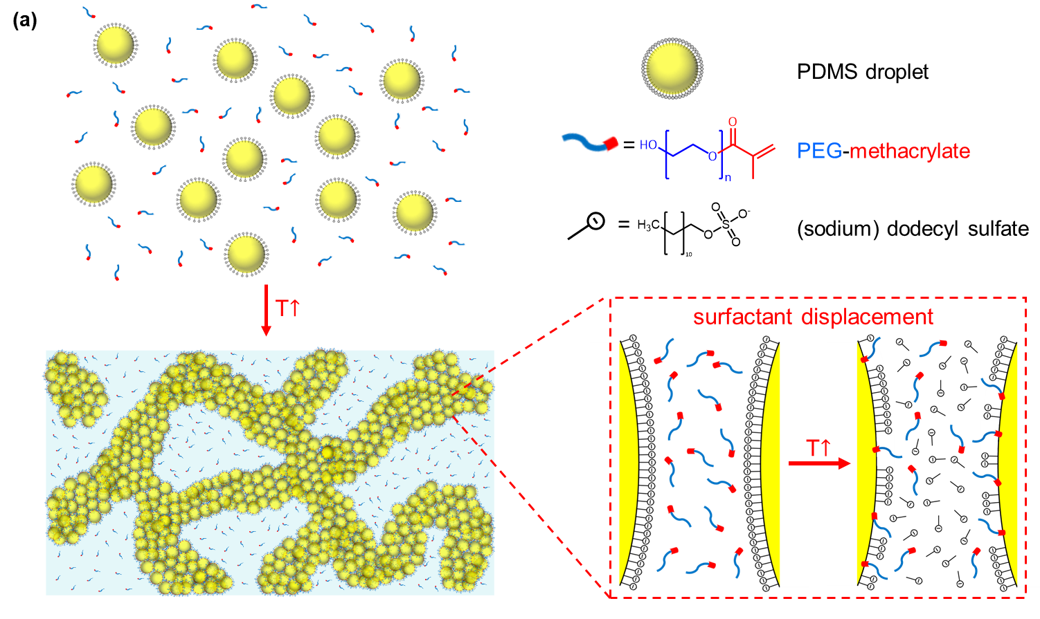
IRG-2. Thermally-Induced Surfactant Displacement to Induce Colloidal Gelation
MIT MRSEC
DMR-1419807
2019
Patrick Doyle
Massachusetts Institute of Technology
Doyle has discovered a new way to thermally-induce gelation of nanoemulsions. They developed a platform wherein colloidal gelation is controlled by tuning repulsive interactions. By including amphiphilic oligomers in colloidal suspensions, the ionic surfactants on the colloids are replaced by the nonionic oligomer surfactants at elevated temperatures, leading to a decrease in electrostatic repulsion. The mechanism was examined by carefully characterizing the colloids, and subsequently allowing the construction of interparticle potentials to capture the material behaviors. With the thermally-triggered surfactant displacement, the dispersion assembles into a macroporous viscoelastic network, and the gelling mechanism is robust over a wide range of compositions, colloid sizes and component chemistries. This stimulus-responsive gelation platform is general and offers new strategies to engineer complex viscoelastic soft materials.
Schematic diagram showing the nanoemulsion system and thermally-induced surfactant displacement. By displacing charged surfactants we can change the droplet-droplet interactions and induce gelation.
Notes:
Doyle developed a colloidal gelation platform whose microstructure and mechanical properties can be controlled easily and reliably using an external temperature source. They systematically investigated the gelation mechanism and confirmed that it is due to thermally-triggered surfactant displacement which reduces the interparticle repulsion. By understanding the mechanism, they applied simple models to construct the interparticle potential and to explain trends in material behaviors. The mechanistic understanding of the gelation also allowed them to extend the platform to other surfactant and colloid chemistries (both droplets and solid nanoparticles). This platform offers a convenient way to assemble and control the properties of a variety of different nanoparticle gels and will be useful for engineering advanced soft materials

