Slide 1
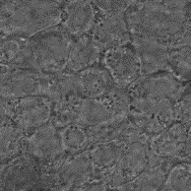
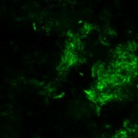
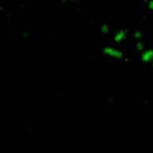
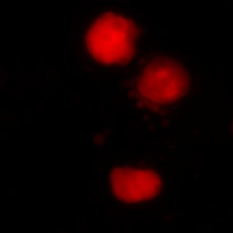
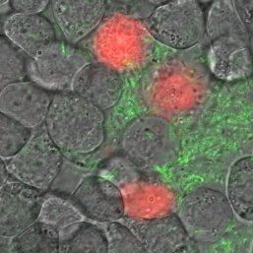
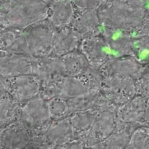
IRG-2. Mucin Glycans Regulate Microbial Virulence
MIT MRSEC
DMR-1419807
2019
Katharina Ribbeck
Massachusetts Institute of Technology
Medium alone
+ Mucin
A slimy layer of mucus serves as the first line of defense against problematic microbes like the bacterial pathogen Pseudomonas aeruginosa.
We have identified mucins, the major gel-forming components of mucus, and their complex sugar structures (glycans) as protective molecules that suppress microbial virulence traits including toxin secretion, bacterial communication, and surface attachment.
This virulence reduction is associated with less host cell killing in vitro (Figure) and less colonization of burn wounds.
Significance: By attenuating the virulence of pathogens rather than eradicating them, mucin glycans are attractive candidates for novel therapeutics.
Mucins prevent host cell killing by P. aeruginosa
20 µm
Host Cells
P. aeruginosa
Cell death
Merge
Top: In medium alone, P. aeruginosa (green) attaches to host cells (bright field), triggering cellular rounding and death (red).
Bottom: The presence of mucin prevents P. aeruginosa from attaching to and killing host cells, thus maintaining a healthy host cell monolayer without rounded morphology.
Wheeler, K. M., Cárcamo-Oyarce, G., Turner, B. S., Dellos-Nolan, S., Co, J. Y., Lehoux, S., Cummings, R. D., Wozniak, D. J., and Ribbeck, K. “Mucin Glycans Attenuate the Virulence of Pseudomonas Aeruginosa in Infection.” Nature Microbiology, 4(12):2146–2154, 2019. <doi:10.1038/s41564-019-0581-8>
Notes:
Technical description, adapted from Wheeler et al 2019: A well-hydrated mucus gel lines all wet epithelia in the human body, including the eyes, lungs, and gastrointestinal and urogenital tracts. Mucus forms the first line of defense while housing trillions of microorganisms that constitute the microbiota. Rarely do these microorganisms cause infections in healthy mucus, suggesting that mechanisms exist in the mucus layer that regulate virulence. In this work, we use a three-dimensional (3D) laboratory model of native mucus to study how it influences the behavior of Pseudomonas aeruginosa, an opportunistic pathogen that causes deadly infections in people with burn wounds, compromised immunity, or defects in mucus production. This bacterium employs several virulence traits to establish infection, including secretion of cytotoxic effector molecules, epithelial adherence, and formation of antibiotic-resistant cellular aggregates known as biofilms. We have found that native mucus disintegrates established biofilms and suppresses several of these key virulence pathways in P. aeruginosa. Further, we reveal that this phenotypic switch is triggered by mucins, which are polymers that are densely grafted with O-linked glycans that form the 3D scaffold inside mucus. We find that isolated mucins act at various scales, suppressing distinct virulence pathways, promoting a planktonic lifestyle, reducing cytotoxicity to human epithelia in vitro (pictured above) and attenuating infection in a porcine burn model. Other viscous polymer solutions lack the same effect, indicating that the regulatory function of mucin does not result from its polymeric structure alone. We identify that interactions with P. aeruginosa are mediated by mucin-associated glycans (mucin glycans). By isolating glycans from the mucin backbone, we assessed the collective activity of hundreds of complex structures in solution. Similar to their grafted counterparts, free mucin glycans potently regulate bacterial phenotypes even at relatively low concentrations. This regulatory function is likely dependent on glycan complexity, as monosaccharides do not attenuate virulence. Thus, mucin glycans are potent host signals with immense therapeutic potential for managing opportunistic infections.
Alternative text for microscopy images. Eight microscopy panels that show epithelial cells exposed to P. aeruginosa in medium alone (top 4 panels) and in medium with mucin (bottom 4 panels). Left: Bright field image of host cells. Middle left: Fluorescent imaging of P. aeruginosa bacterial cells expressing green fluorescent protein. Middle Right: Fluorescent imaging dead cells bound to propidium iodide, which has red fluorescence. Right: The left 3 panels are merged into a single image. Top right: In medium alone, P. aeruginosa cells attach to the host tissues. Three host cells near the attached bacterial aggregates are red, indicating cell death. Host cells are rounded, indicating a disruption to the host cell monolayer. Bottom right: In medium with mucin, few P. aeruginosa cells have attached to the host cells. The healthy host cells are monolayer is maintained and there is no propidium iodide fluorescence, indicating mucin prevents bacterial attachment and killing of host cells.

